Slide 1

African Proverbs

Slide 2
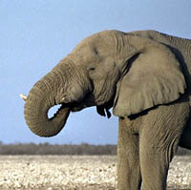

Proverb A
Setting a mousetrap to catch an elephant is a waste of time.

Slide 3
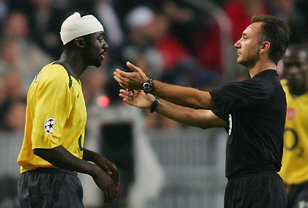
Proverb B
The one who refused advice came to be found with a wounded head.

Slide 4
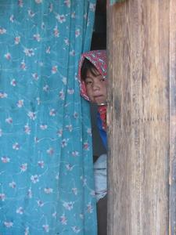
Proverb C
A child who does not cry will die in the sling-cradle.

Slide 5
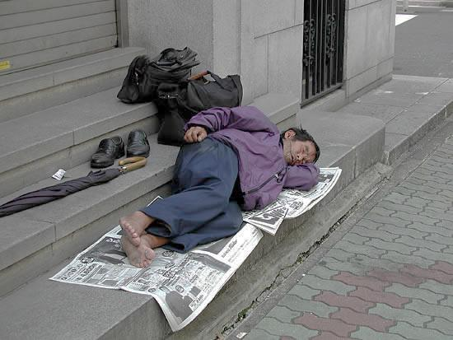
Proverb D
To sleep on a worn-out mat is better than sleeping on the bare ground.

Slide 6
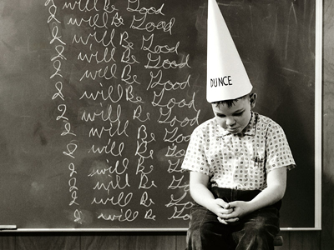
Proverb E
If an idiot is a member of your own family, you should applaud his dancing.

Slide 7
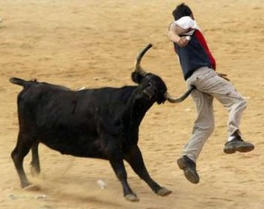
Proverb F
Horns cannot be concealed by wrappings.

Slide 8

Proverb G
The axe forgets, not the tree.

