Slide 1
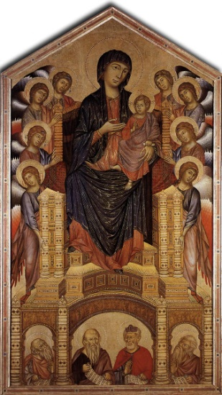
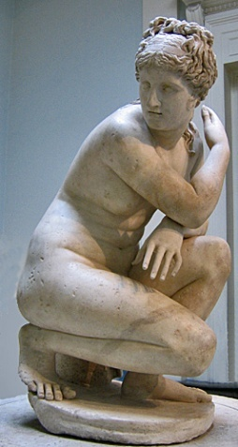
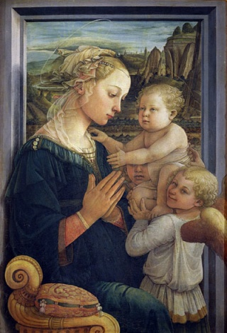
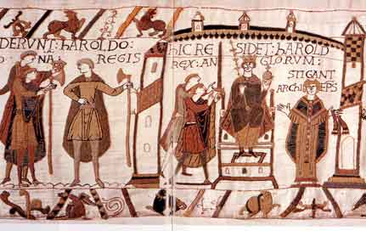
Analyzing art by historical period
Classical, Medieval, or Renaissance?

Slide 2
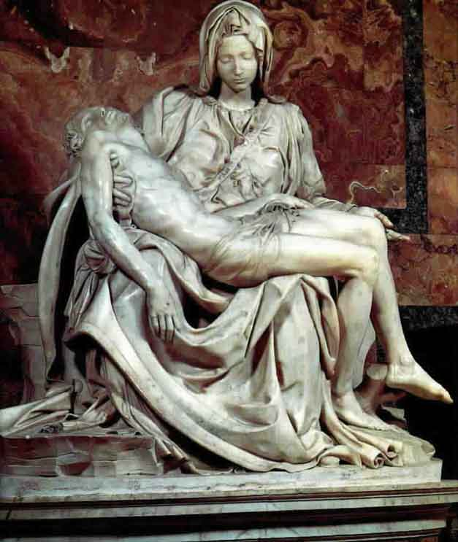
Analyzing art by historical period: Prior Knowledge
List as many characteristics as you can of the three historical periods of art
You may use bullet point notes for this
Do not share ideas with anyone else in your group
Be prepared to share your ideas

Slide 3
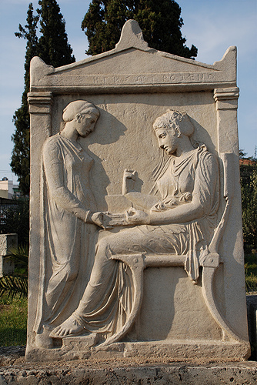
Analyzing art by historical period: Characteristics
Read over the characteristics of art in each historical period
Annotate for all three periods of art
Circle any vocabulary words you don’t know

Slide 4

Analyzing art by historical period: make a choice
Carefully examine each art piece on the screen
Review with your partner the information on your characteristics sheet to determine in which historical period the work was created
Circle the answer on your sheet, and write 2-3 bullet point reasons why you chose this period

Slide 5

Madonna and Child With Angels

Slide 6
Madonna and Child With Angels
Fra. Fillippo Lippi
1437
Renaissance

Slide 7

Bathing Venus

Slide 8
Bathing Venus
Praxiteles
4th Century B.C.
Classical

Slide 9
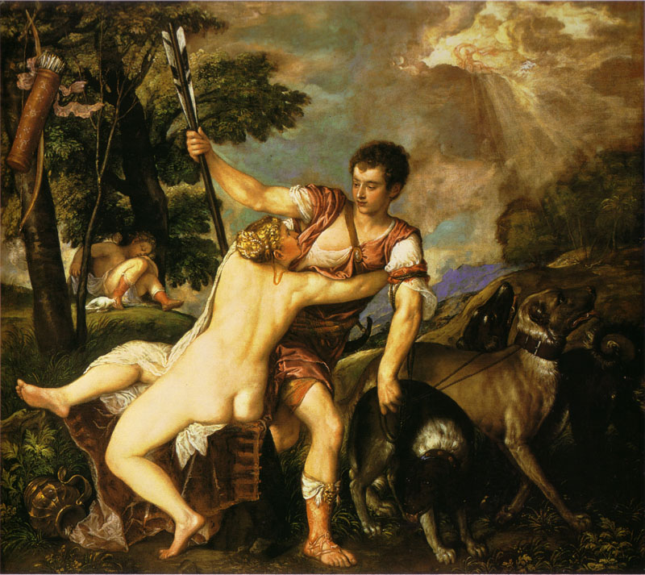
Venus and Adonis

Slide 10
Venus and Adonis
Titian
1553-1554
Renaissance

Slide 11
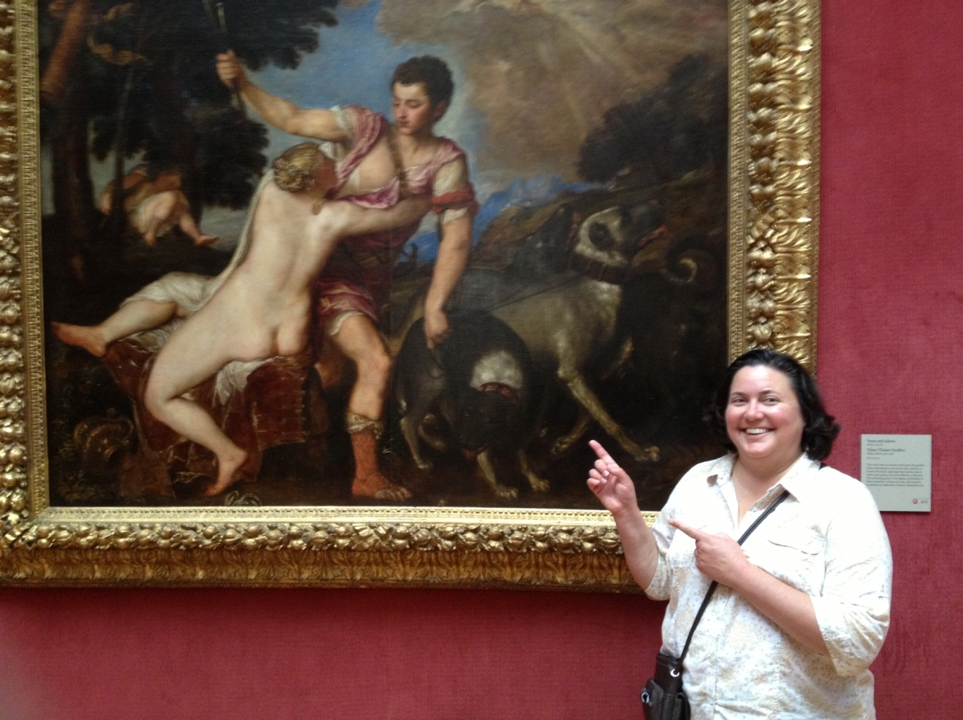
Venus and Adonis
AKA Crack Kills

Slide 12

Madonna and Child in Majesty

Slide 13
Madonna and Child in Majesty
Cimabue
1150-1200
Medieval

Slide 14
Grave Stele of Hegeso

Slide 15
Grave Stele of Hegeso
Unknown
End of 5th Century
B.C.
Classical

Slide 16
Bayeaux Tapestry

Slide 17
Bayeaux Tapestry
Unknown
1070
Medieval

Slide 18
Pieta

Slide 19
Pieta
Michelangelo
1499
Renaissance

Slide 20
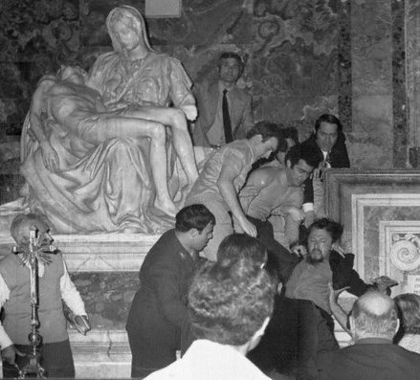

Slide 21
Are you an art scholar now?
Let’s see if you can classify the following works of art:

Slide 22
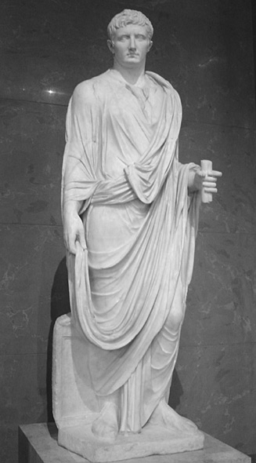
A. Classical, Medieval, or Renaissance?
Give two
reasons
for choosing
this era

Slide 23
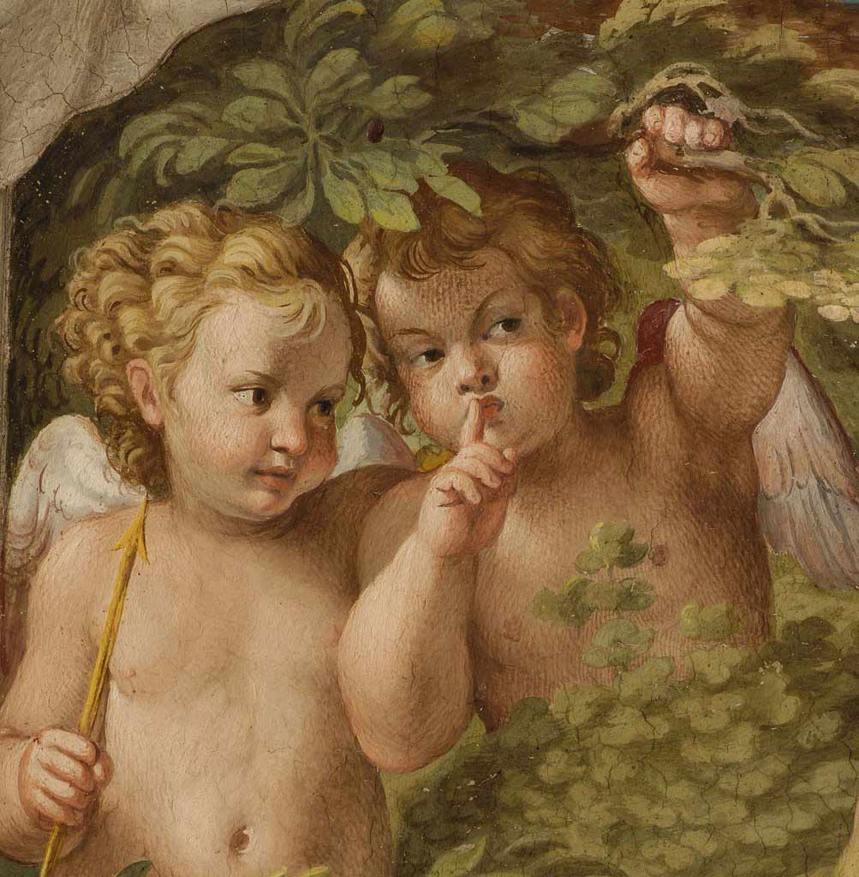
B. Classical, Medieval, or Renaissance?
Give two
reasons
for choosing
this era

Slide 24
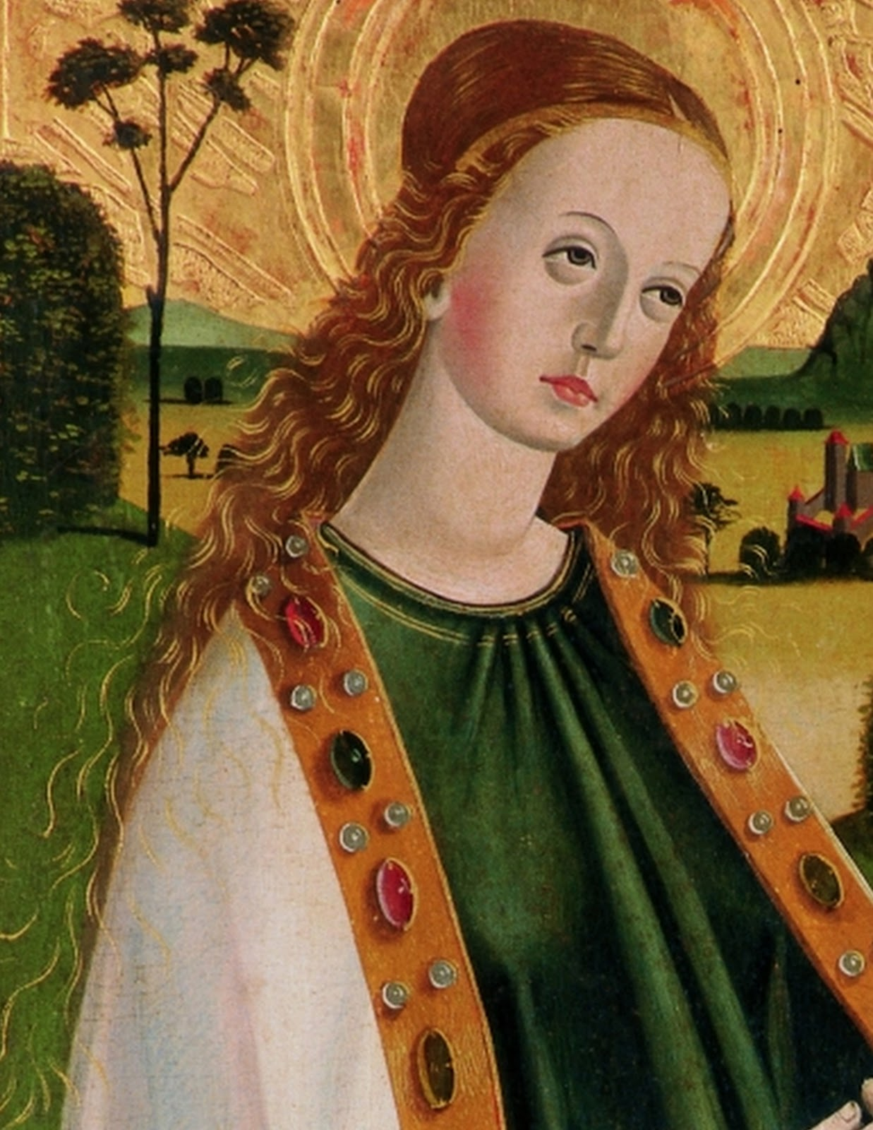
C. Classical, Medieval, or Renaissance?
Give two
reasons
for choosing
this era

Slide 25
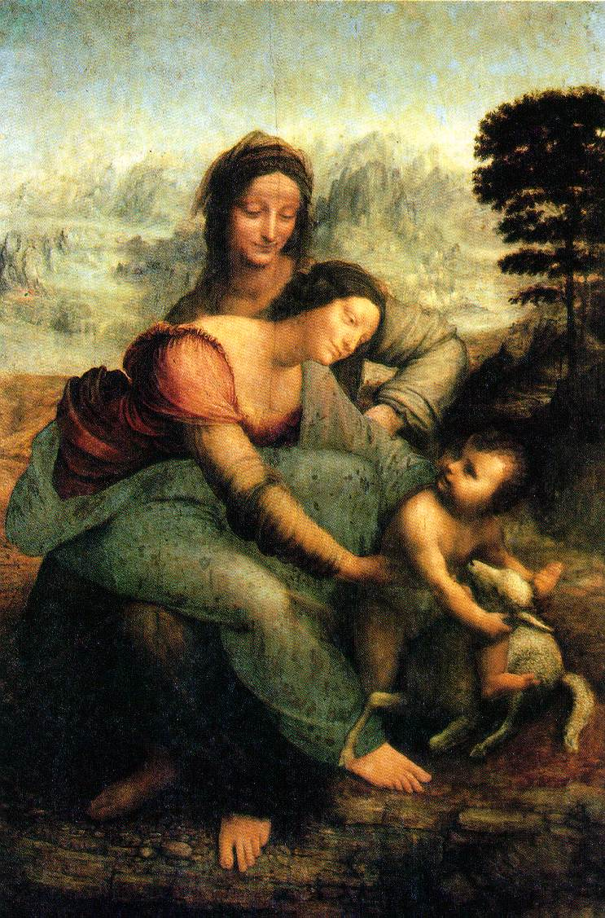
D. Classical, Medieval, or Renaissance?
Give two
reasons
for choosing
this era

Slide 26
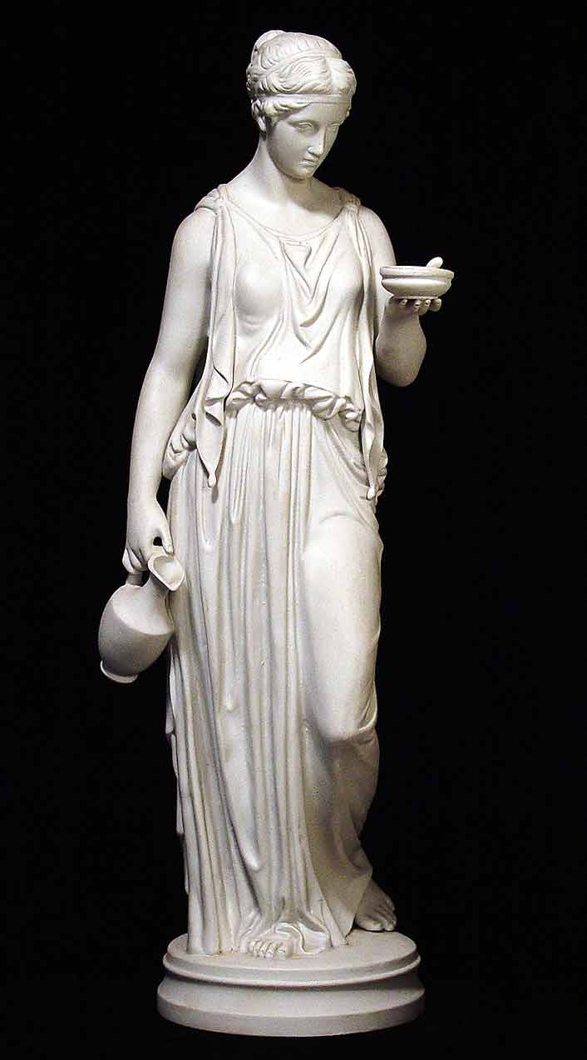
E. Classical, Medieval, or Renaissance?
Give two
reasons
for choosing
this era

Slide 27
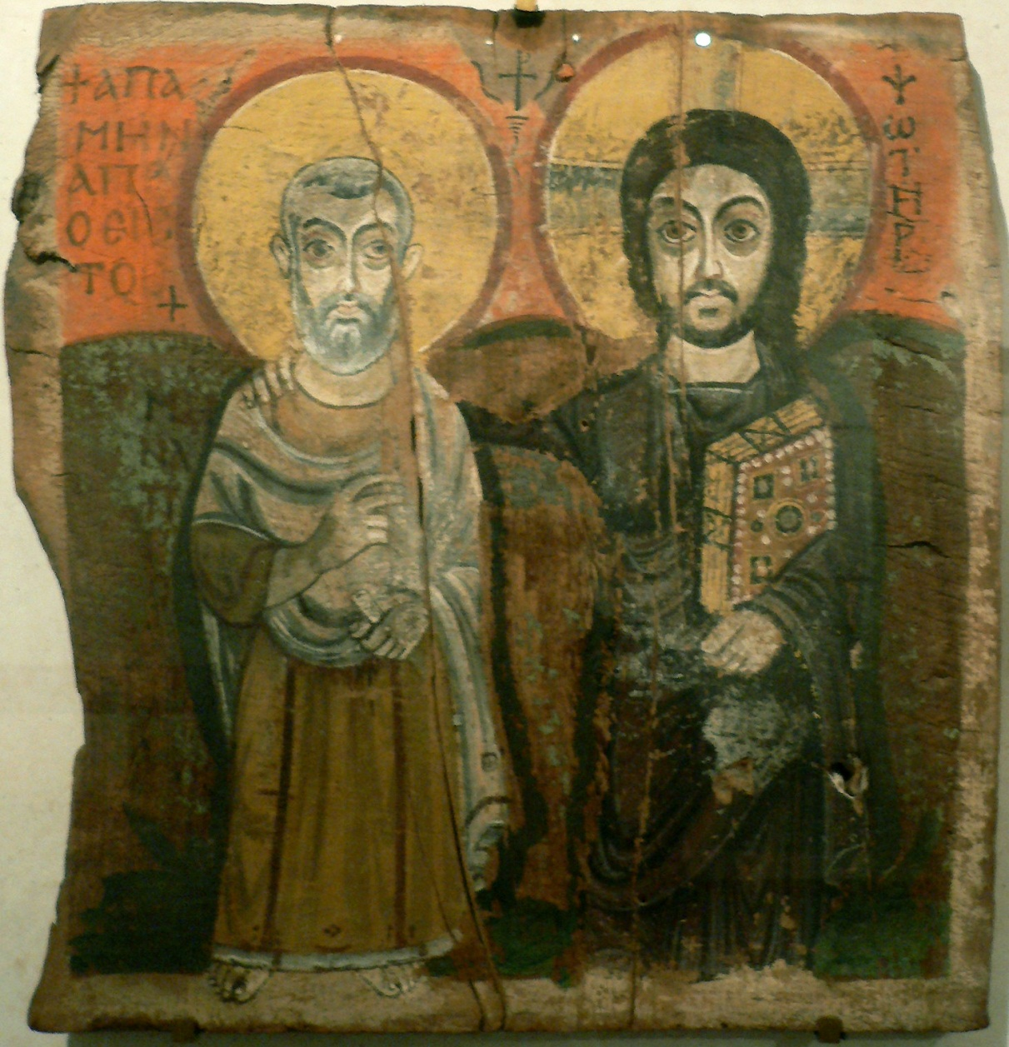
F. Classical, Medieval, or Renaissance?
Give two
reasons
for choosing
this era

