Slide 1
Mongol Invasion Scrolls
Visual Discovery

Slide 2
Background Information
The Mongol rulers of China attacked Japan in 1274 and 1281. The Japanese warrior Takezaki Suenaga, who participated in both invasions, commissioned scrolls detailing the battles. The scrolls were lost for centuries. Some 450 years after the battles, they were discovered--in pieces. After the scrolls were reconstructed, some scenes were out of order, some of the images were missing, and new ones had been added. The images you see on the following slides are from the original scrolls.

Slide 3
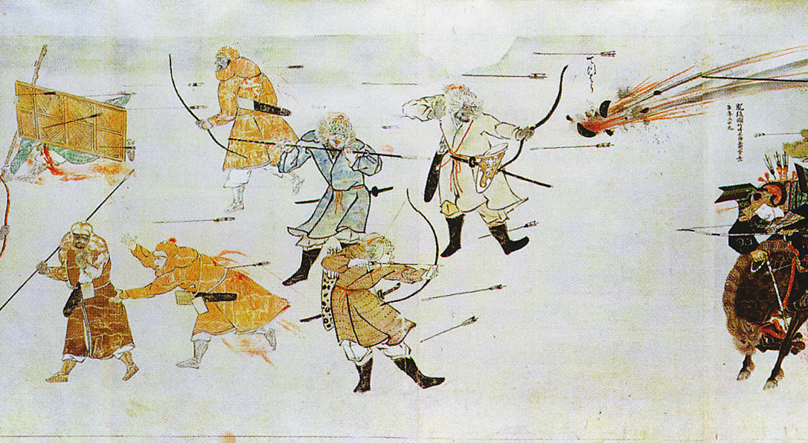
Evidence: What do you see?
Thoughts: Do you have questions about the evidence?
Hypothesis/conclusion: What is going on in this image?
Mongol Scroll #1

Slide 4
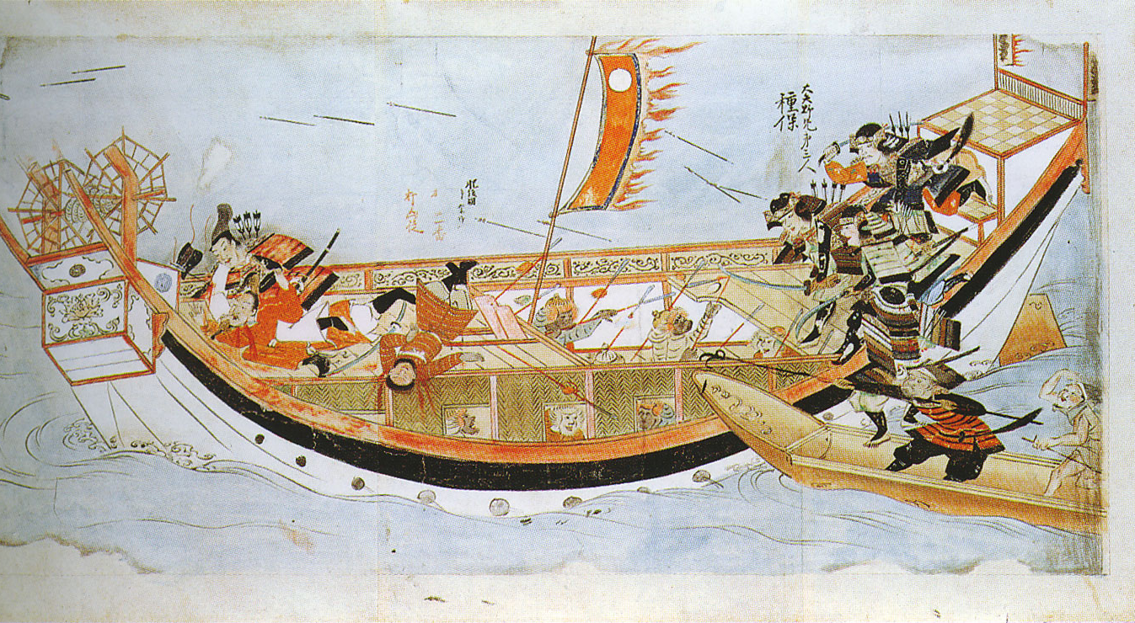
Evidence: What do you see?
Thoughts: Do you have questions about the evidence?
Hypothesis/conclusion: What is going on in this image?
Mongol Scroll #2

Slide 5
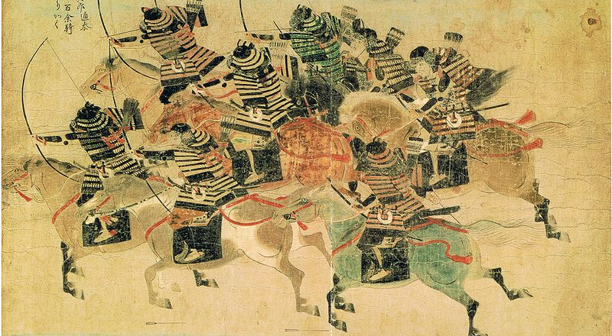
Evidence: What do you see?
Thoughts: Do you have questions about the evidence?
Hypothesis/conclusion: What is going on in this image?
Mongol Scroll #3

Slide 6
Summary Activity
Why do you think Suenaga would commission scrolls depicting the scenes of battle?
How might a scroll created by the Mongols look different?

