Slide 1
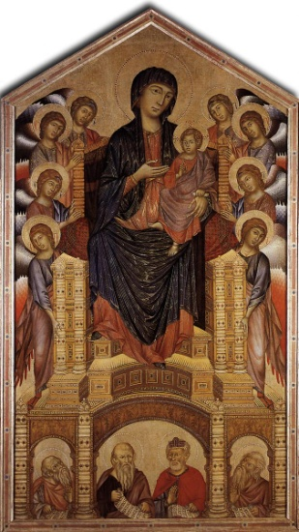
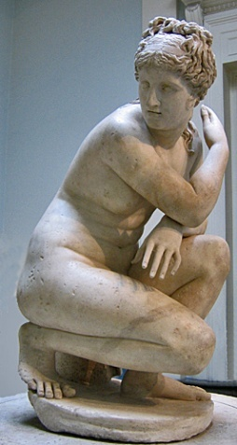
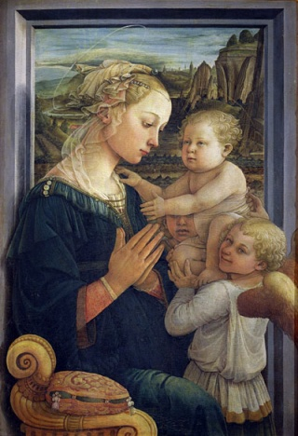
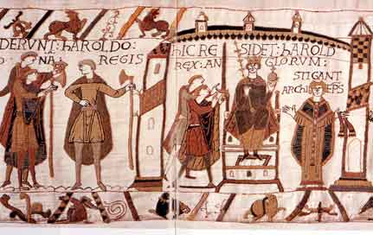
Analyzing art by historical period
Classical, Medieval, or Renaissance?

Slide 2
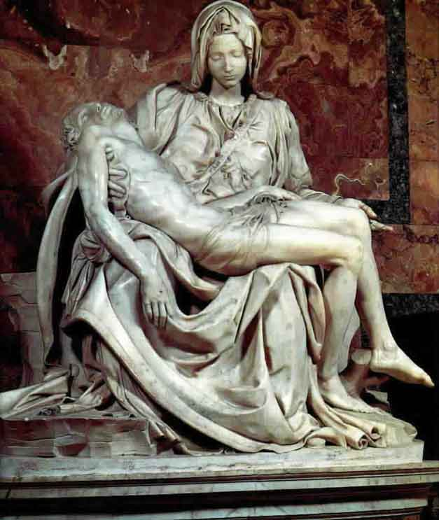
Analyzing art by historical period: Prior Knowledge
List as many characteristics as you can of the three historical periods of art
You may use bullet point notes for this
Do not share ideas with anyone else in your group
Be prepared to share your ideas

Slide 3
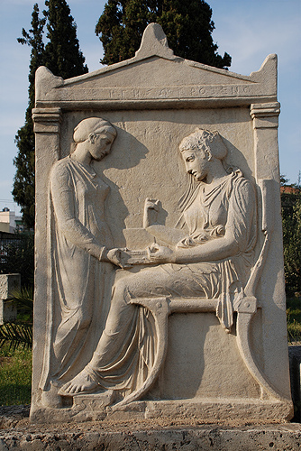
Analyzing art by historical period: Characteristics
Read over the characteristics of art in each historical period
Annotate for all three periods of art
Circle any vocabulary words you don’t know

Slide 4

Analyzing art by historical period: make a choice
Carefully examine each art piece on the screen
Review with your partner the information on your characteristics sheet to determine in which historical period the work was created
Circle the answer on your sheet, and write 2-3 bullet point reasons why you chose this period

Slide 5

Madonna and Child With Angels

Slide 6

Bathing Venus

Slide 7
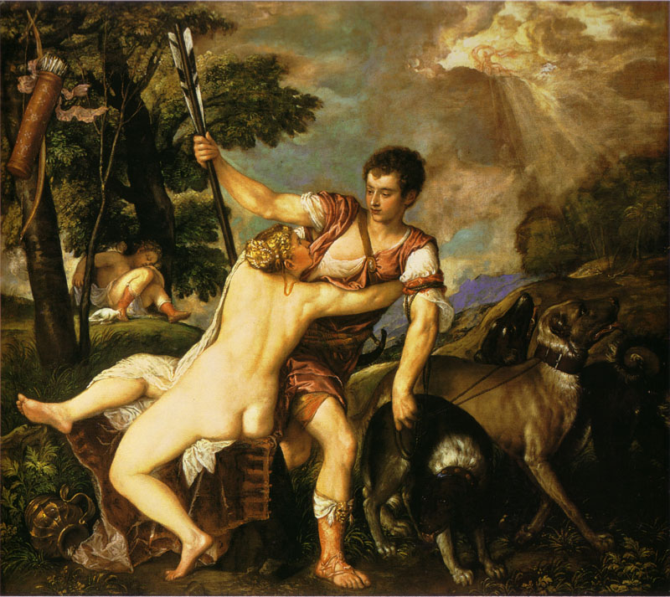
Venus and Adonis

Slide 8
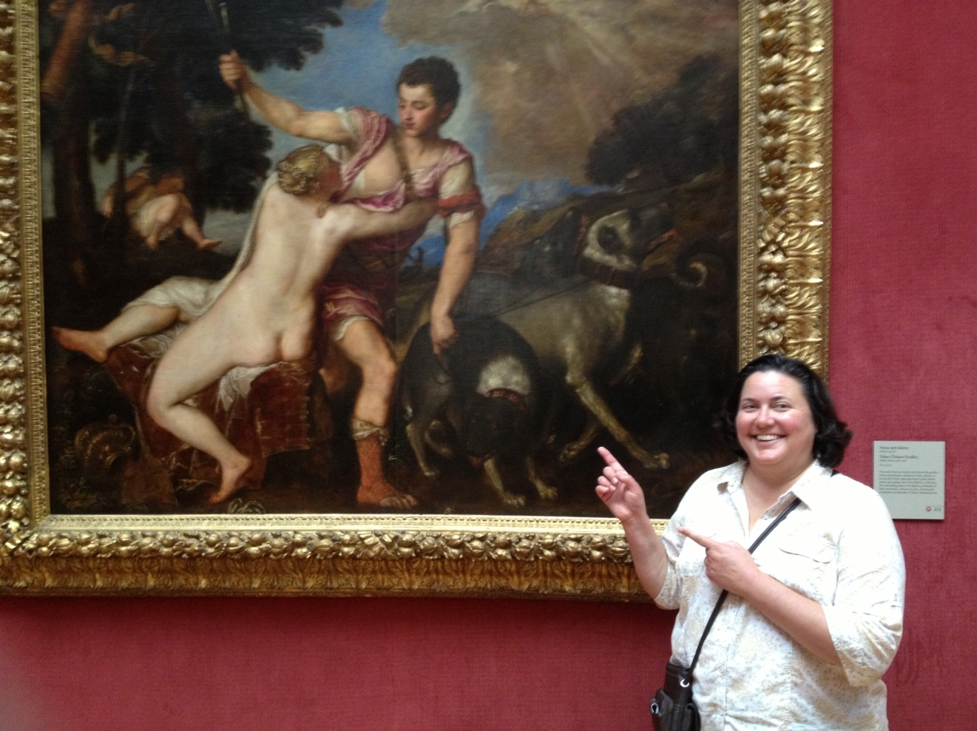
Venus and Adonis
AKA Crack Kills

Slide 9

Madonna and Child in Majesty

Slide 10
Grave Stele of Hegeso

Slide 11
Bayeaux Tapestry

Slide 12
Pieta

Slide 13
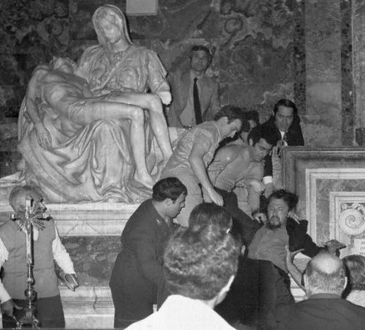

Slide 14
Are you an art scholar now? Let’s see if you can classify the following works of art:

Slide 15
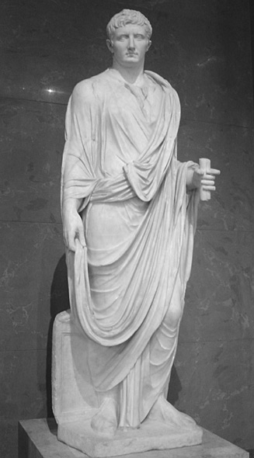
A. Classical, Medieval, or Renaissance?
Give two
reasons
for choosing
this era

Slide 16
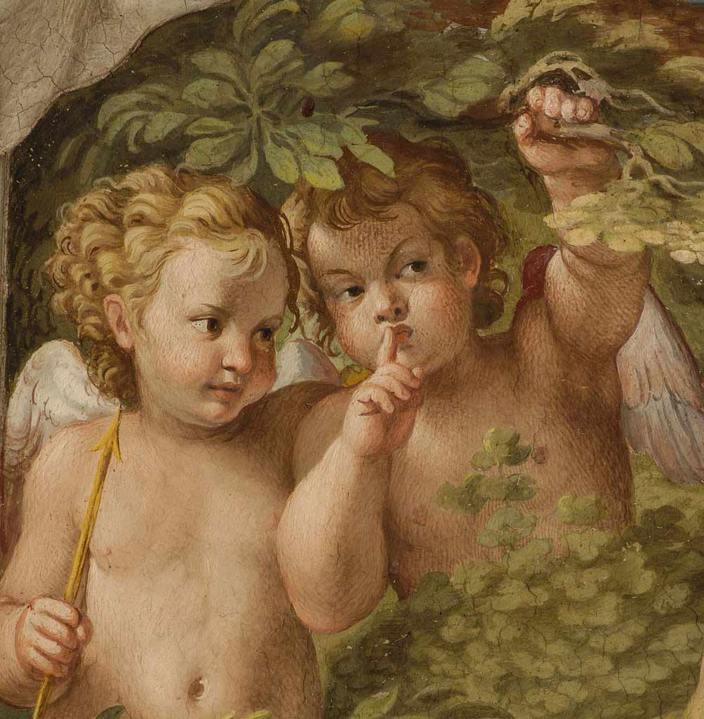
B. Classical, Medieval, or Renaissance?
Give two
reasons
for choosing
this era

Slide 17
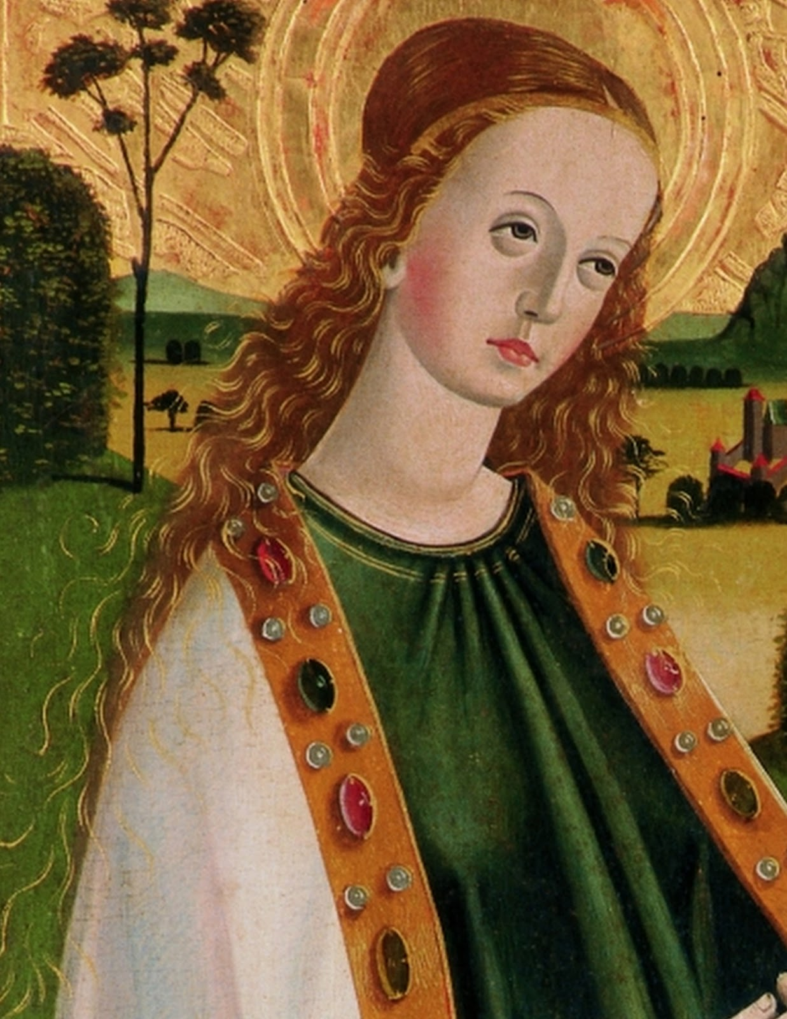
C. Classical, Medieval, or Renaissance?
Give two
reasons
for choosing
this era

Slide 18
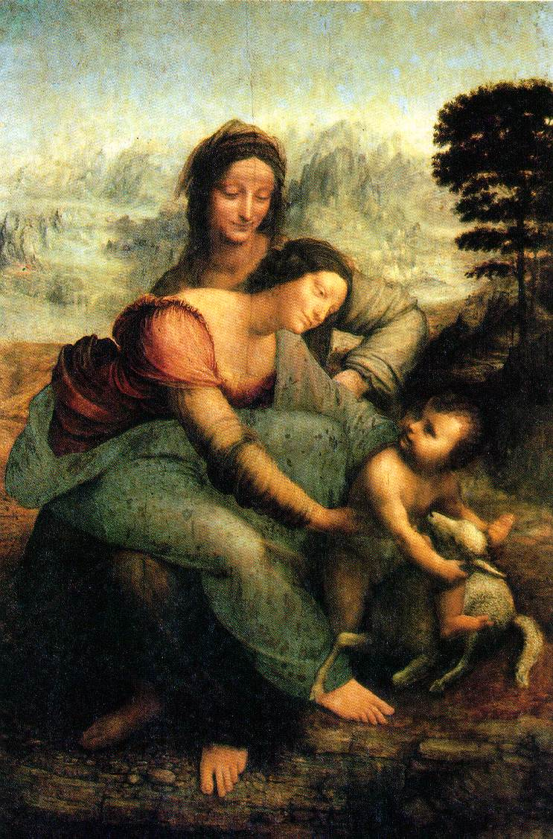
D. Classical, Medieval, or Renaissance?
Give two
reasons
for choosing
this era

Slide 19
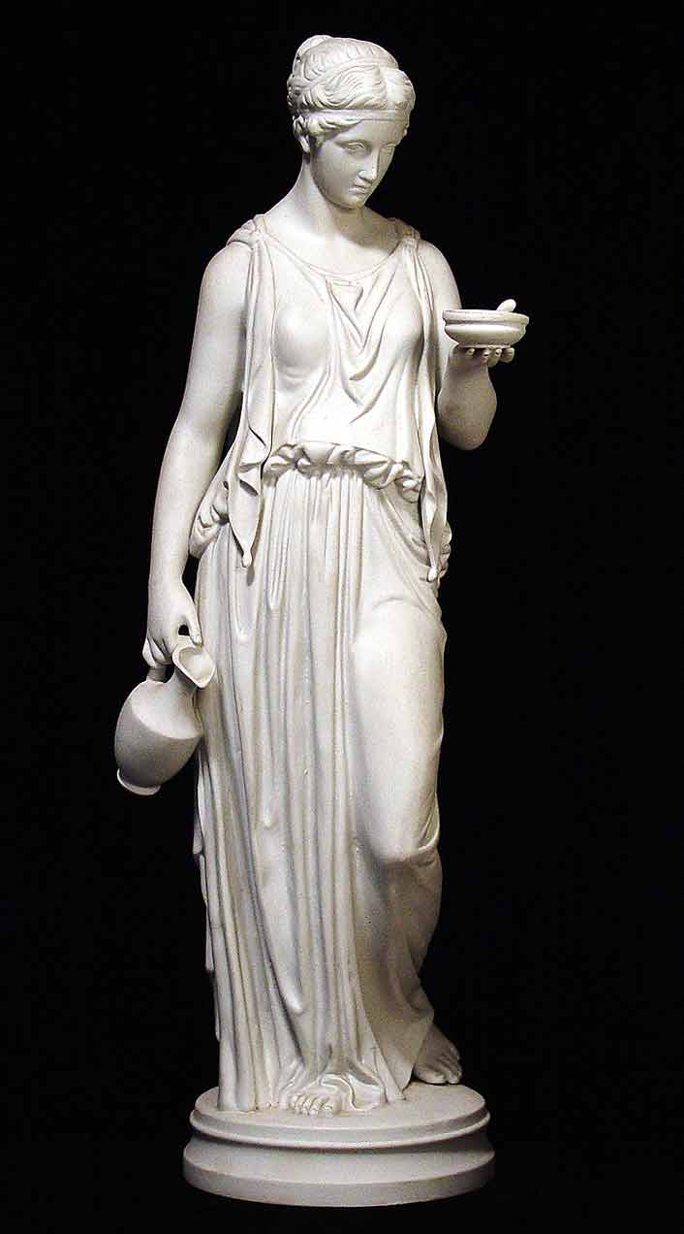
E. Classical, Medieval, or Renaissance?
Give two
reasons
for choosing
this era

Slide 20
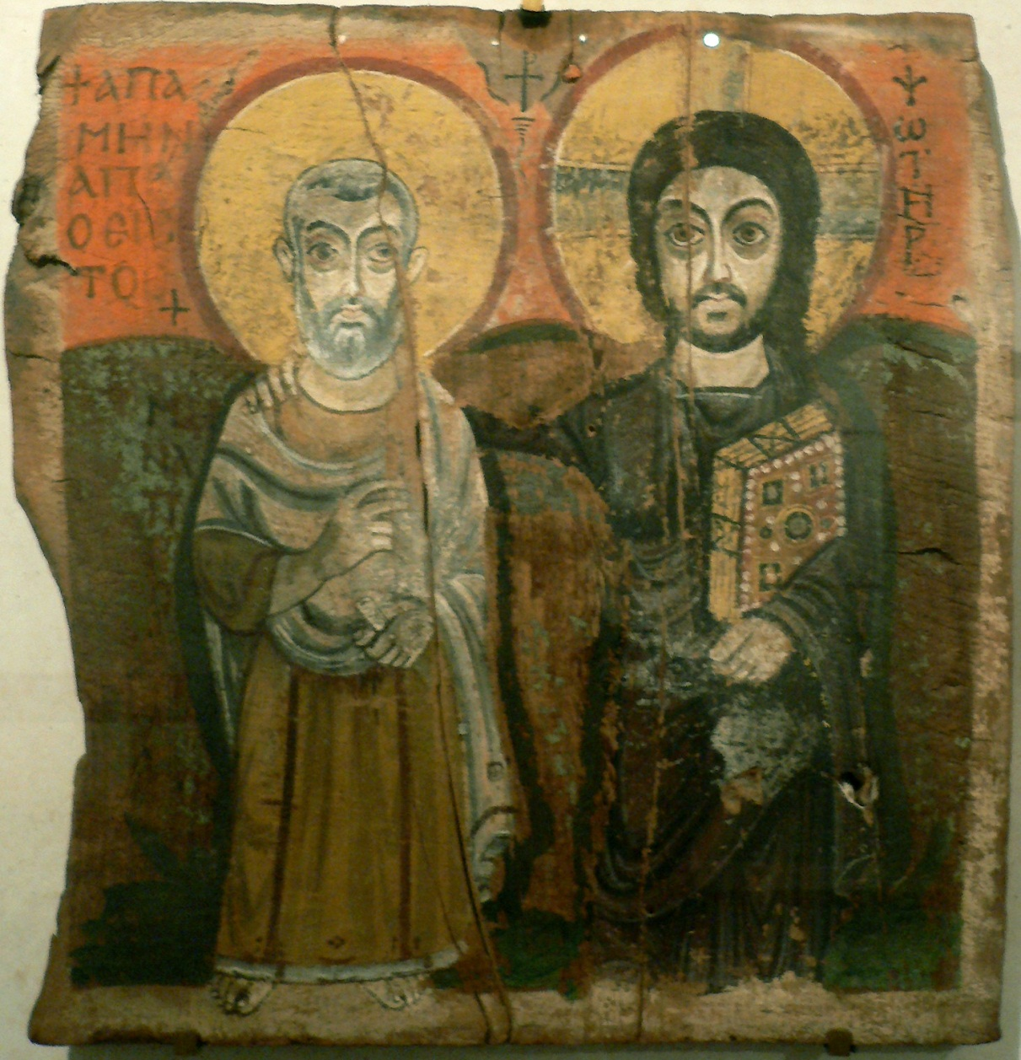
F. Classical, Medieval, or Renaissance?
Give two
reasons
for choosing
this era

