Slide 1
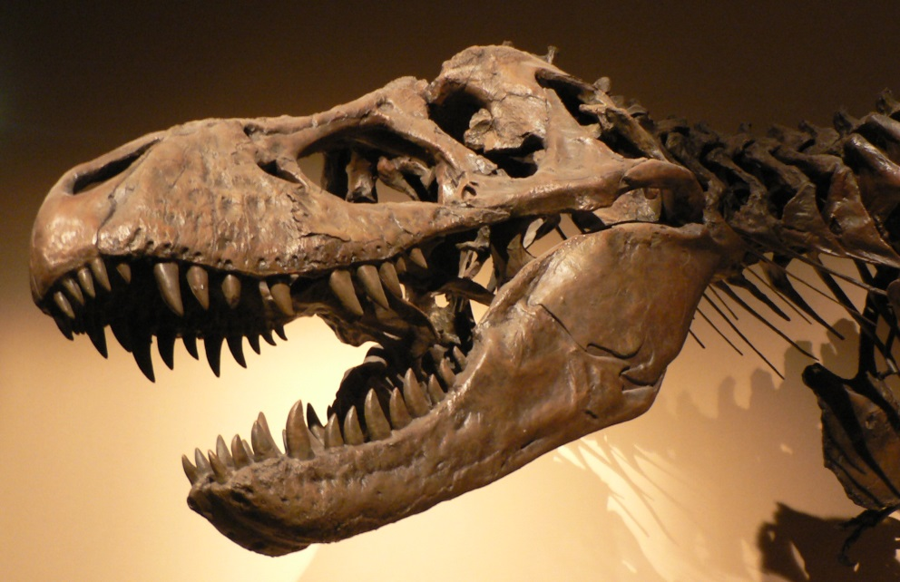
Clues from the Past
Chapter 1, section 1

Slide 2
Topic Question
How do historians use sources to develop credible explanations and interpretations of historical events?

Slide 3
Big Idea
Historians and archaeologists study fossils, artifacts and written records to learn about the past.

Slide 4

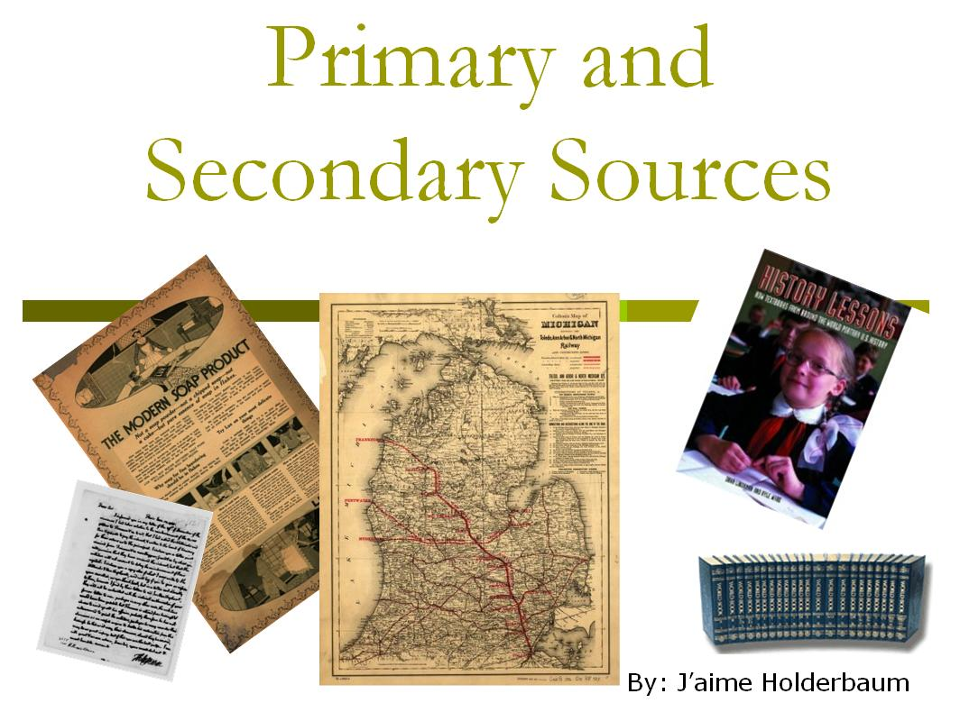
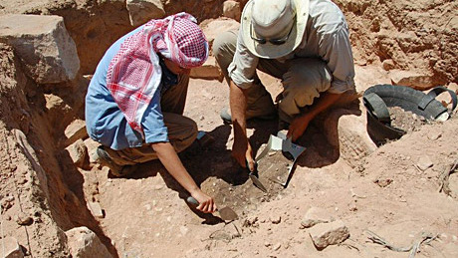
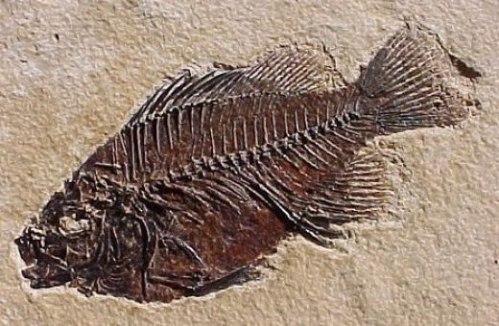
Vocabulary
History
Primary Source
Secondary Source
Archaeology
Fossil
Artifacts

Slide 5
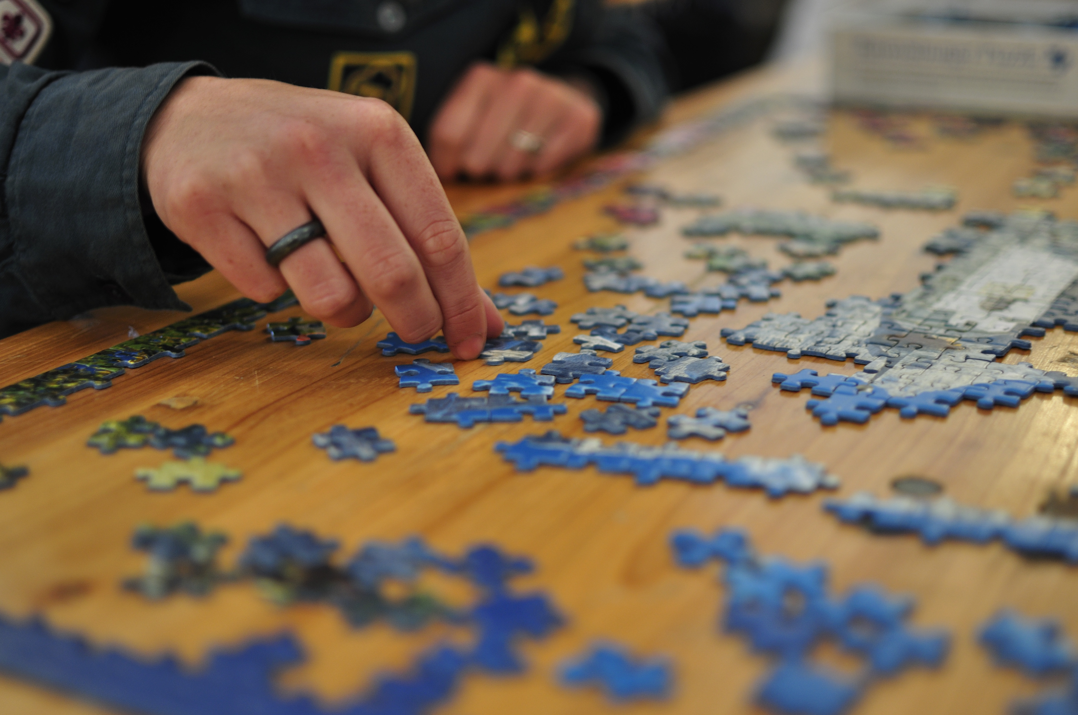
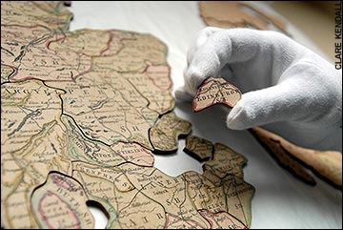
Looking for Clues
How is history like a jigsaw puzzle?

Slide 6
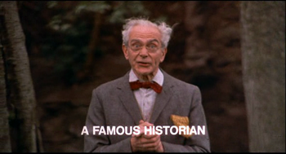
What Historians Do
Why do historians study the past?
What specifics about the past do they want to know?
How do historians find out about the past?

Slide 7
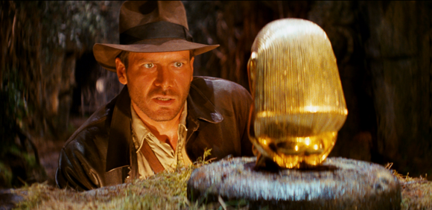
What Archaeologists Do
How do archaeologists help historians?
How do archaeologists find out about the past?

Slide 8
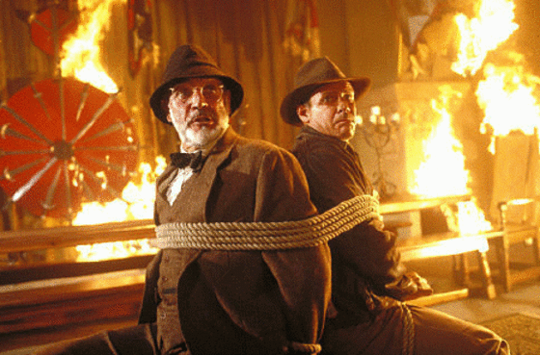
Other Sources of Clues
How do historians and archaeologists work together?

Slide 9
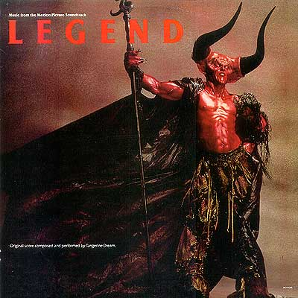
Legends
How do legends lead to clues about history?
Discuss a common legend about:
The United States
California
Fresno

Slide 10
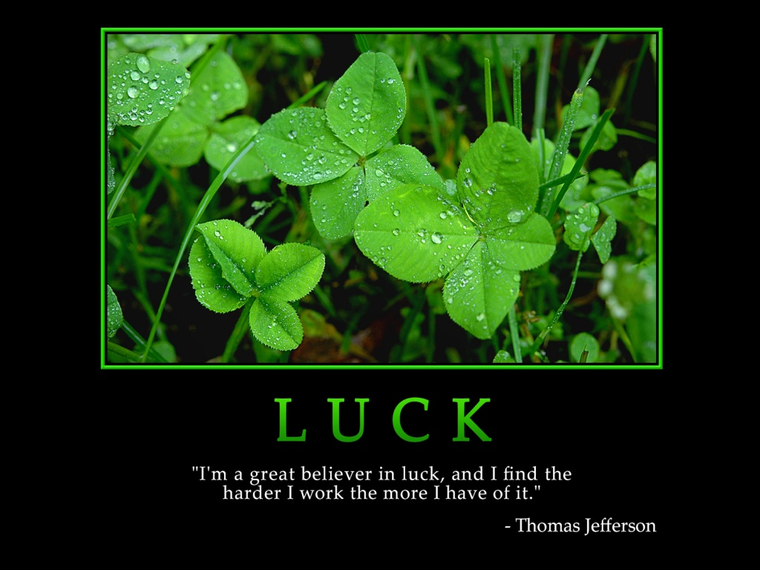
Luck
How does luck contribute to the study of history?

Slide 11
Reflection
Refer back to the topic question and write a 7 sentence response using the section.

Slide 12
Reflection Example
In chapter 1, section 1, “Clues from the Past,” historians use sources to develop credible explanations and interpretations of historical events. Through analyzing fossils, artifacts, primary and secondary source documents, legends and lucky finds help scholars with discoveries. Primary and secondary sources are the most credible for learning about history. Talking to a person who witnessed an event makes filling in the gaps of history much easier. If a witness is not available, interviews and research are the next step for finding answers. But sometimes legends and luck are more fun because they can spur ideas and discoveries. As you can see, historians and archaeologists use a variety of methods for interpreting historical events.

