Slide 1
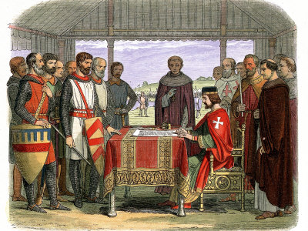
Political and Social Change
Chapter 10, section 4

Slide 2
Topic Question
Describe how Europe’s political and social systems underwent great changes during the Middle Ages.

Slide 3
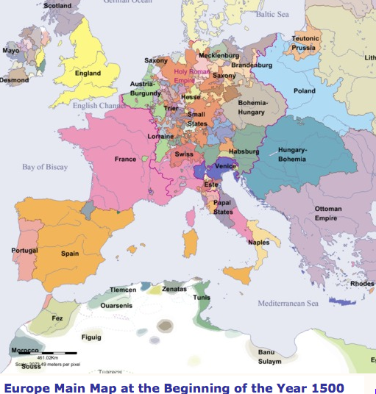
The Big Idea
Europe’s political and social systems underwent great changes in the late Middle Ages.

Slide 4
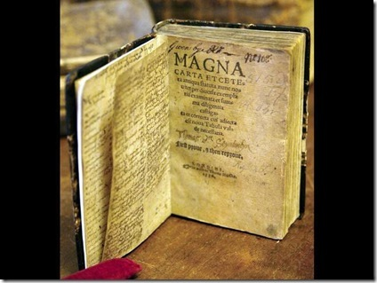
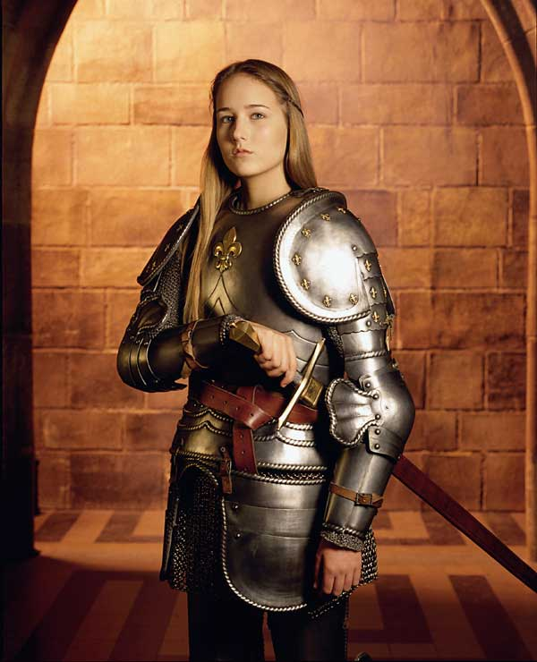
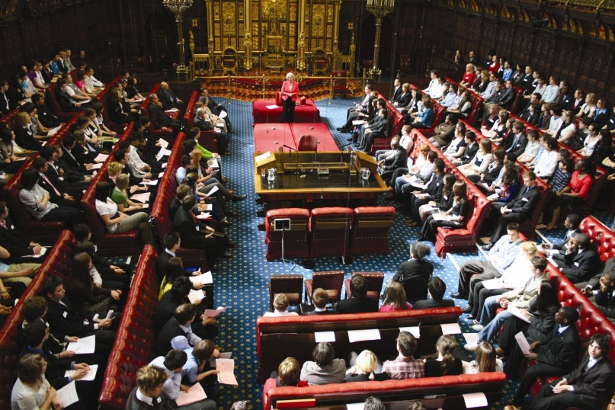
Vocabulary
Magna Carta
  P. 277 Primary Source
Parliament
  P. 278 Time Line
Hundred Years’ War
Joan of Arc
Black Death

Slide 5
Magna Carta causes changes in England
In 1215 …
Who wanted their rights respected?
Who was king?
What was he forced to do?
What does Magna Carta mean in Latin?

Slide 6

The effects of the Magna Carta
The Magna Carta required the king to honor certain rights.
Habeas Corpus
  Discuss habeas corpus
Who had to obey the law?

Slide 7
Changes after Magna Carta
What did the Magna Carta do to the power of kings?
What was created to help the king?
The English wanted to secure and protect their rights.
List the rights which were the most important.

Slide 8
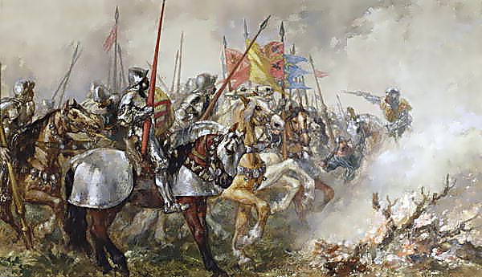
The Hundred Years’ War
What countries were affected by the Magna Carta?
What happened?

Slide 9
The course of the War
In 1328 the king of ____________ died with no sons.
Who claimed the throne?
How did the losing king feel about the outcome?
What happened?
Who rose up to help the French troops?
What was the year of the end of the war?
Who won the war?

Slide 10
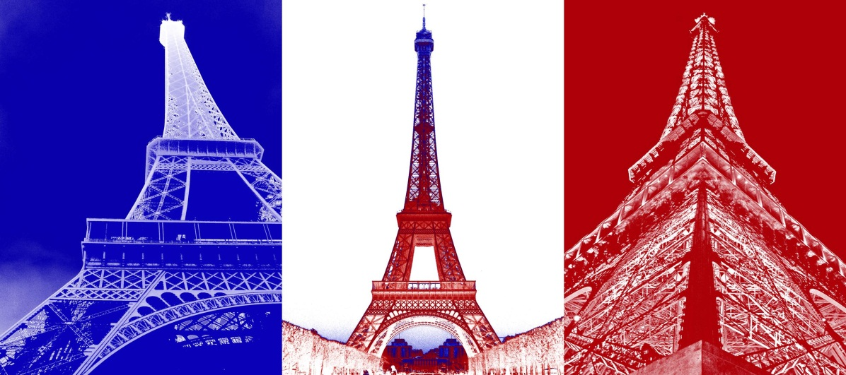

Results of the War
The Hundred Years’ War changed the governments of what 2 countries?
How did the power in England change and grow?
How did the power in France change and grow?

Slide 11

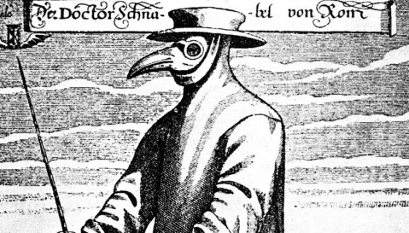
The Black Death
During the Hundred Years’ War, an even greater crisis began to “infect” Europe.
Where did the plague come from?
How did it get to Europe?
Discuss the forms of the plague
How many people did Europe lose?
Discuss why the manor system failed

Slide 12
Reflection
Refer back to the Topic Question.
Based on discussion write a 7 sentence paragraph answering the question.

