Slide 1
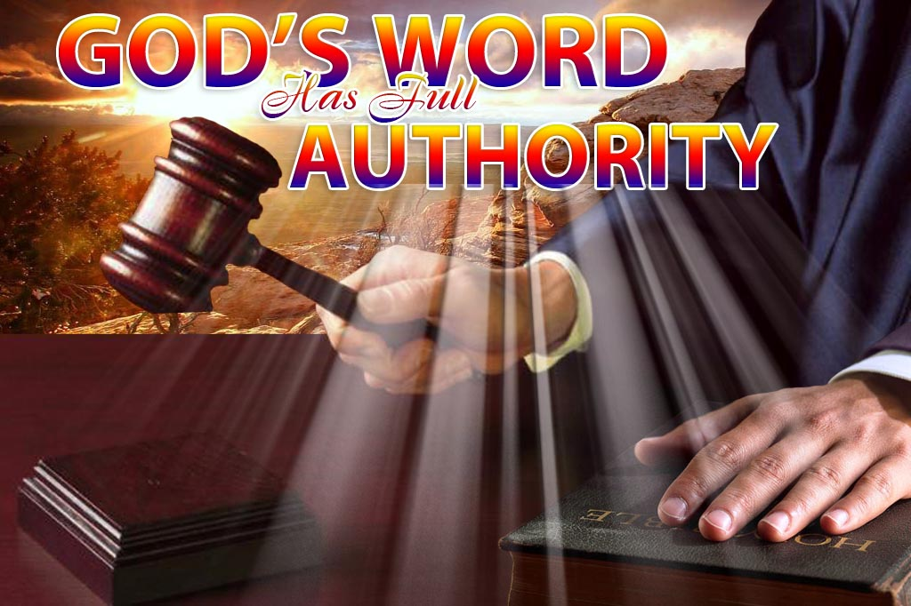
Challenges to Church Authority
Chapter 10, section 5

Slide 2
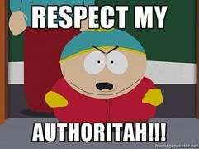
Topic Question
How did the Church deal with the challenges to their authority?

Slide 3
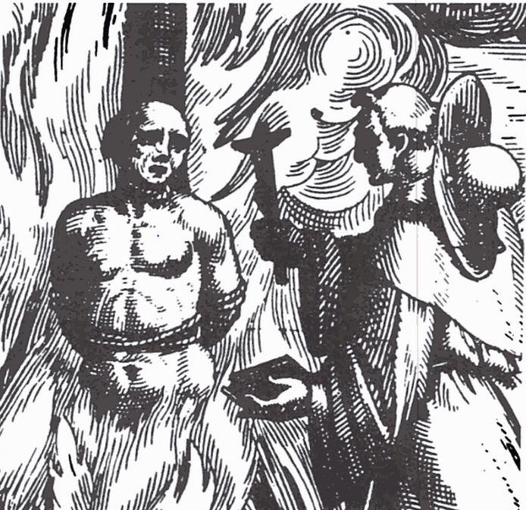
The Big Idea
In the Middle Ages, the Christian Church dealt harshly with people who did not respect its authority.

Slide 4
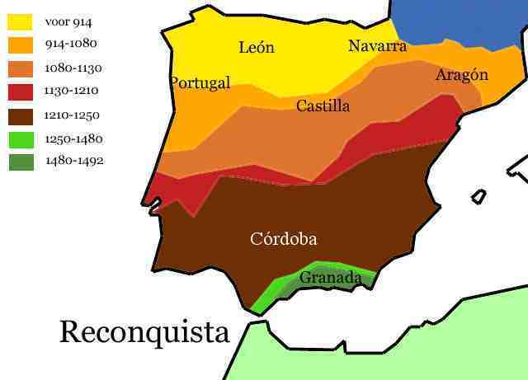

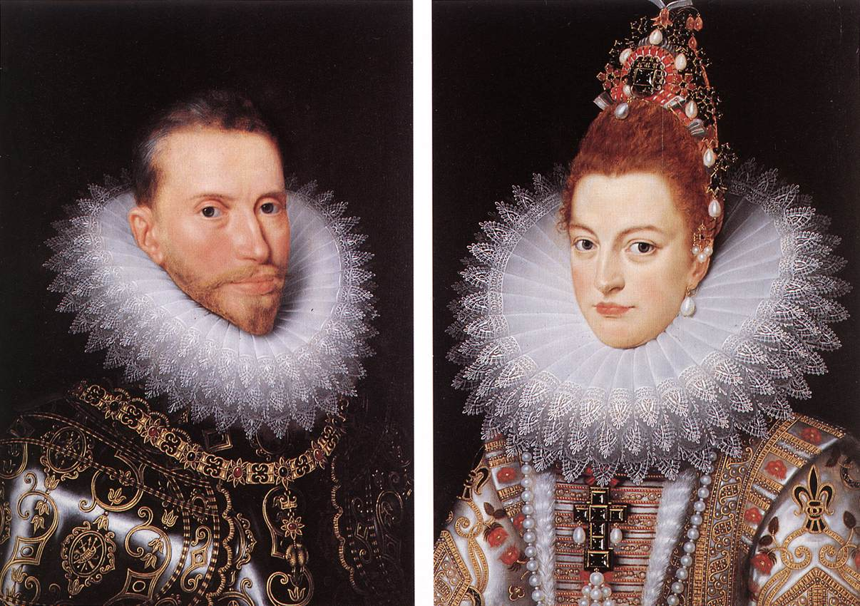
Vocabulary
Heresy
Reconquista
  P. 283 map
King Ferdinand
Queen Isabella
  P. 284 Bio
Spanish Inquisition
  P. 285 painting

Slide 5
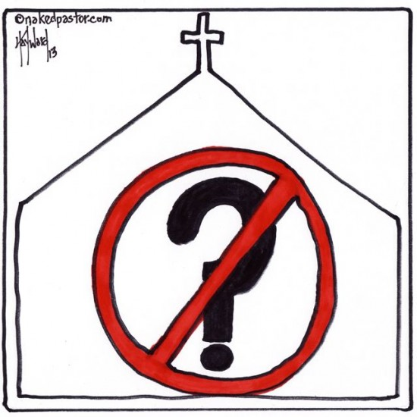
The Church reacts to Challengers
By 1100 some Christians began to question church teachings…
List the concerns
How did the church respond?
What happened?

Slide 6
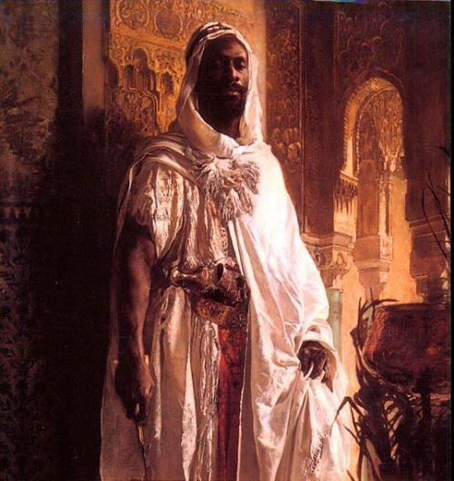
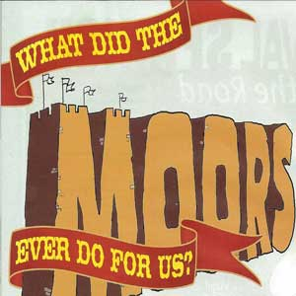
Christians fight the Moors
List the countries where Christians fought “church enemies”
What was their goal?

Slide 7
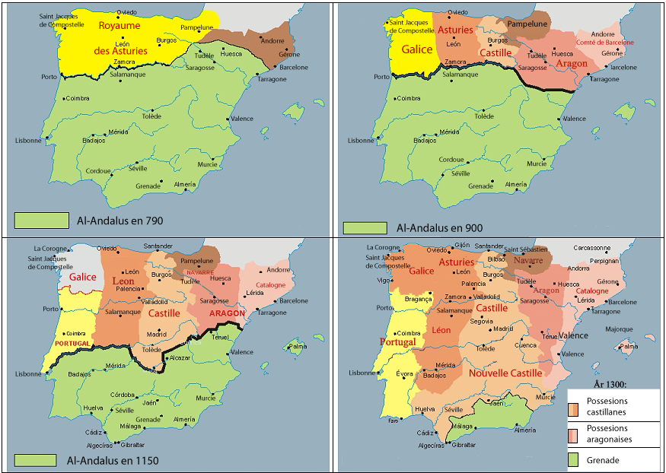

Weakening of Muslim control
By 900 the Muslims were losing control in what country?
What year did Muslim control end?
Why did it end?

Slide 8
Fight against the Moors
Who are the Moors?
In 1085, what kingdom won over the Moors?
Who joined as a result?
In what year were the Moors pushed out of Europe?
One territory remained in Muslim control, what is it?

Slide 9
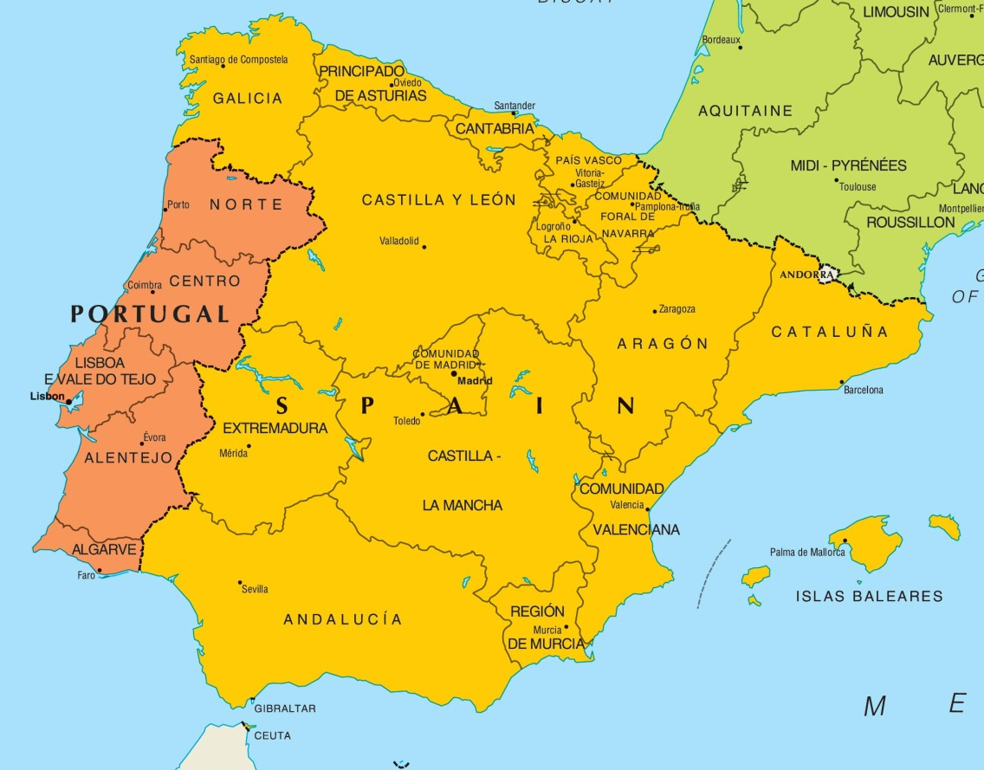
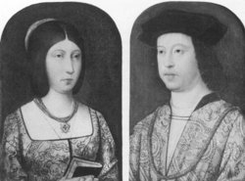
The Rise of Portugal and Spain
What was Portugal able to do?
Who was king and queen?
Why was this marriage significant?
List the victories of this pair

Slide 10
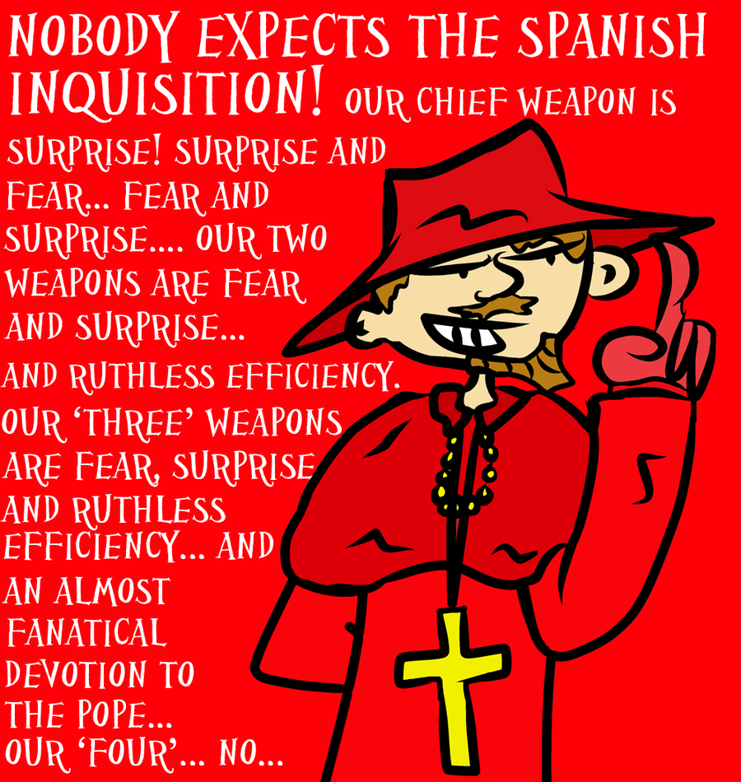
The Spanish Inquisition
Religion was a hot topic in Spain.
What was Spain’s official law on religions?
What was created to enforce the law?
Discuss how the new organization dealt with heretics.
http://www.youtube.com/watch?v=b_1je7r7RYE.

Slide 11
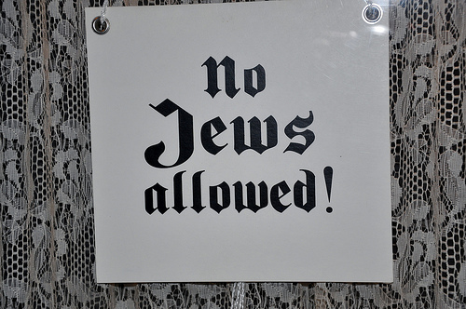
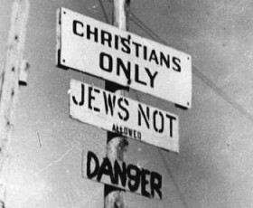
Jews face Discrimination
List the people who were persecuted for their beliefs.
Why were Jews targeted by Christians?
List what the Jews were forced to endure.

Slide 12
Reflection
Refer back to the Topic Question.
Based on discussion write a 7 sentence paragraph answering the question.

