Slide 1
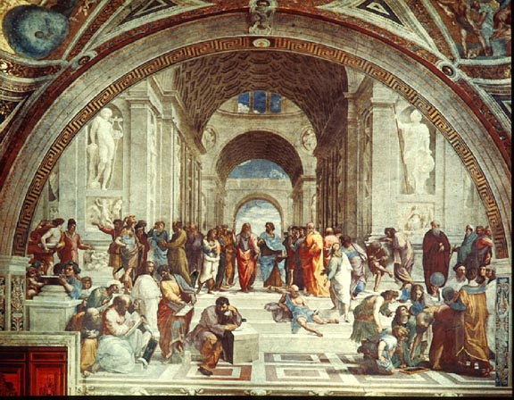
The Italian Renaissance
Chapter 11, section 2

Slide 2
Topic Question
Choose one person who had an impact on the Renaissance and discuss their contributions.

Slide 3
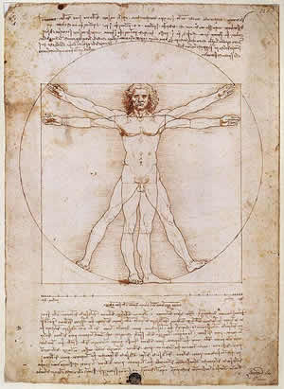
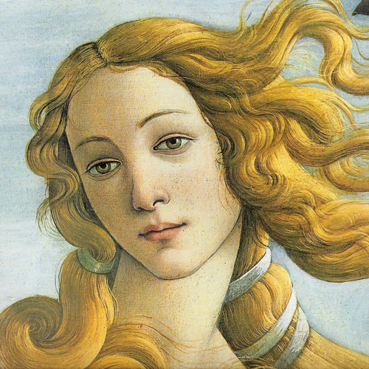
The Big Idea
New ways of thinking created a rebirth of the arts and learning in Italy.

Slide 4
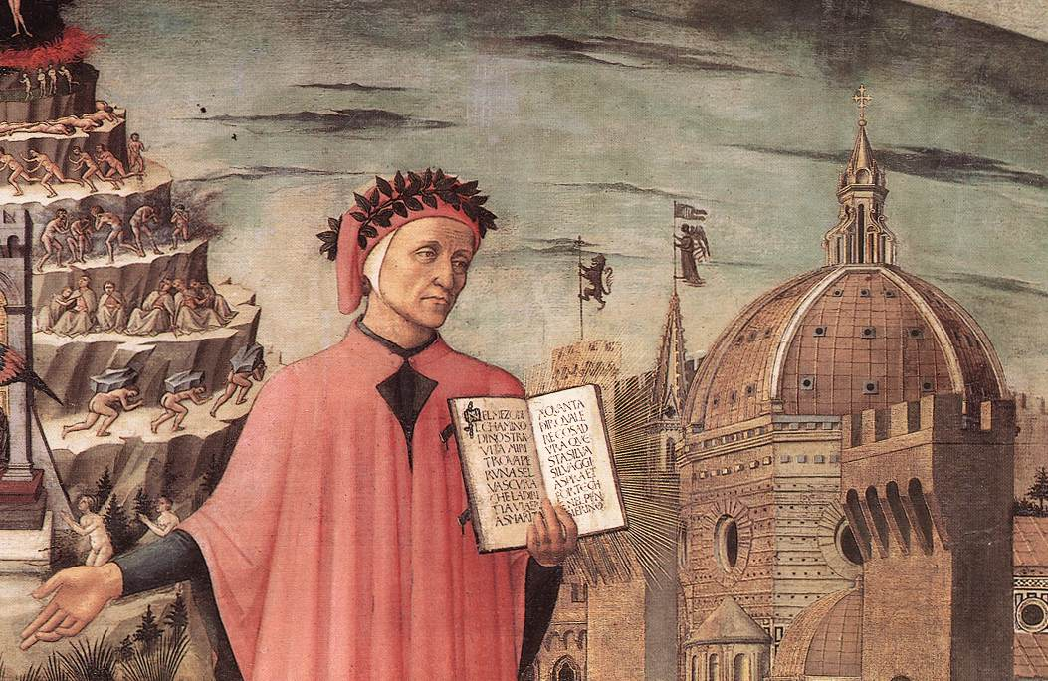
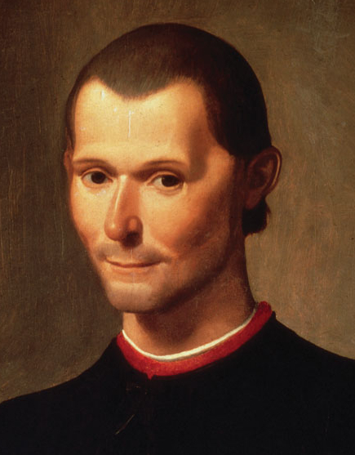
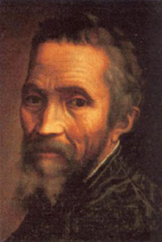
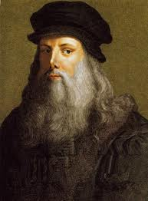
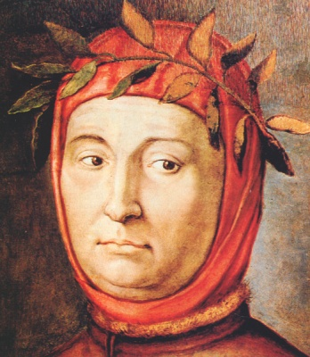
Vocabulary
Humanism
Dante Alighieri
Niccolo Machiavelli
P. 306 Primary Source
Perspective
P. 307 Renaissance art
Michelangelo
P. 311 Bio
Leonardo da Vinci
P. 308-309
Petrarch

Slide 5


New Ways to see the World
Until the Renaissance people devoted their lives to…
Now focus shifted to…
What is this study called?
Why?

Slide 6
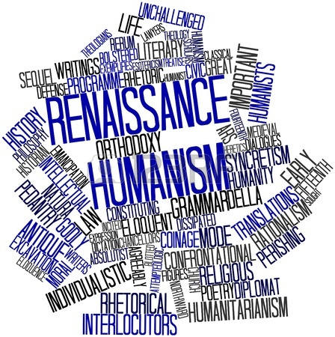
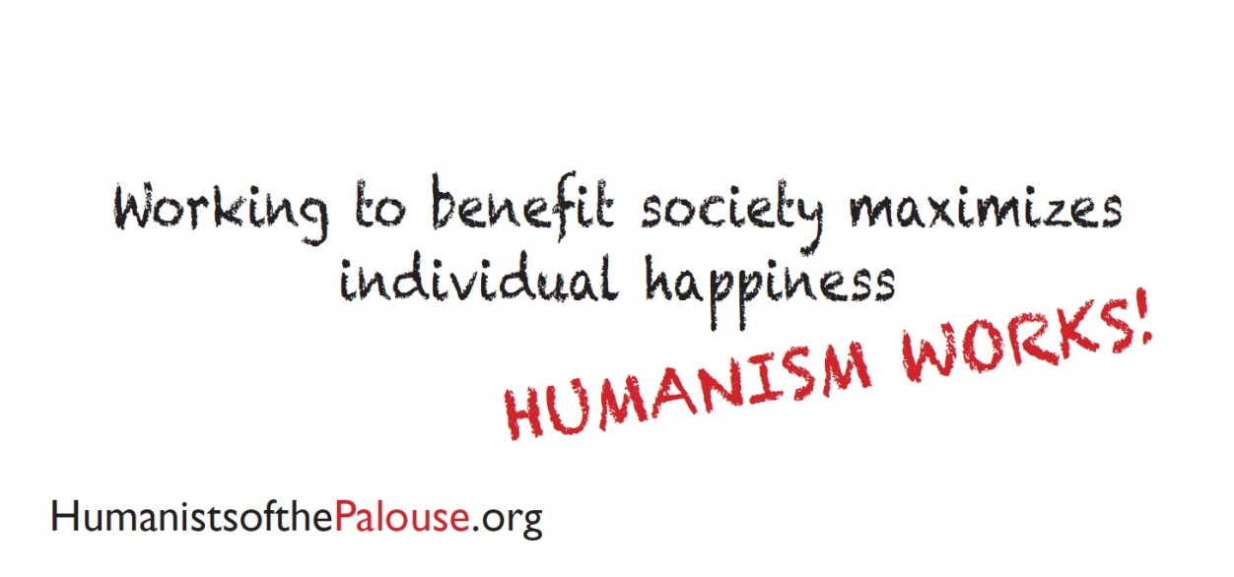
Humanism and Religion
What religion were humanists?
How does humanism differ from religion?

Slide 7
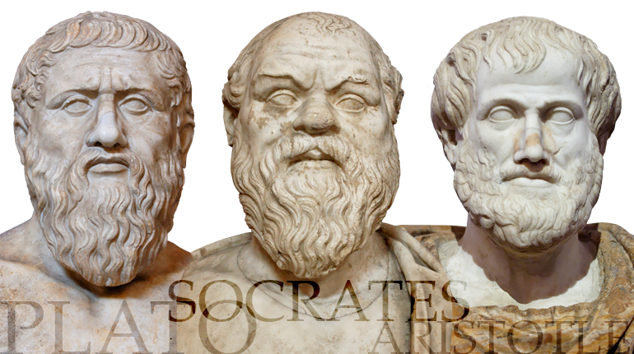
Rediscovering the Past
A new interest took hold of people…
How did the classics survive?
What specific subjects were revived?
What did Renaissance thinkers/artists do?

Slide 8
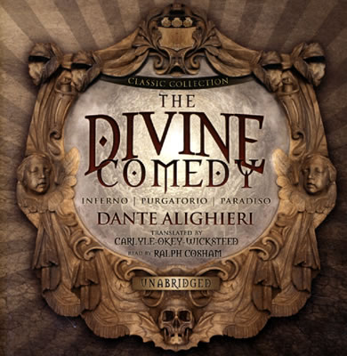
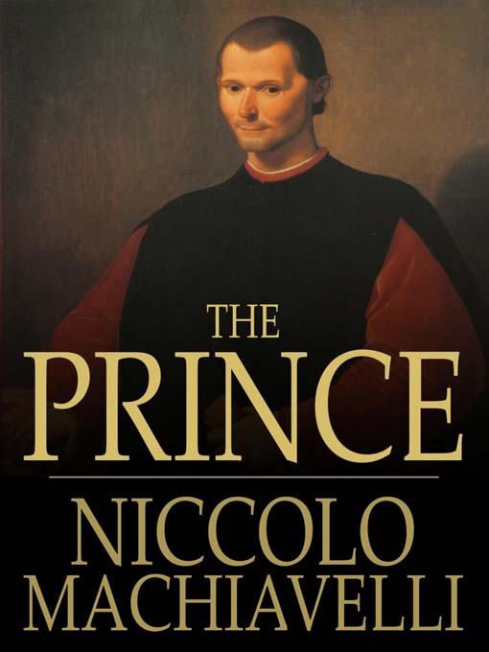
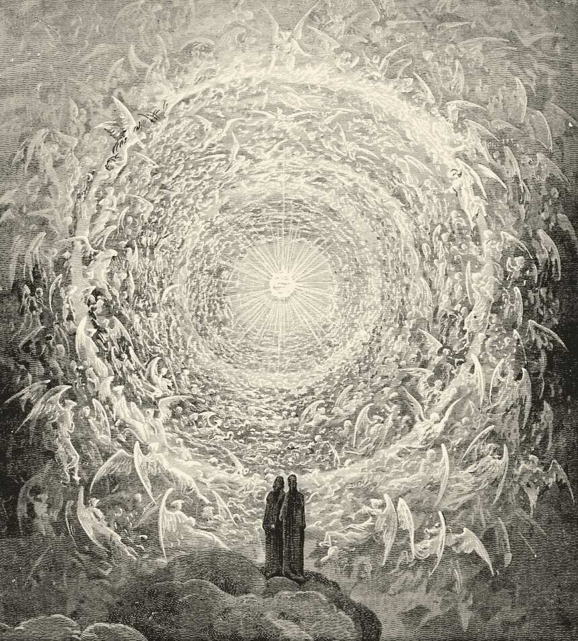
Italian writers
Dante
Machiavelli

Slide 9
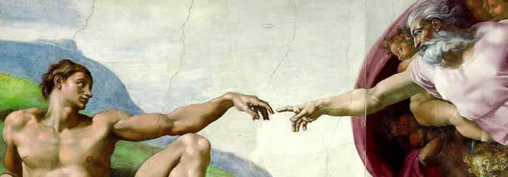
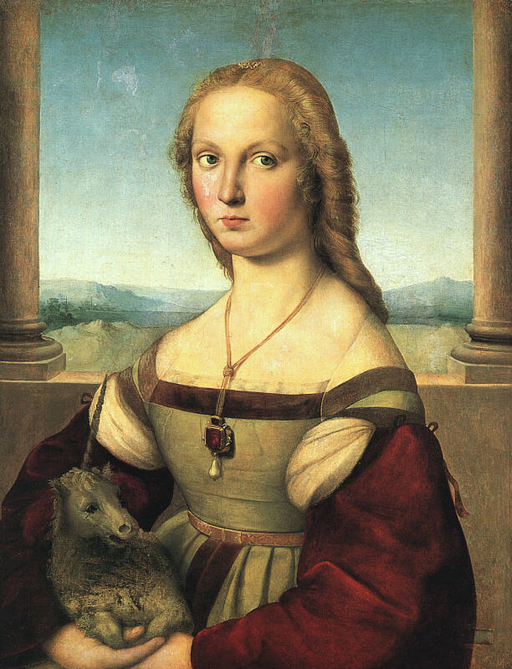
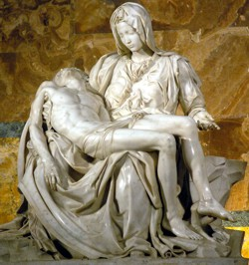
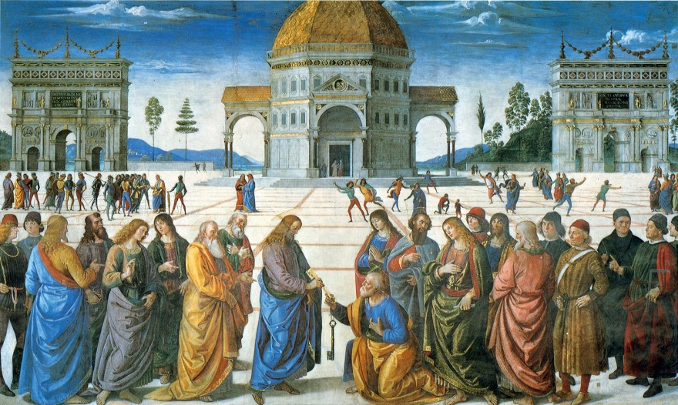
Italian Art and Artists
Art became a focus, how did artists get commissioned? By whom?

Slide 10
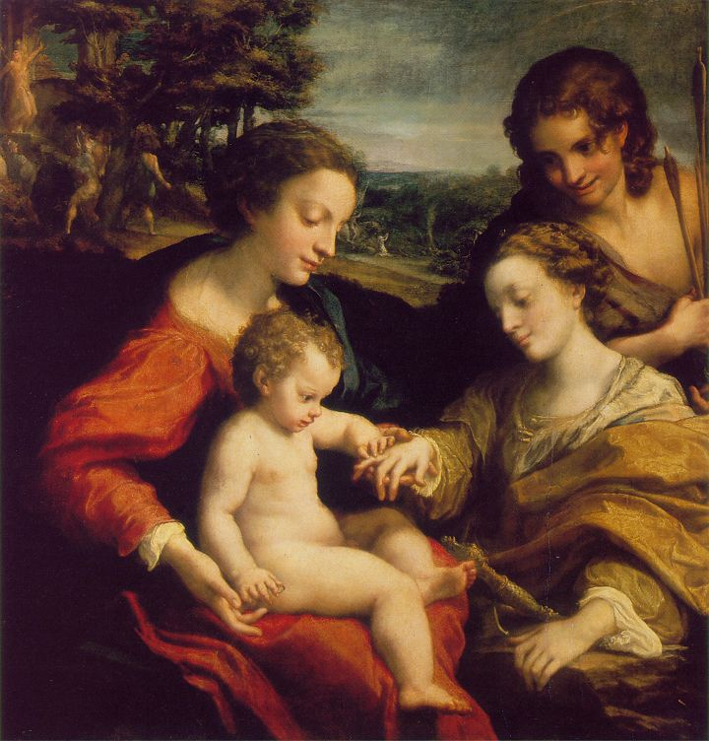
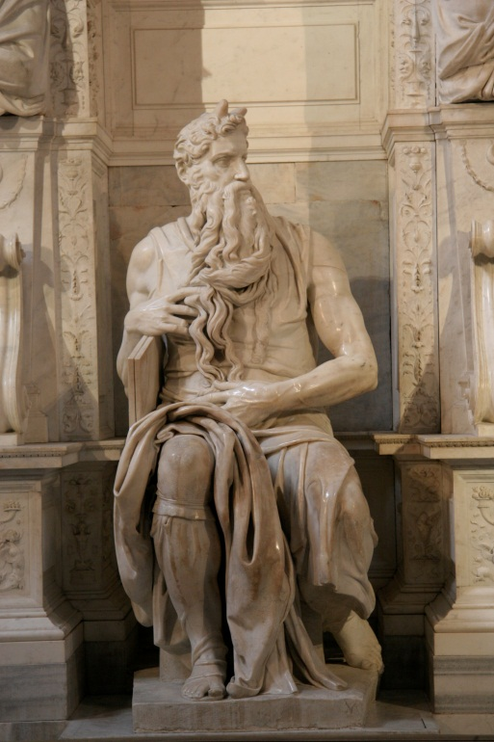
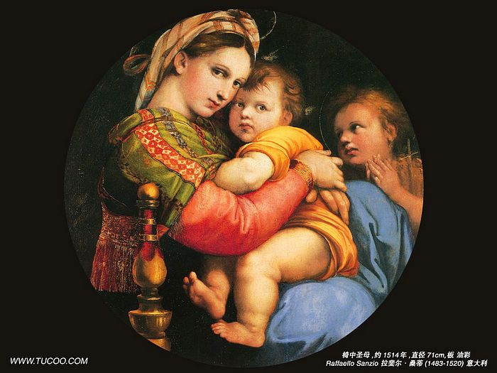
New Methods for a New Era
What are the themes of art?
How was the art different?
What methods are new?

Slide 11
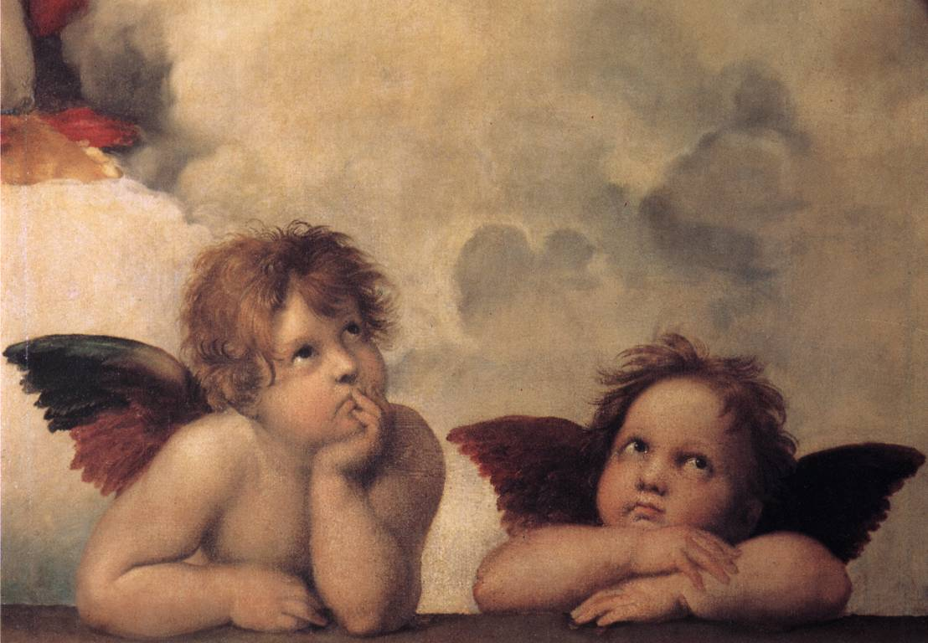
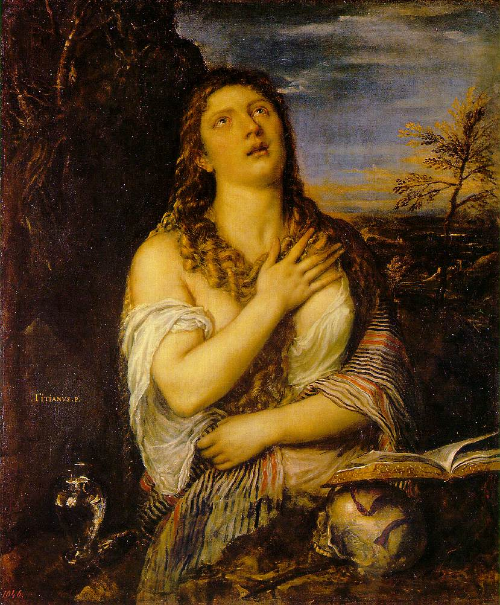
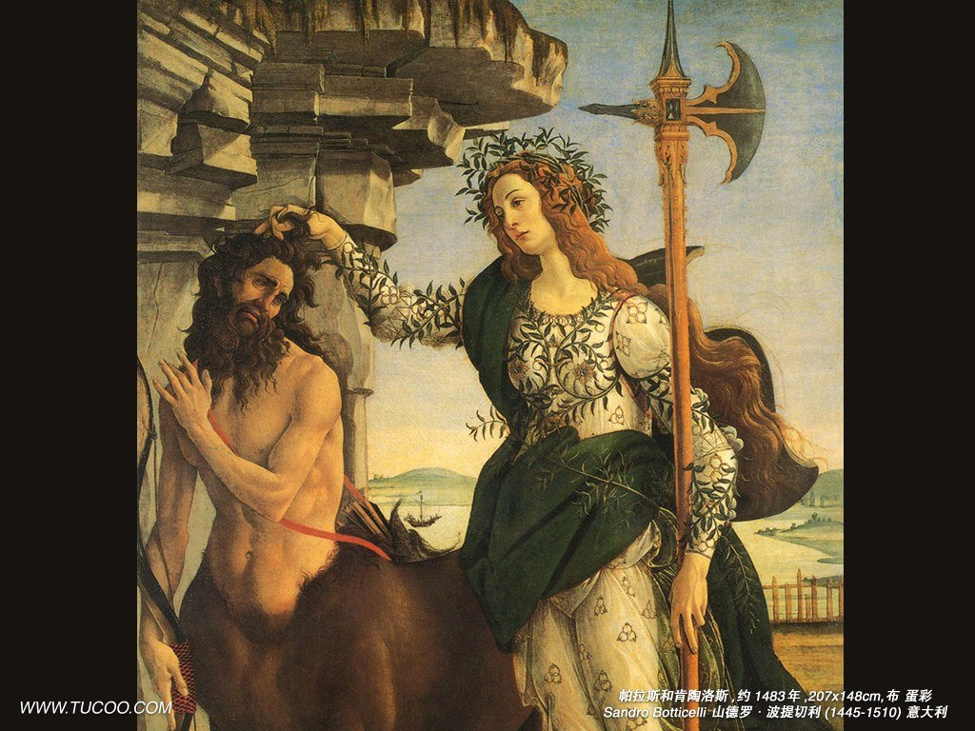
Great Artists
How are people now seen?
Raphael
Botticelli
Titian

Slide 12
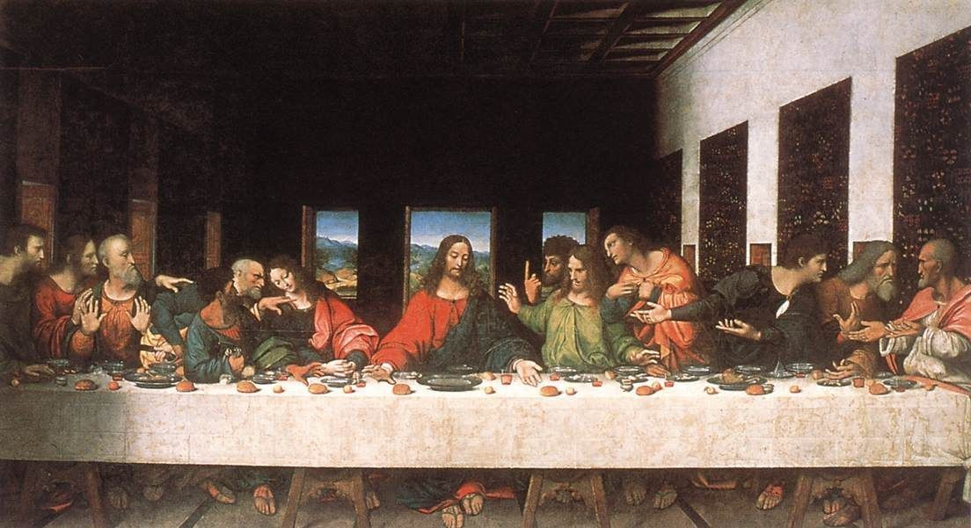
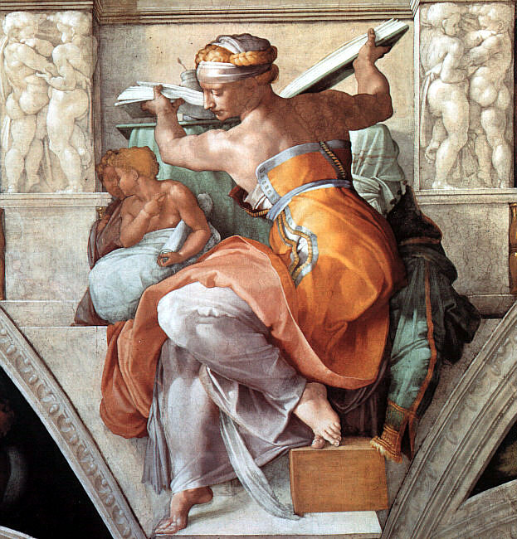
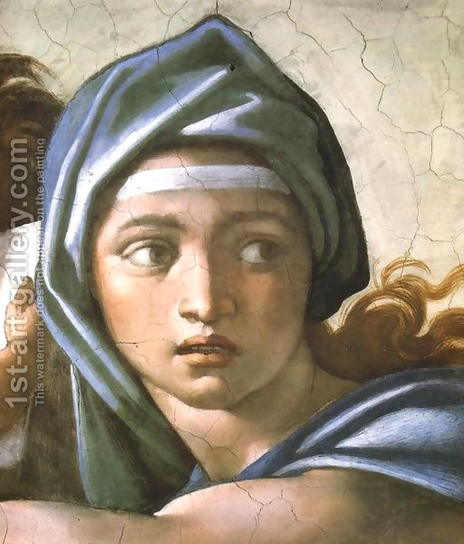
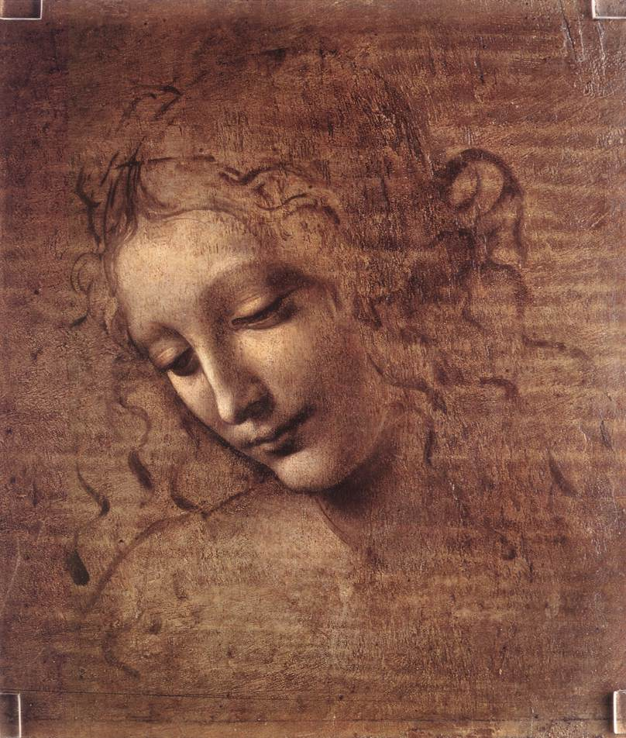
Two Masters
Michelangelo
Da Vinci

Slide 13
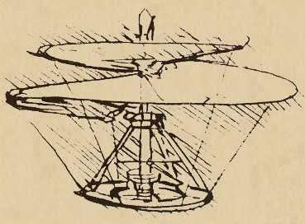
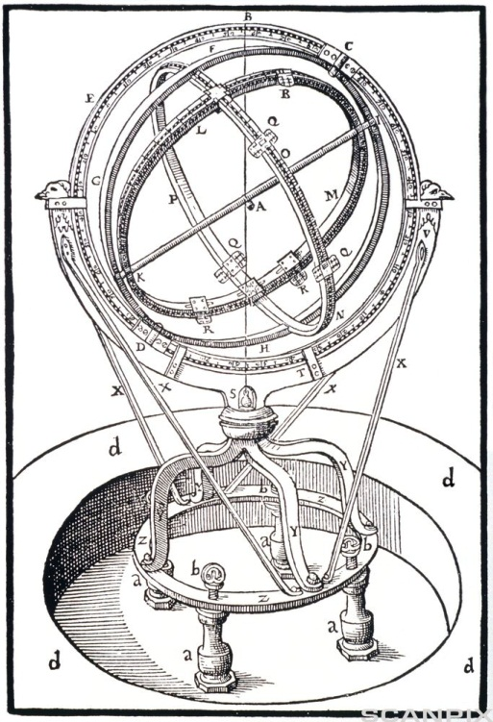
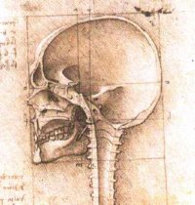
Science and Education
Many of the texts rediscovered in the 1300s dealt with science…
How did scholars use them?

Slide 14
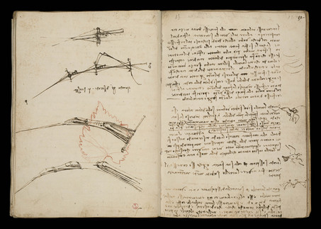
Mathematics
Scholars used math to understand the mysteries of the ______________.
And they invented new symbols…
What symbols do we still use?

Slide 15
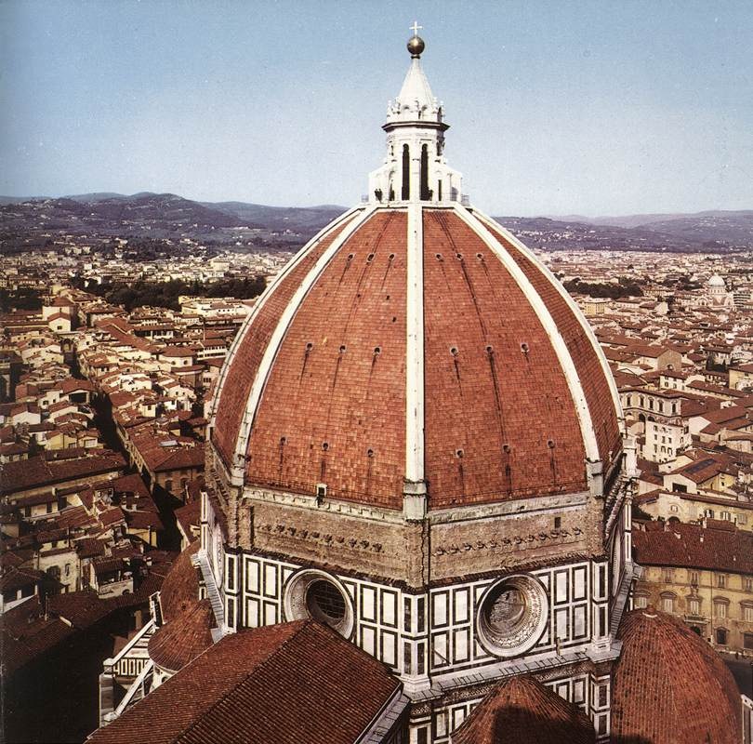
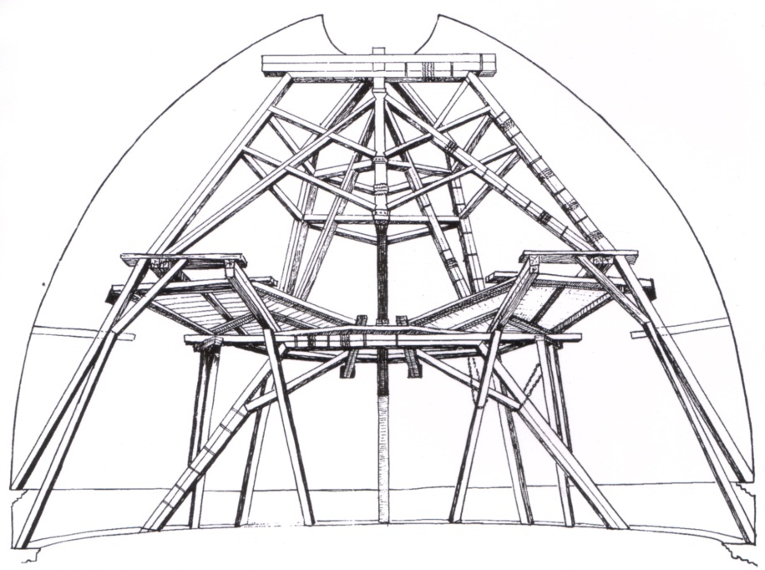
Engineering and Architecture
Advances in math led to advances in other fields of science…
Brunelleschi

Slide 16
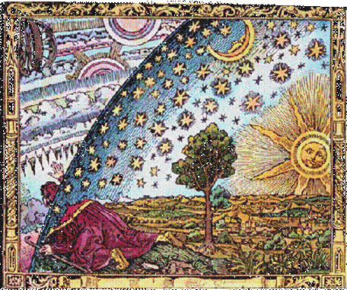
Astronomy and Cartography
Astronomy is the study of…
What important discovery about the universe was realized?
How did scholars study the earth?

Slide 17
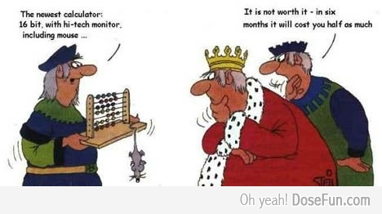
Changes in Education
What was the focus of education in the Middle Ages?
What new subjects became important in education?

Slide 18
Reflection
Refer back to the Topic Question.
Based on discussion write a 7 sentence paragraph answering the question.

