Slide 1
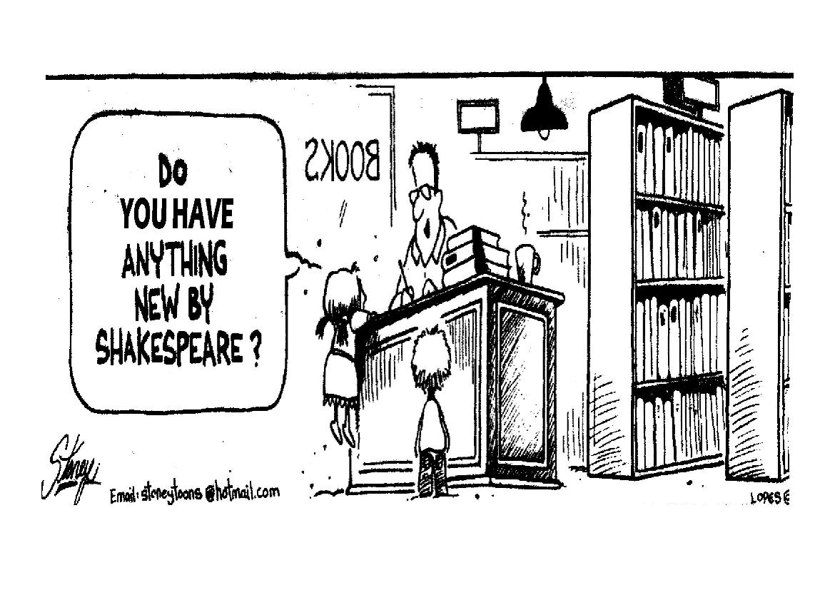
The Renaissance beyond Italy
Chapter 11, section 3

Slide 2
Topic Question
Choose one person who was not Italian who had an impact on the Renaissance in their country. Discuss their contributions.

Slide 3
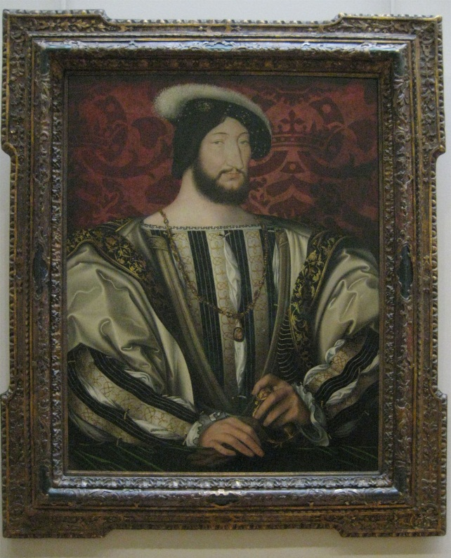
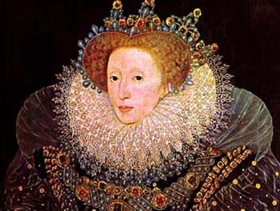
The Big Idea
The Renaissance spread far beyond Italy and changed in the process.

Slide 4
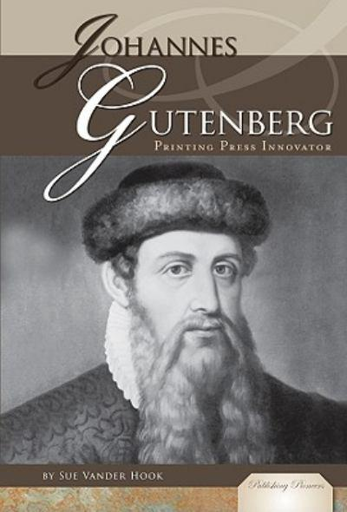
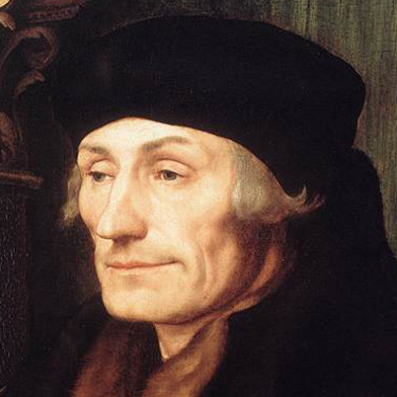
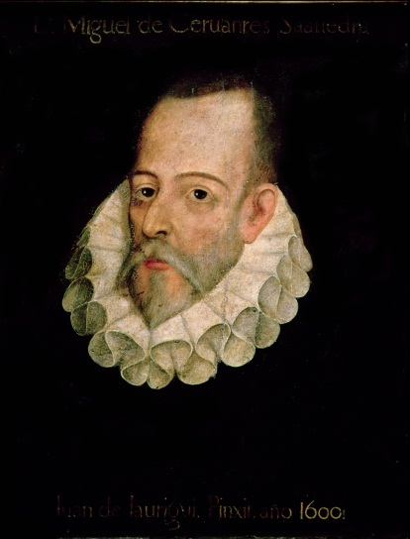
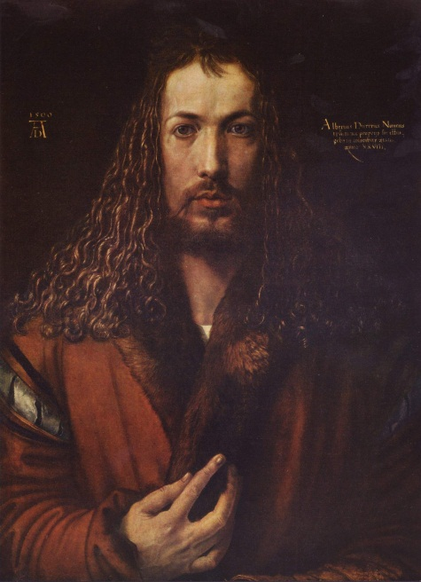
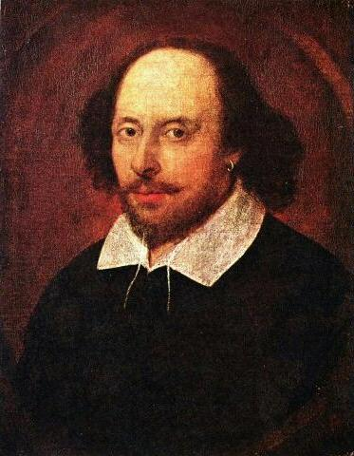
Vocabulary
Johann Gutenberg
P. 312-313 Time line
Christian humanism
Desiderius Erasmus
Albrecht Durer
Miguel de Cervantes
P. 316 Don Quixote
William Shakespeare
Bio p. 317

Slide 5
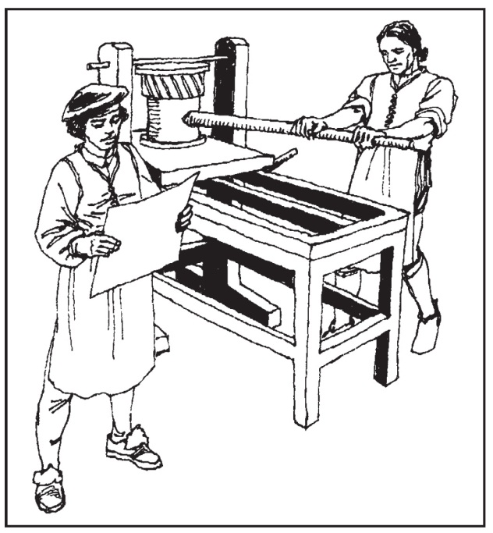

Spread of New Ideas
Who spread the Renaissance throughout Europe?
What development was the most influential? Why?

Slide 6

Paper and Printing
Where did papermaking come from?
Explain how the printing press worked
What was the first published book?
When? Language?

Slide 7
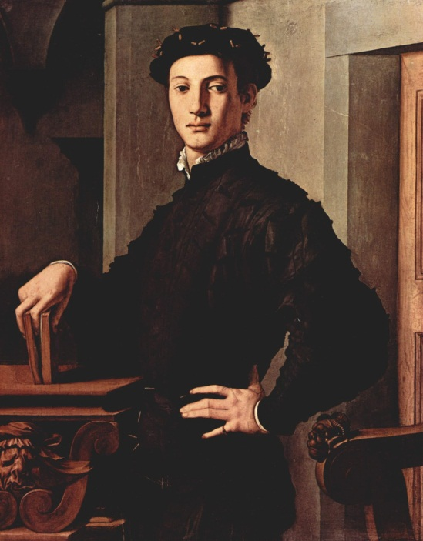
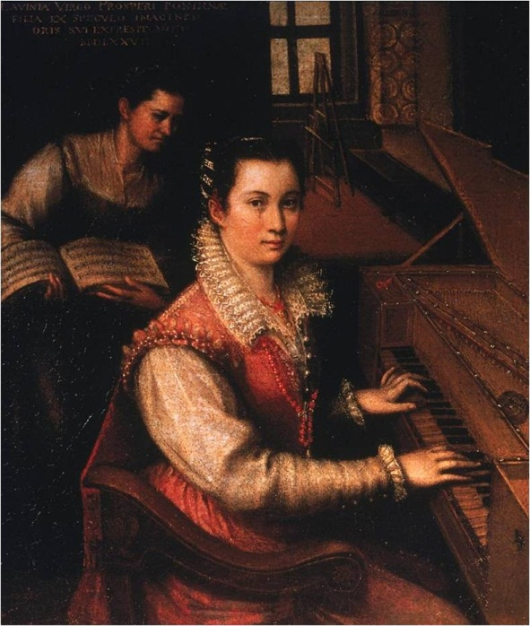
New Universities
How did education contribute to the spread of the Renaissance?
What belief did most teachers have?
Men
Women
Discuss the differences in education for:

Slide 8
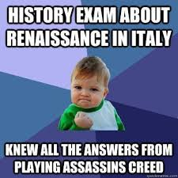
The Northern Renaissance
Northern European scholars were most interested in…
How did scholars feel about the Church?
What did they do?

Slide 9
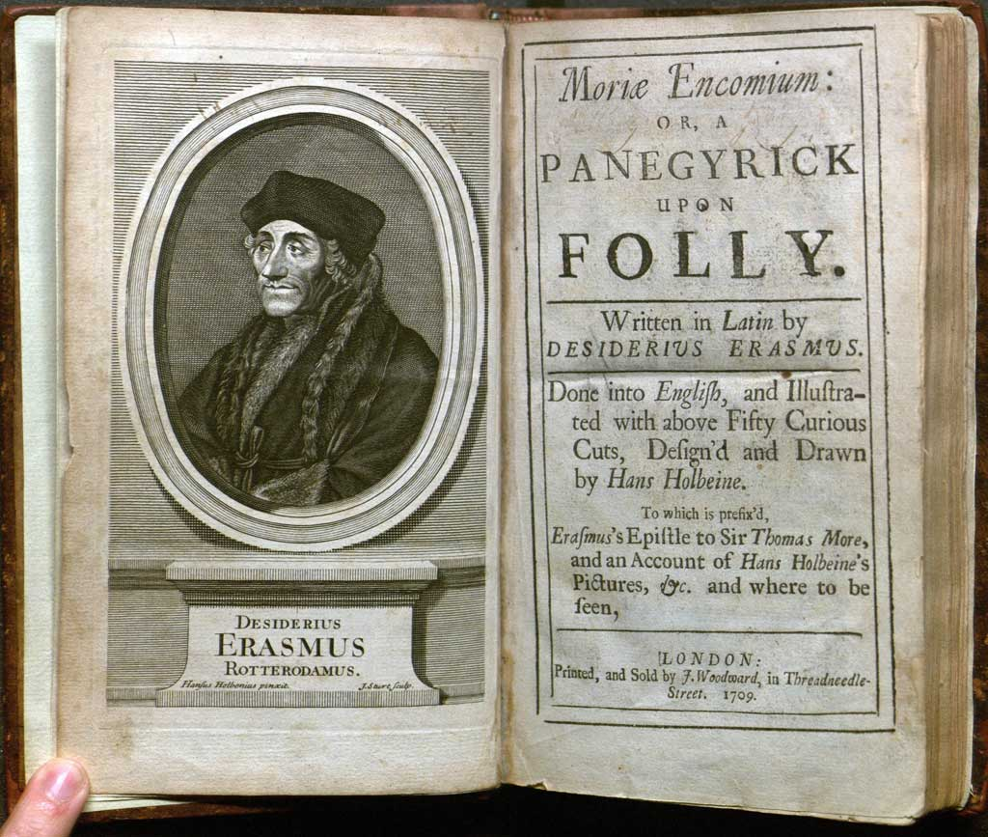
A Northern Scholar
Who was the most important scholar?
Why?
What did he publish?
What was his focus?

Slide 10
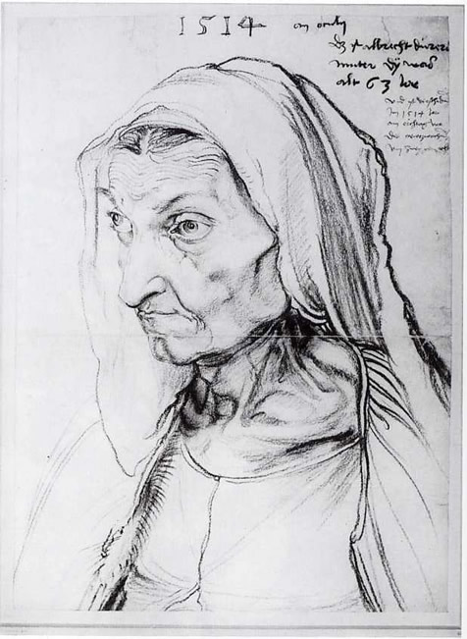
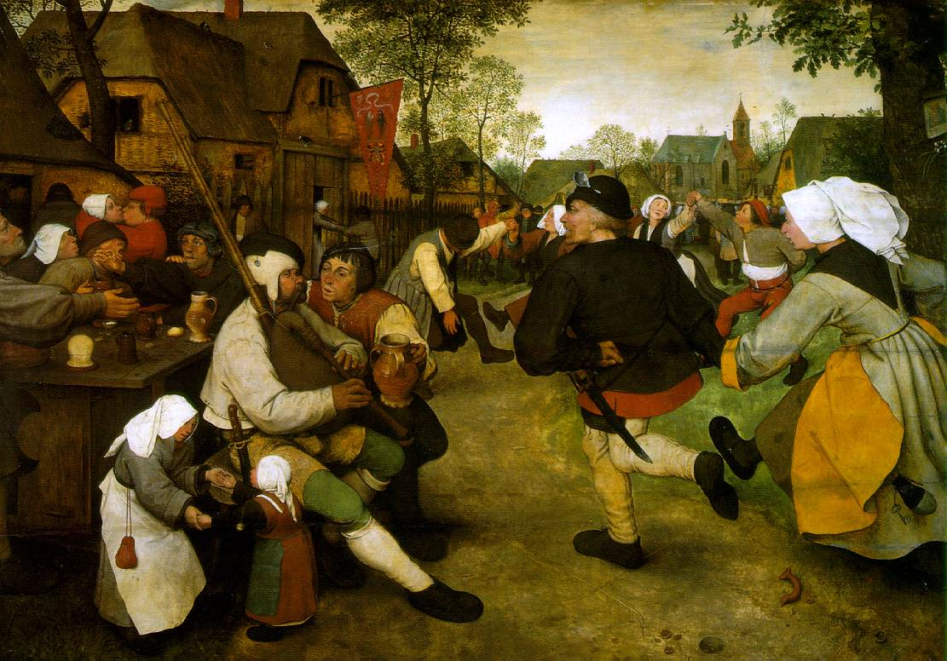
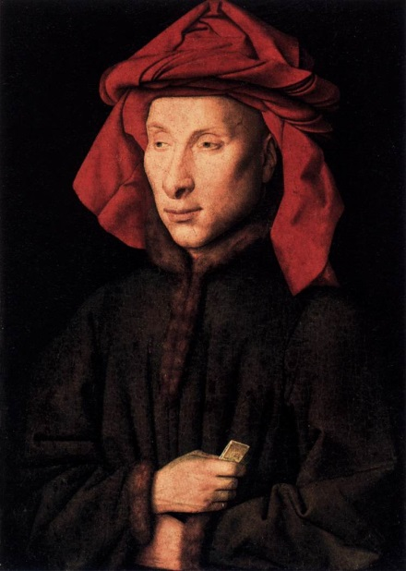
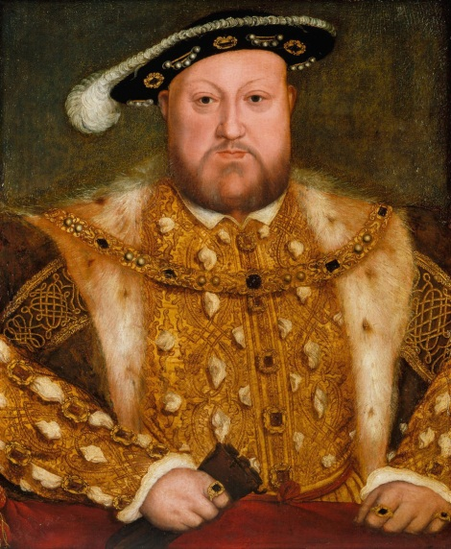
Northern Renaissance Art
Northern European art also changed…
What was the new look of humans? Objects?
What were the subjects of paintings?
Discuss the Northern Renaissance painters
Brueghel
Durer
Holbein
Van Eyck

Slide 11
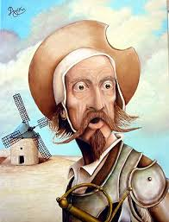
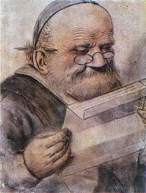
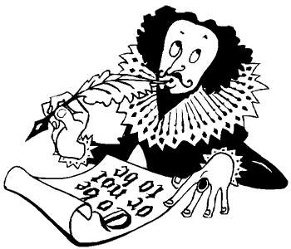
Literature Beyond Italy
Great writers came from all over Europe…
Discuss each writer and their contribution
Spain
France
England

Slide 12
Reflection
Refer back to the Topic Question.
Based on discussion write a 7 sentence paragraph answering the question.

