Slide 1
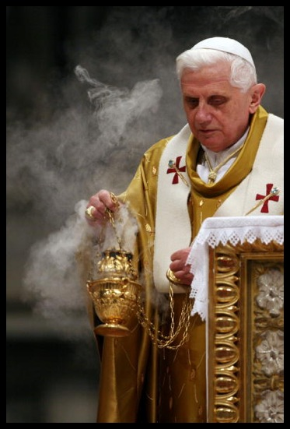
The Catholic Reformation
Chapter 12, section 2

Slide 2
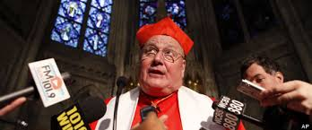
Topic Question
Discuss the Catholic Church’s response to growing pressure to reform.

Slide 3
The Big Idea
Catholic leaders worked to reform the Catholic Church and spread Catholic teachings.

Slide 4
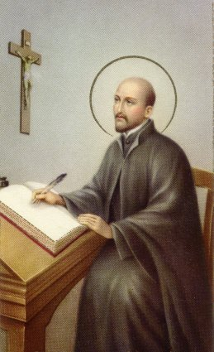
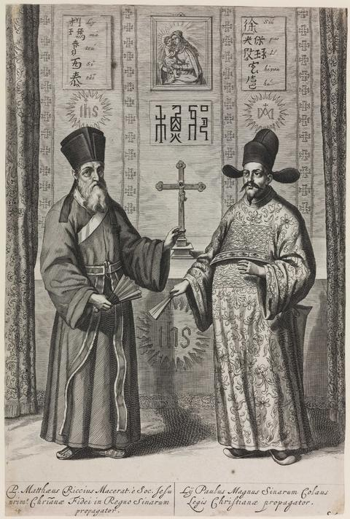
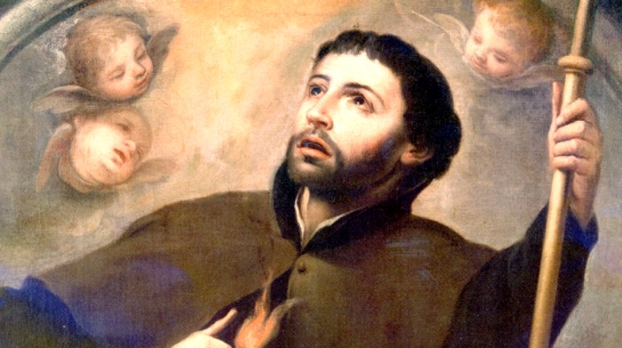
Vocabulary
Catholic Reformation
  P. 336-337
Ignatius of Loyola
  Bio p. 336
Jesuits
  Map p. 338-339
Francis Xavier

Slide 5
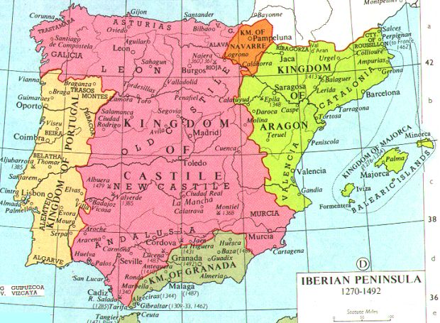
Catholic Culture in Spain
What was the goal of Catholic Reformation Leaders?
What country was the strongest supporter?
Why?

Slide 6
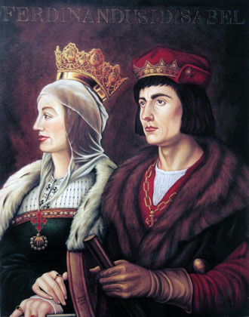



The Growth of Roman Catholic Spain
Spain had always been a home to what 3 religions?
But that didn’t last…
  Who were king and queen?
  What did they do?

Slide 7
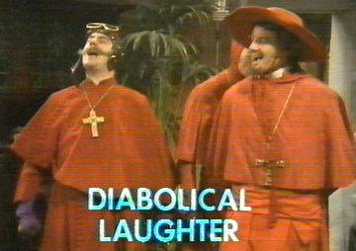
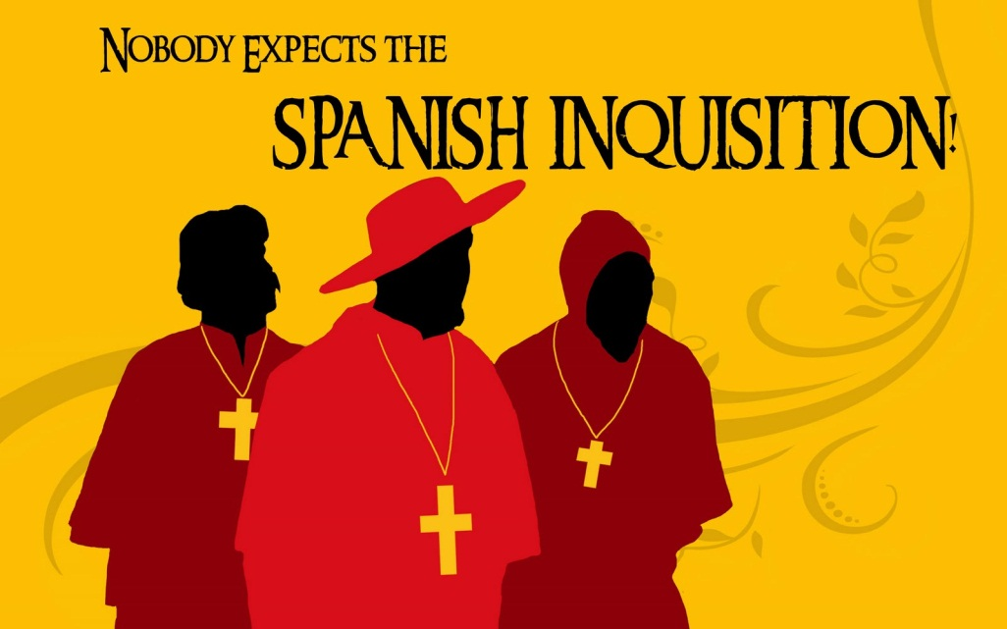
The Spanish Inquisition
What was the job of the Inquisition?
What were its methods?
Who became the new targets?
What was the result in Spain?

Slide 8
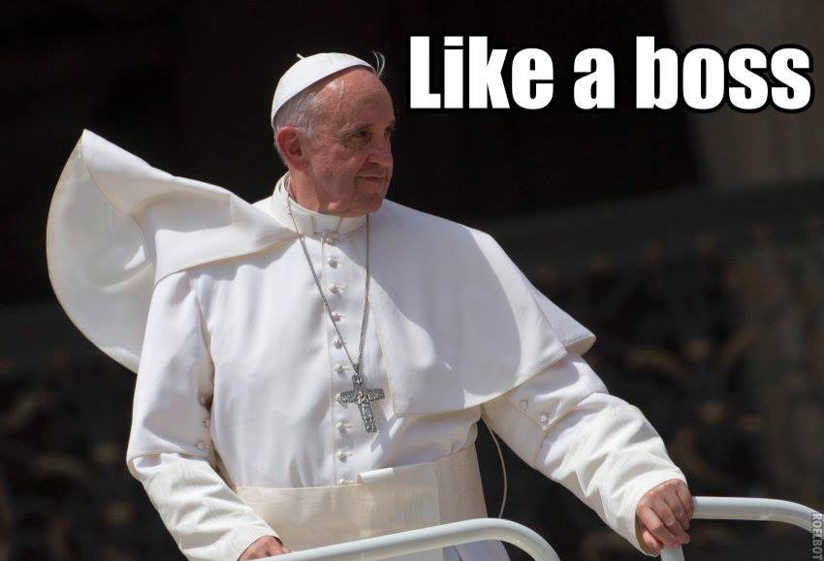
Catholic Reforms
By the mid 1500s Catholic leaders were responding to Protestants…
What did they do?

Slide 9
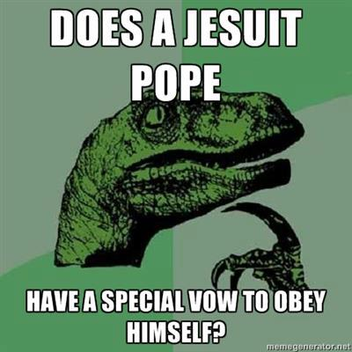
New Religious Orders
What was founded by reformers?
Name the two orders
Their leaders
Their Goals
How their order was organized

Slide 10
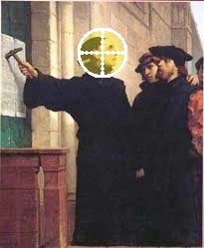
The Council of Trent
Who created the Council?
Why?
Where?
What did they do?

Slide 11
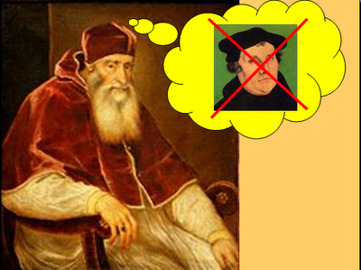
The Fight against Protestants
Some Catholic Reformation leaders wanted to be more direct…
What were the Pope’s actions?
What were the punishments?

Slide 12
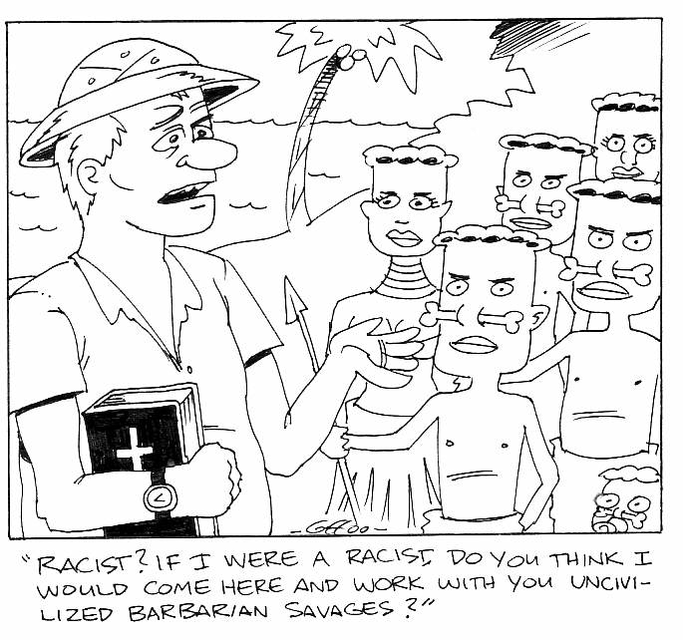
Missionaries Spread Catholic Teachings
Some Catholics chose not to change…
What did they choose to do?
Where did Missionaries go?
What was their success?

Slide 13
Reflection
Refer back to the Topic Question.
Based on discussion write a 7 sentence paragraph answering the question.

