Slide 1
The Columbian Exchange
Chapter 16, section 2

Slide 2
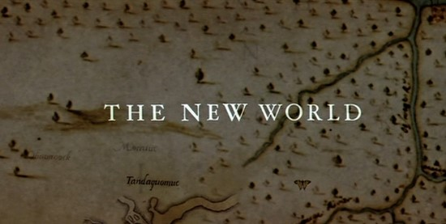
Topic Question
How did the Columbian Exchange change America?

Slide 3
Big Idea
The exchange of plants, animals, ideas and technology between the Old World and the New World brought many changes all over the world.

Slide 4
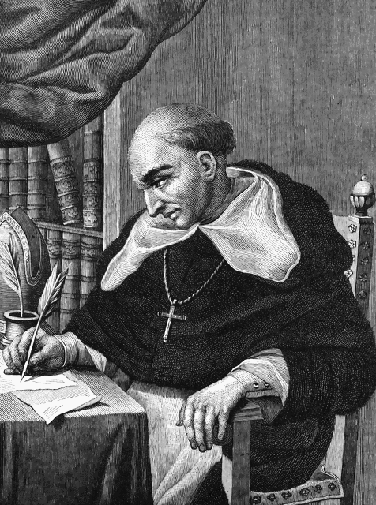
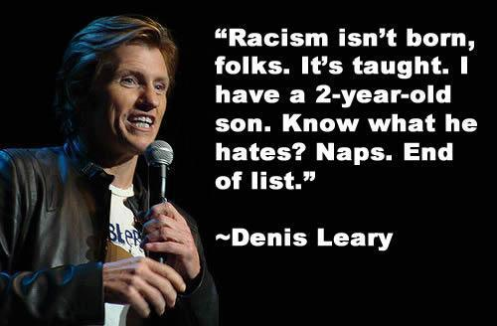
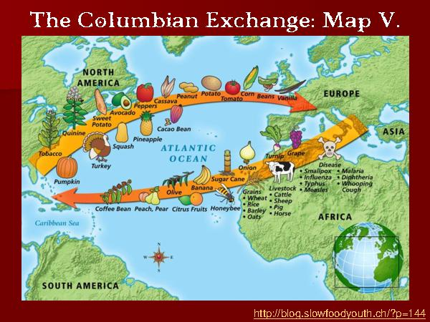
Vocabulary
Columbian Exchange
Plantations
Bartolome de las Casas
Racism

Slide 5
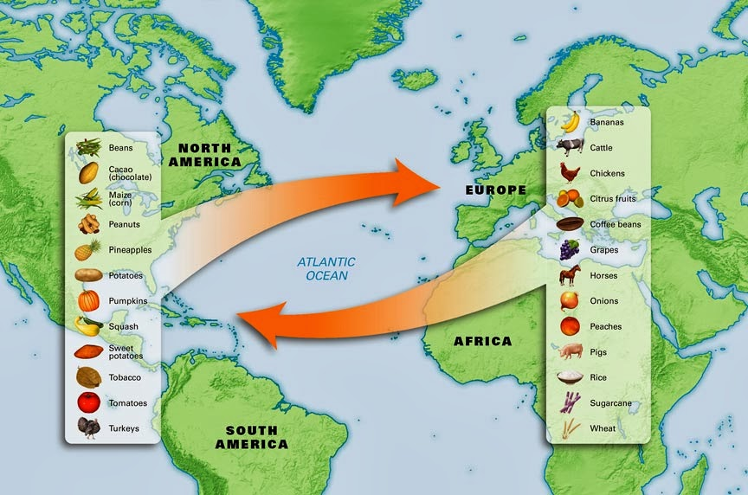
Plants and Animals
What were European explorers looking for? What did they run into?

Slide 6
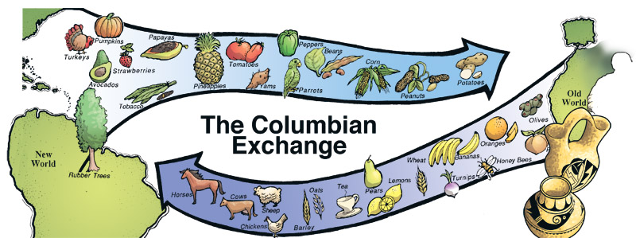
Old World Plants and Animals
List what came from where
Asia
Europe
What effect did these new items have on America?

Slide 7
New World Plants and Animals
List what came from where
America
What effect did these new items have on the world?

Slide 8
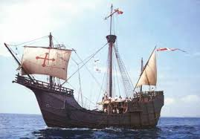
Culture and Technology
What else was introduced to new places?

Slide 9
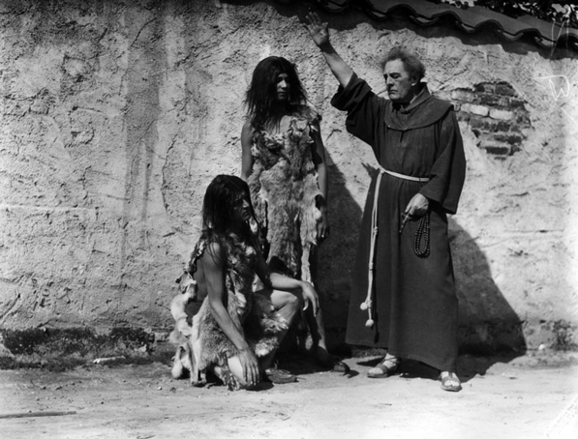
Religion and Language
Religion was #1 priority.
How was religion passed?
How was language passed?

Slide 10
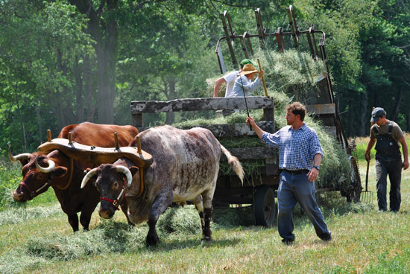
Technology
What new technologies were introduced?
How did they affect life?

Slide 11
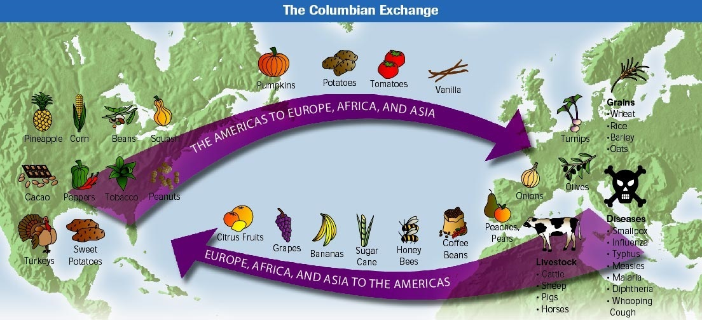
Society and the Economy
The Europeans increased _____. This had a huge effect on _______ and __________.

Slide 12
Treatment of American Indians
Portugal and Spain made money from ________.
But these needed lots of workers.
Where did we get our workers?
How were they treated?
What was the effect on the population?
What did people try to do?

Slide 13
Slavery and Society
When too many Indians died, to whom did we turn for our labor?
What was the effect of all these cultures mingling?
Describe the social order

Slide 14
Reflection
Refer back to the topic question and write a 7 sentence response using the section.

