Slide 1
The Byzantine Empire
Chapter 2, section 3

Slide 2
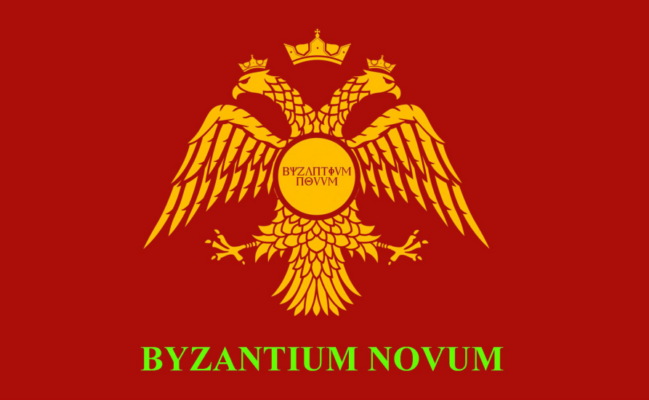
Topic Question
What were the major differences between the Eastern and Western Empires?

Slide 3
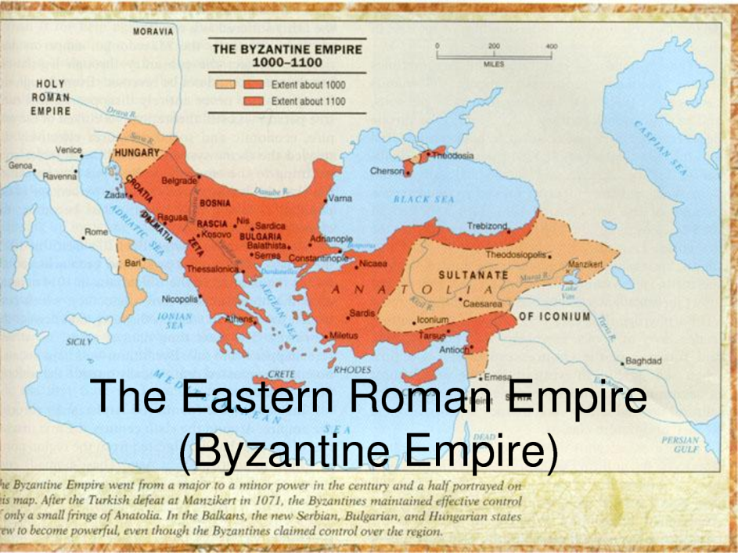
The Big Idea
The Roman empire split into 2 parts. The Eastern Empire prospered for hundreds of years after the Western Empire fell.

Slide 4
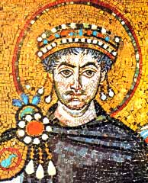
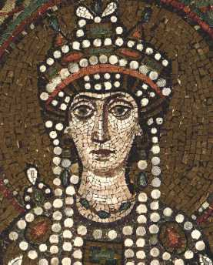
Vocabulary
Justinian
  P. 41
Theodora
  P. 41
Byzantine Empire
  Map p. 37
Mosaics

Slide 5
Emperors Rule from Constantinople
Pg. 37 Small Map
Pg. 38-39
Where was Constantinople located?
Why was location significant?
A bit of frivolity…
http://www.youtube.com/watch?v=XiGGusLWGR0

Slide 6
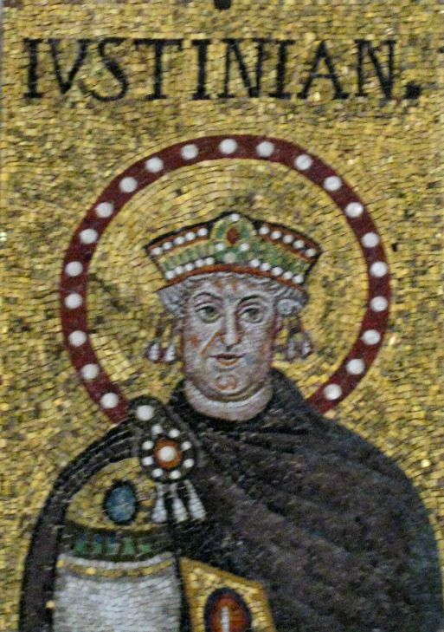
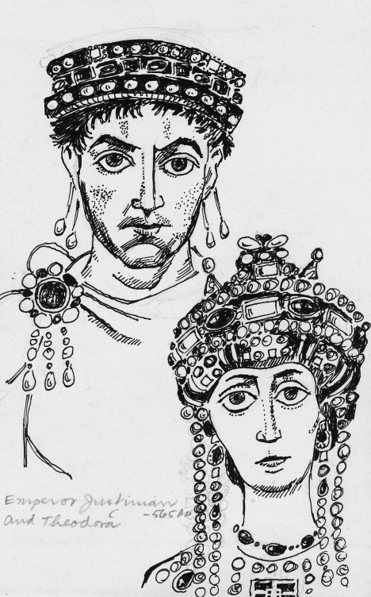
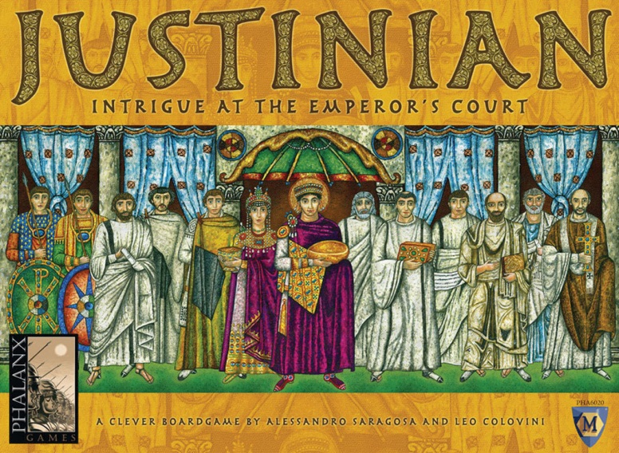
Justinian
What were Justinian’s dates of rule?
What were his passions as king?
What happened to him?
Who is Theodora?

Slide 7
The Empire After Justinian
After Justinian’s death in 565 the Eastern Empire…
Began to decline
Continued its greatness
Began to grow immensely
Discuss your answer based on text evidence.

Slide 8
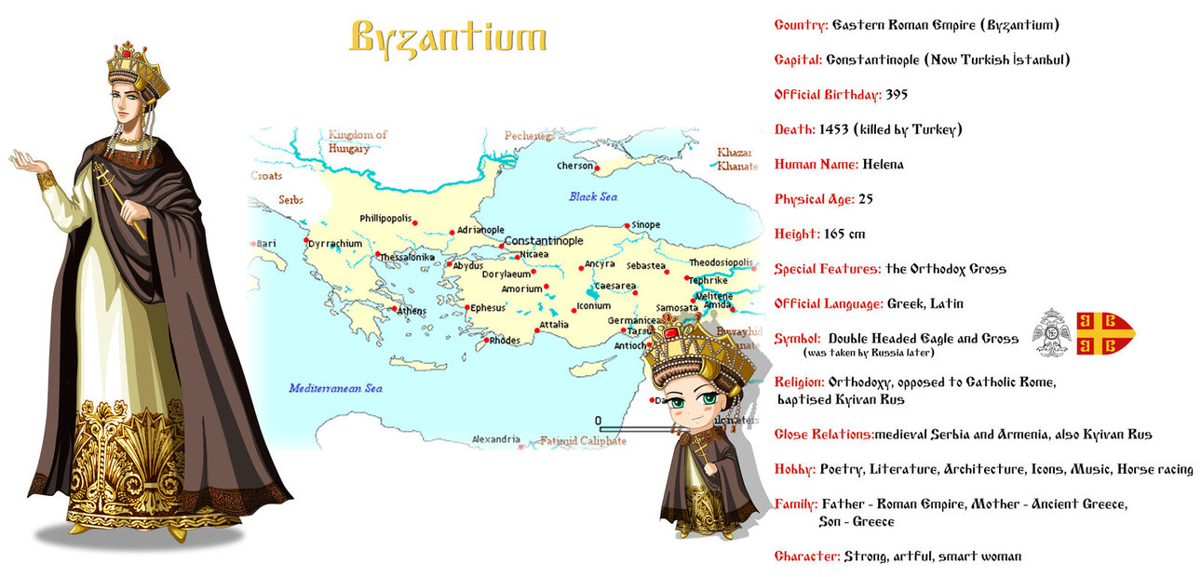
A New Society
How did the Empire change after Justinian?
Outside Influence
Government

Slide 9
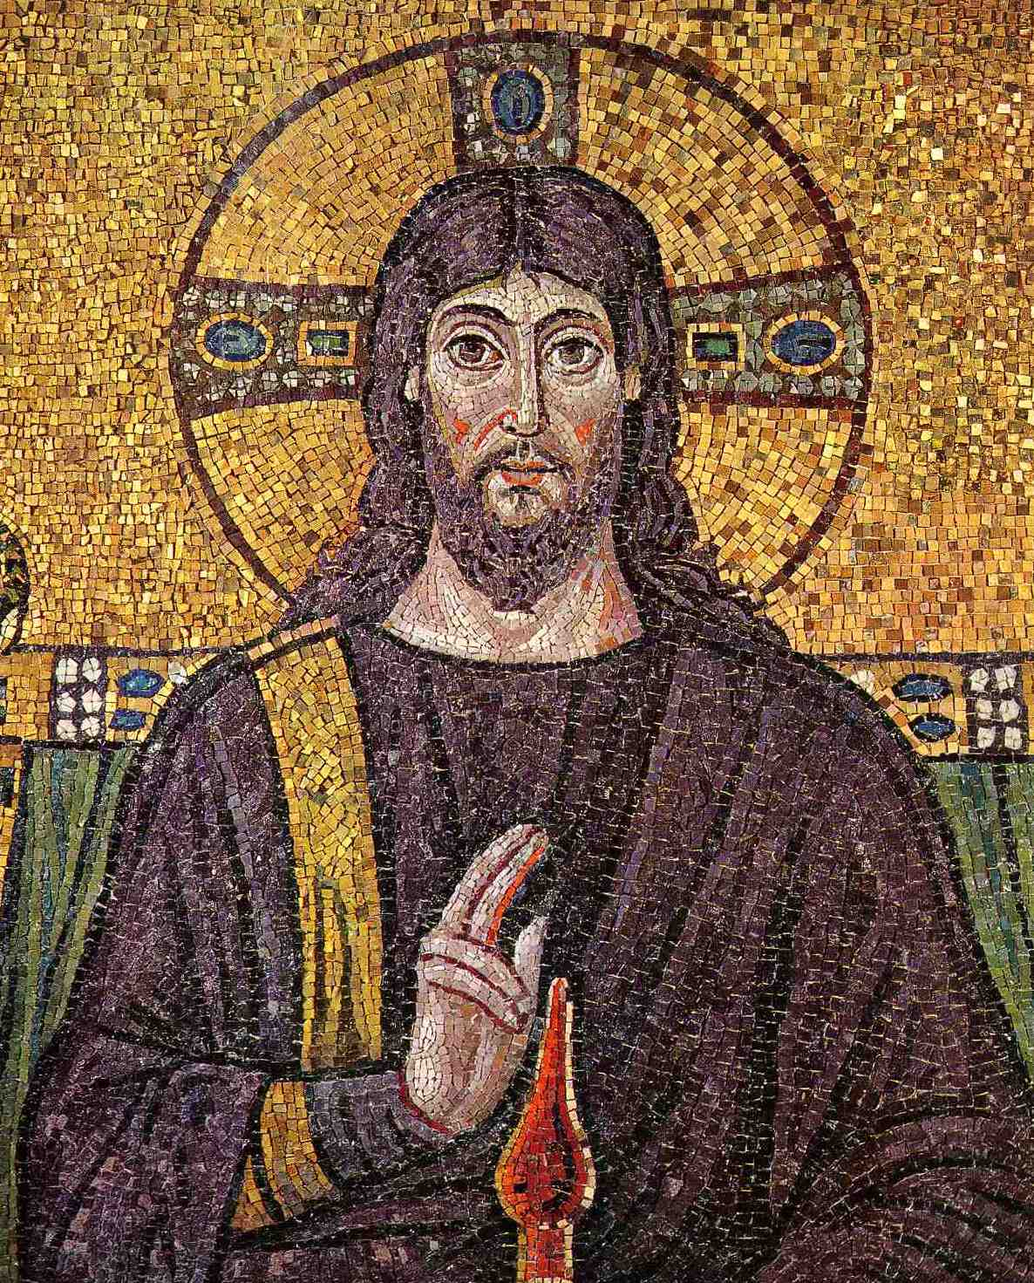
Byzantine Christianity
How did the Byzantium Christian people show their devotion to God?
How did Christianity change?

Slide 10
Reflection
Refer back to the Topic Question.
Based on discussion write a 7 sentence paragraph answering the question.

