Slide 1
Origins of Islam
Chapter 3, section 2

Slide 2
Topic Question
What is the one key Islamic belief about God, and in what ways are Islamic beliefs similar to those of Judaism and Christianity?

Slide 3
The Big Idea
Muhammad, a merchant from Mecca, introduced a major world religion called Islam.

Slide 4
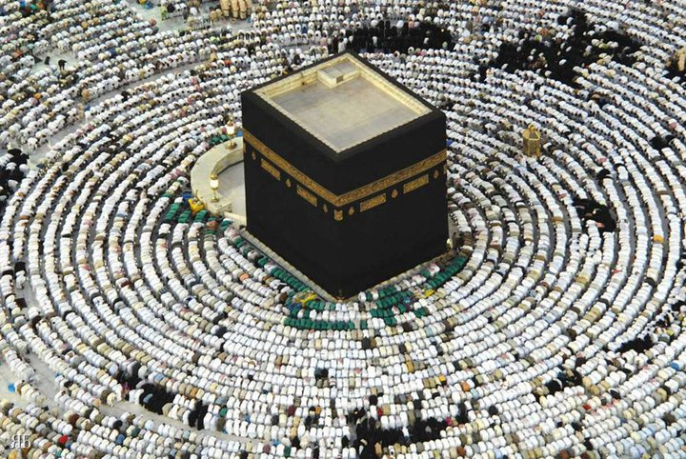
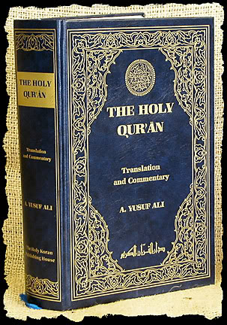
Vocabulary
Muhammad
Islam
P. 60-61 timeline
Muslim
Qur’an/koran
Shrine
Pilgrimage
Mosque
P. 64 The Prophet’s mosque

Slide 5
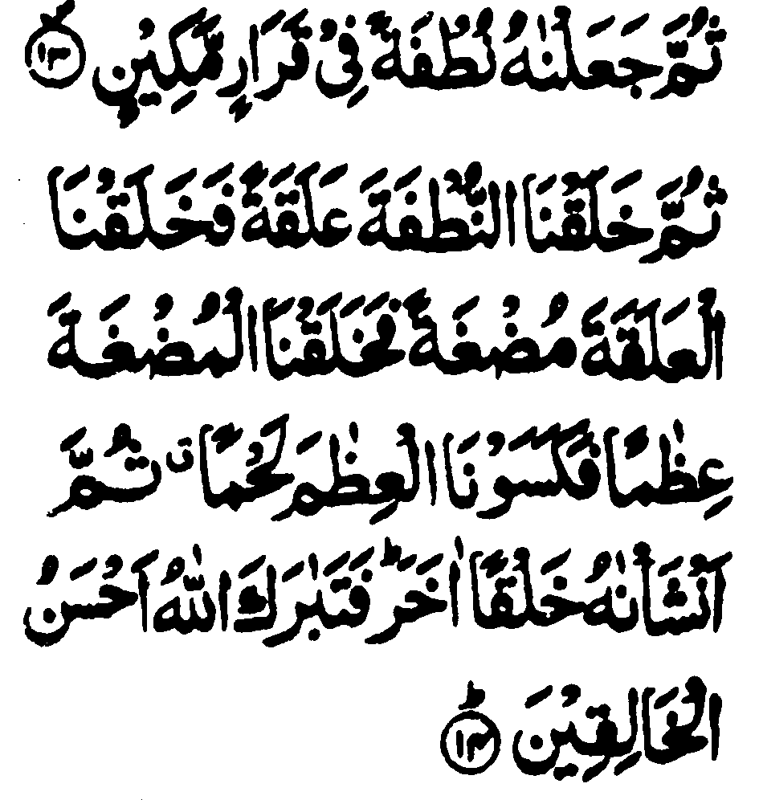
Muhammad Becomes a Prophet
What do we know about Muhammad? How do we know it?

Slide 6
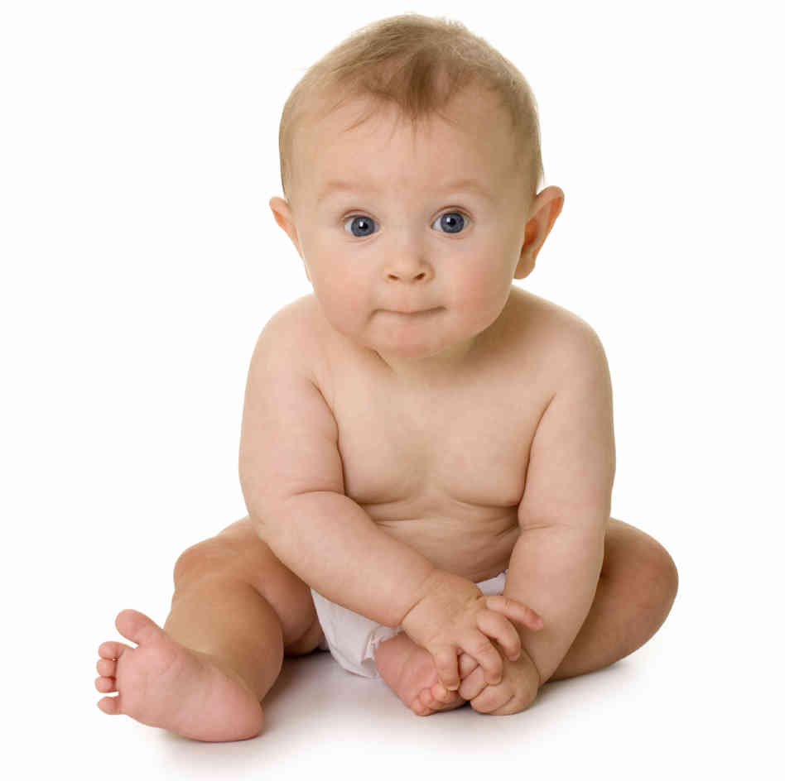
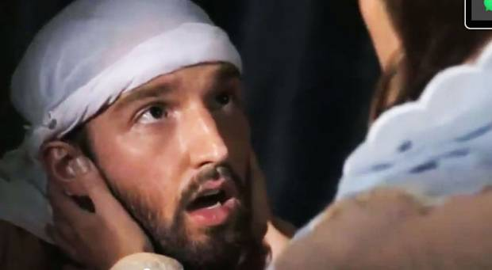
Muhammad’s Early Life
What do we know about Muhammad’s childhood?
What do we know about Muhammad’s adult life?

Slide 7
A Message for Muhammad
What happened to Muhammad when he went to the cave?
How old was he?
What was Muhammad’s immediate reaction?
What was the year he chose to speak?

Slide 8
Muhammad’s Teachings
Muhammad’s teaching were NOT new. They were very similar to two other religions.
Those two religions are…
How did the Muslim people receive Muhammad’s words?

Slide 9
A Belief in One God
One key Islam belief:
1.
The vocab term is:
What prophets do Islam, Christianity, Judaism share?
How do the three religions differ?

Slide 10
A Challenge to Old Ideas
Before Muhammad most Arabians believed…
The vocab term is:
Why did Arabians resist the teachings of Muhammad?

Slide 11
Islam Spreads in Arabia
Muhammad faced persecution for his teachings. What did the people force him to do?

Slide 12
From Mecca to Medina
As Muhammad’s teachings began to grow in popularity some people were afraid of his influence.
What was threatened to happen?
What did Muhammad do?
Who went with him?

Slide 13
From Medina to the Rest of Arabia
What year is important to Muslims? Why?
What new revelations came to light?
What city was previously the most important? What city is now the most important?
Muhammad’s influence reached so far that he was eventually welcomed back to…

Slide 14
Reflection
Refer back to the Topic Question.
Based on discussion write a 7 sentence paragraph answering the question.

