Slide 1
Early Expansion
Chapter 4, section 1

Slide 2
Topic Question
Discuss the many reasons why people converted in such large numbers to Islam

Slide 3
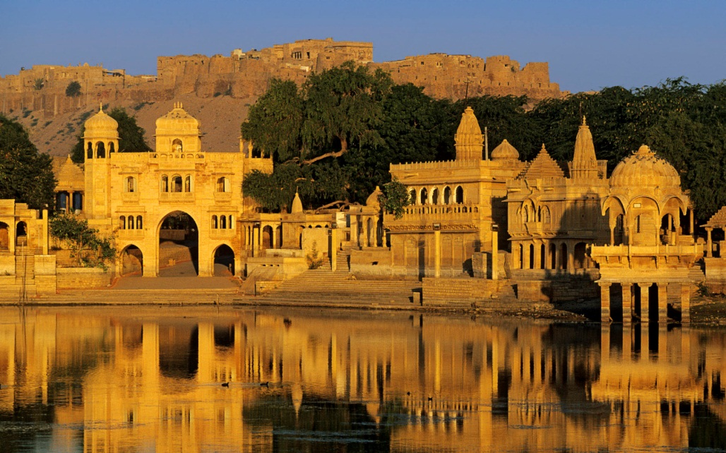
The Big Idea
Conquest and trade led to the spread of Islam, the blending of cultures and the growth of cities

Slide 4
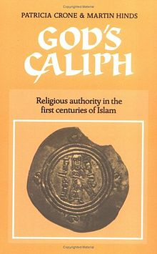

Vocabulary
Abu Bakr
Caliph
Tolerance

Slide 5
Muslim Armies Conquer many Lands
Who was chosen to succeed Muhammad?
What were his duties?
What did Muslims begin doing?
Time Line pg 80-81

Slide 6
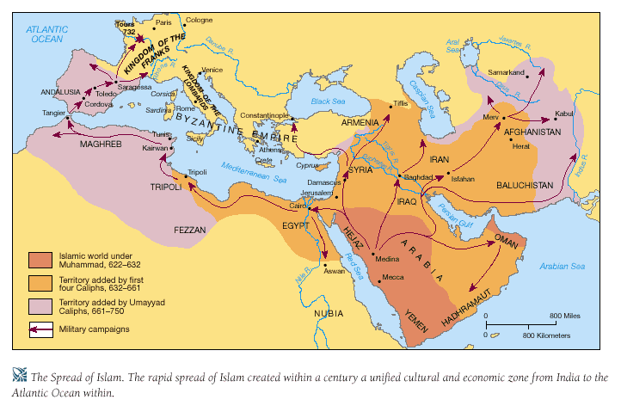
Beginnings of an Empire
Who unified the Muslims?
What two empires were defeated?
What were the agreements made by Muslims and non-Muslims?

Slide 7

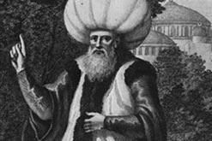
Growth of the Empire
From what family did most Caliphs come from?
Where was their capital?
How did they grow their power?
Who are the new Caliphs?

Slide 8
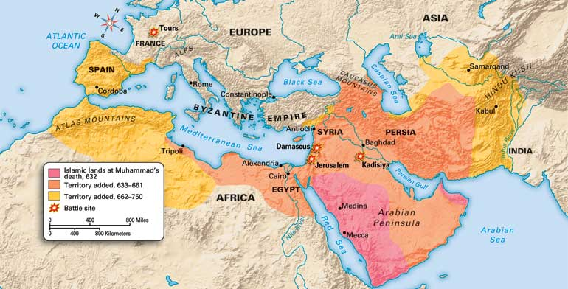
Trade helps Islam Spread
Islam spread through trade in what continents?

Slide 9
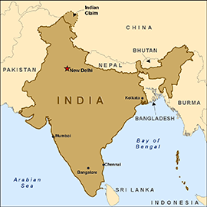
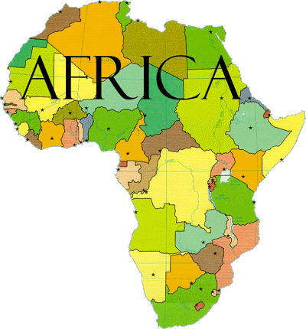
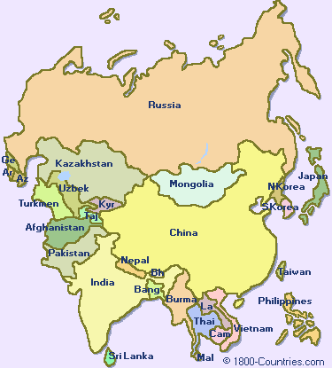
Merchants and the Spread of Islam
Arab Merchants took their religion to many lands.
India?
Africa?
Asia?

Slide 10
Products and Inventions
The Arab people learned from other cultures. What did we get from…
China-
Africa-
India-
Southwest Asia-
Europe-
Sahara-

Slide 11
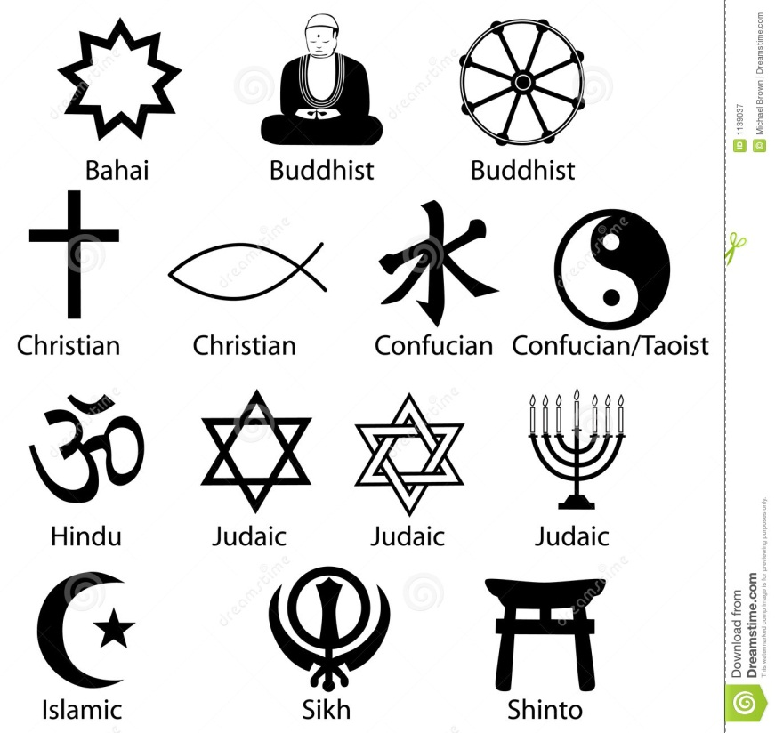
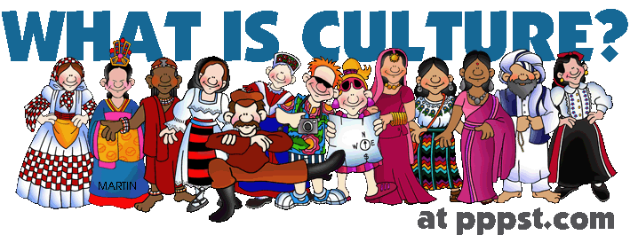
A Mix of Cultures
What was the Muslim’s approach to:
Religion
Culture

Slide 12
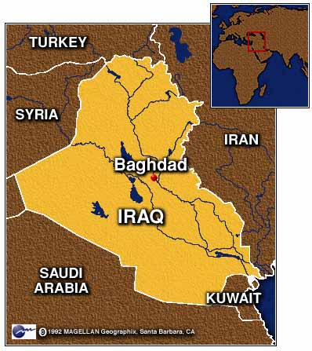
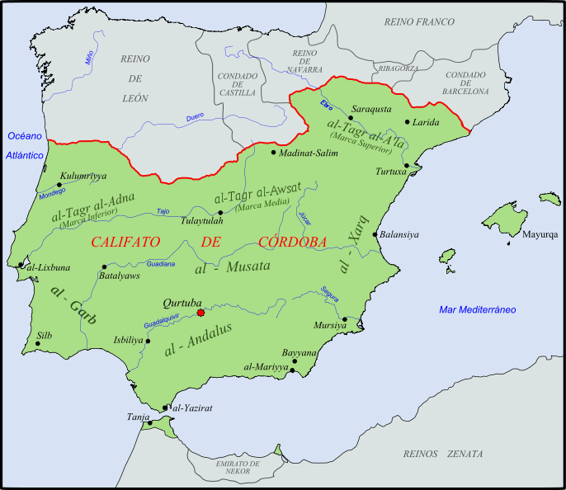
Growth of Cities
Baghdad
Cordoba
What years are important?
What is each city’s significance to the Muslim world?
What made this town important to the world?
City of Cordoba pg. 84-85

Slide 13
Reflection
Refer back to the Topic Question.
Based on discussion write a 7 sentence paragraph answering the question.

