Slide 1
Early Culture and Trade
Chapter 5, section 2

Slide 2
Topic Question
Discuss the importance of family and culture in daily life.

Slide 3
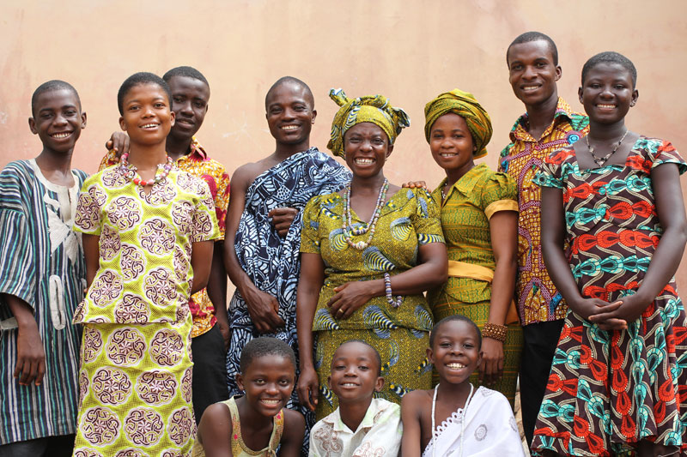
The Big Idea
Family ties, religion, iron technology, and trade all contributed to the growth of West African societies.

Slide 4
Vocabulary
Extended family
  P. 117 Quick facts box
Animism

Slide 5
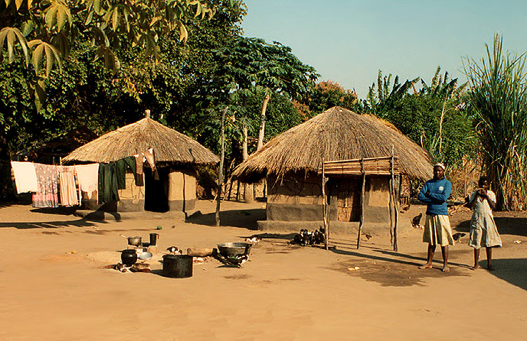
Families, Religion, and Daily life
What changed in West Africa?
What made people move?
What was their life in a village like now?

Slide 6
Families, Villages and Loyalties
What is the root belief of families?
Some people formed
Age-Sets
List some Age-Sets
Each gender had traditional roles to perform.
Men?
Women?
Children?
Elderly?

Slide 7
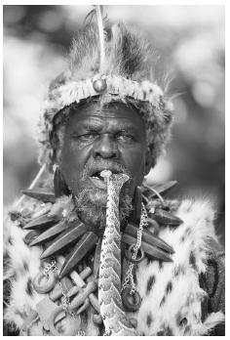
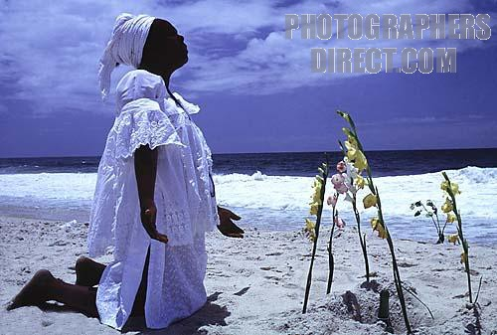
Religion and Culture
What are the traditional beliefs of West African Religion?

Slide 8
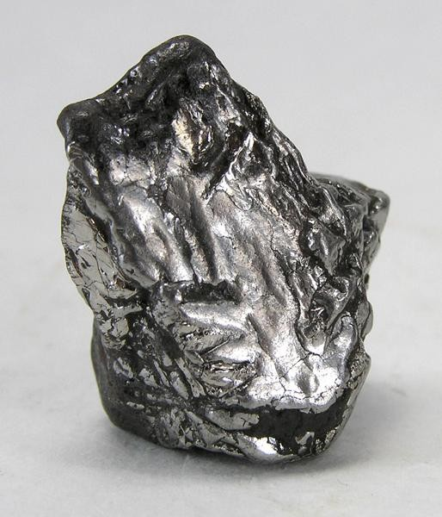
Technology and Change
What is the metal that became valuable?
Describe the process
Who used the metal?
What did it help the people do?

Slide 9
Trade and West Africa
Why did the people of West Africa begin trading?

Slide 10
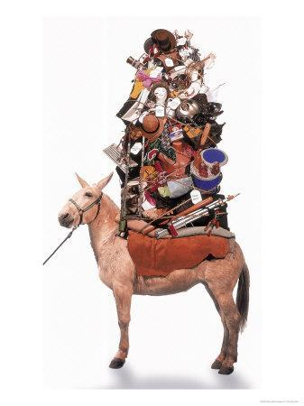
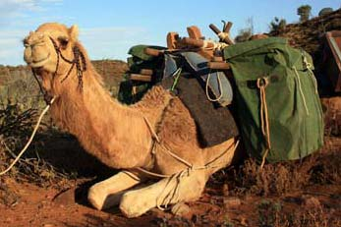
Desert Trade
What animals were first used?
Why were the traders unable to go far?
What animals were used later?
What were the benefits?

Slide 11


Trade in Gold and Salt
GOLD
Where was the gold traded?
SALT
Where was the salt traded?
What other items were traded?

Slide 12
Reflection
Refer back to the Topic Question.
Based on discussion write a 7 sentence paragraph answering the question.

