Slide 1
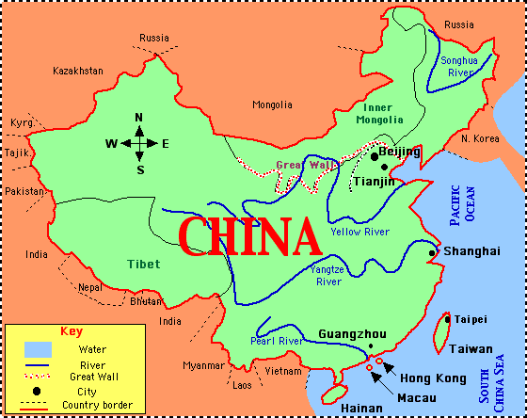
China Reunifies
Chapter 7, section 1

Slide 2

Topic Question
Discuss the differences and similarities of the Chinese ruling dynasties.

Slide 3
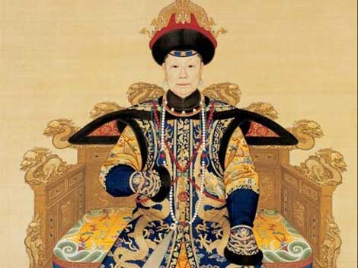
The Big Idea
The period of Disunion was followed by reunification by rulers of the Sui, Tang and Song dynasties.

Slide 4
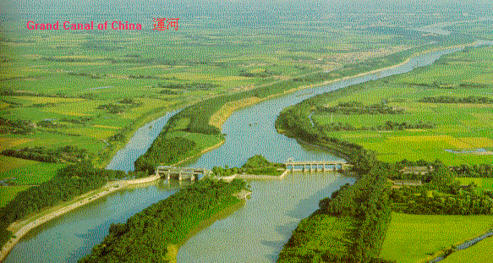
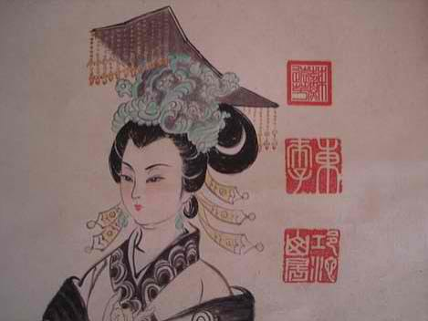
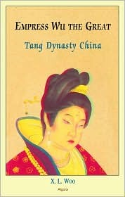
Vocabulary
Period of Disunion
Grand Canal
Empress Wu
P. 168 Bio

Slide 5
The Period of Disunion
What Dynasty fell?
During this period Culture changed. In what ways did people begin to change as never before?

Slide 6
The Sui, Tang and Song
Finally after centuries of political confusion and cultural change, China was reunified.
How long was China reunified?
Who ruled China?

Slide 7
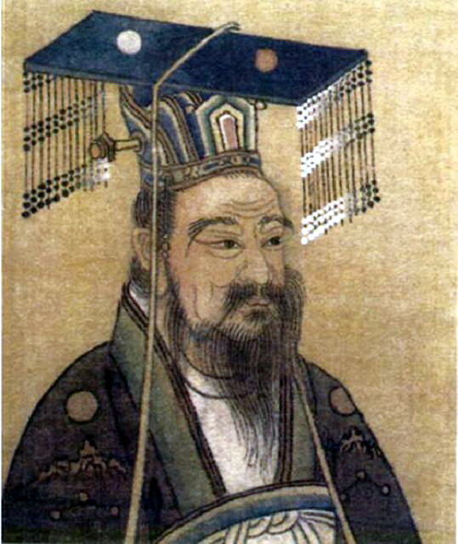
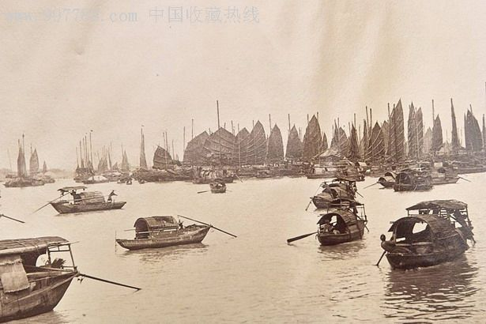
The Sui Dynasty
Who finally ended the Period of Disunion?
When? How?
What are the dates of this Dynasty?
What were their contributions?

Slide 8

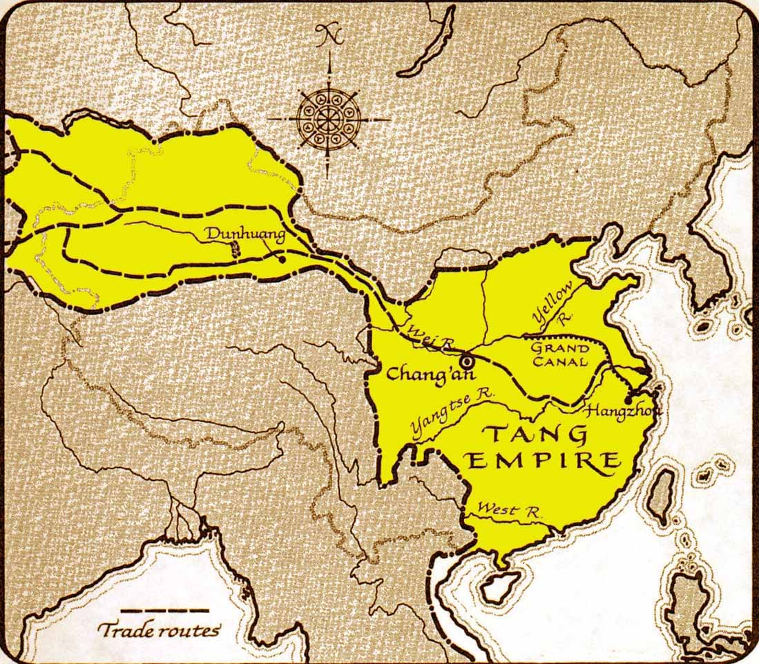
The Tang Dynasty
What are the dates of this Dynasty?
Who were the rulers?
What were their contributions?
What happened when this Dynasty ended?

Slide 9
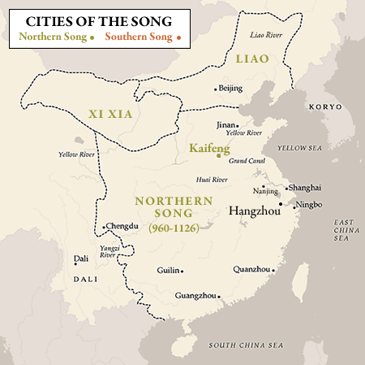
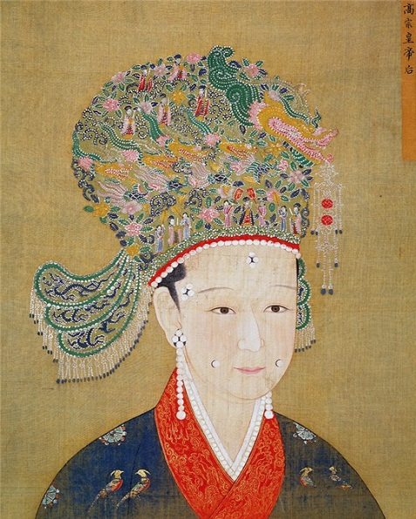
The Song Dynasty
What are the dates of this Dynasty?
Who were the rulers?
What were their contributions?

Slide 10
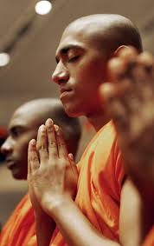
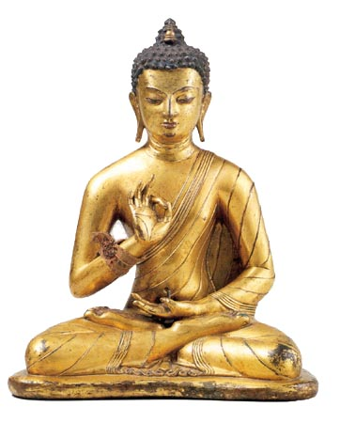
The Age of Buddhism
Pg. 169 Map
Where was Buddhism from?
What are some teachings?
How did Buddhism change?
How did Buddhism influence:
culture
life
people

Slide 11
Reflection
Refer back to the Topic Question.
Based on discussion write a 7 sentence paragraph answering the question.

