Slide 1
The Yuan and Ming Dynasties
Chapter 7, section 4

Slide 2
Topic Question
Discuss what life was like in each Empire. Who were the rulers? The famous people? Which would you prefer to live under?

Slide 3
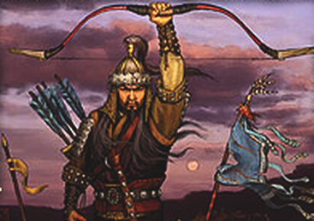
The Big Idea
The Chinese were ruled by foreigners during the Yuan Dynasty, but they threw off Mongol rule and prospered during the Ming Dynasty.

Slide 4
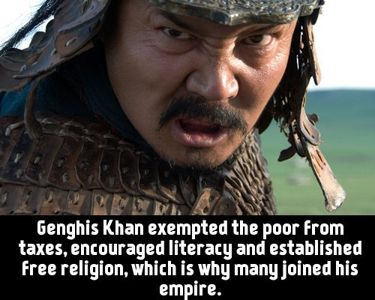
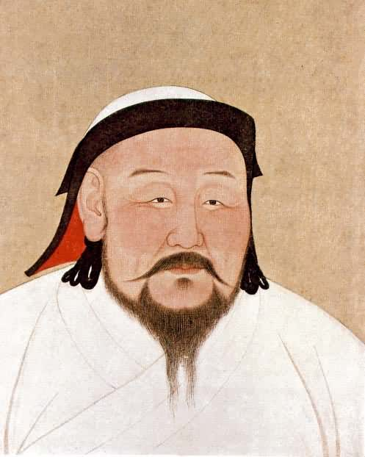
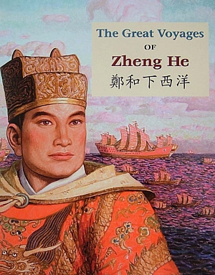
Vocabulary
Genghis Khan
Kublai Khan
  P. 187 Bio
Zheng He
  P. 183 Ship
Isolationism

Slide 5
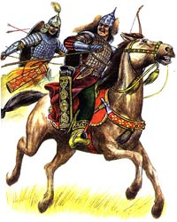
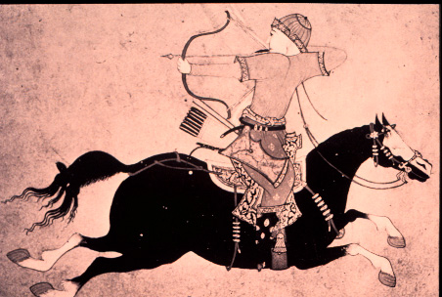
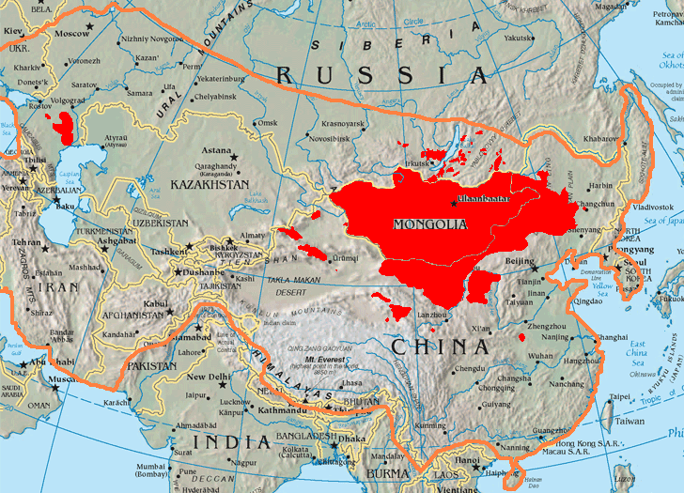
The Mongol Empire
How did the Mongols live?
Who was their leader?
What title did he take?
What did his title mean?

Slide 6
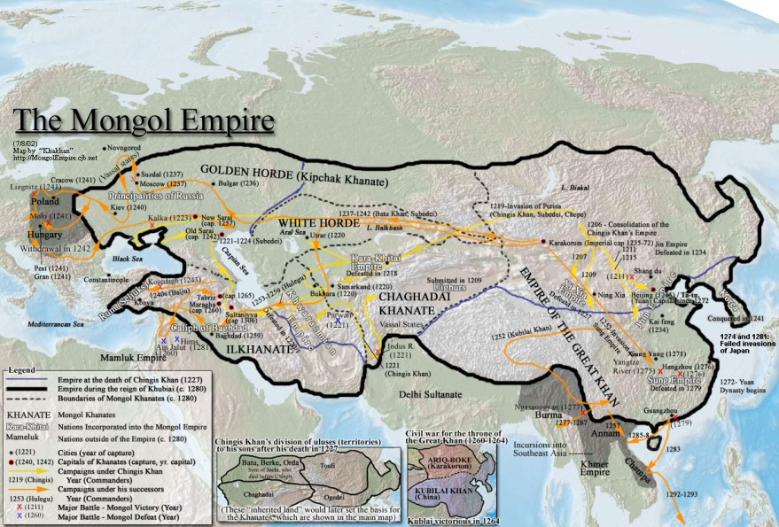
The Mongol Conquest
The Mongol armies, led by Genghis Khan, tore their way through Asia.
Who was spared by the Mongols?
When did he turn his attention to China?
Surely the brutality of the Mongols ended with Genghis Khan’s death...
When did China fall?

Slide 7
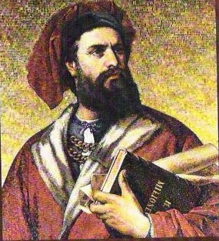
Life in Yuan China
How were Kublai Khan and the Mongols different than the Chinese?
How did Kublai Khan control the Chinese?
Who is the famous Italian who lived there?
End of Yuan Dynasty
Who did the Mongols decide to invade next?
Did it work? Why?
How did the Chinese feel in the 1300s?

Slide 8
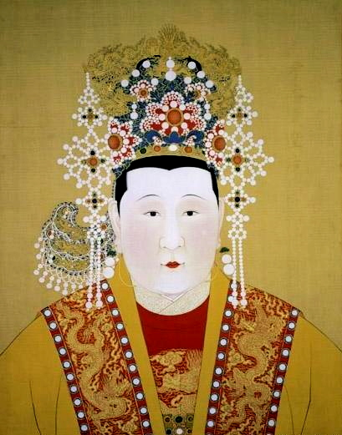
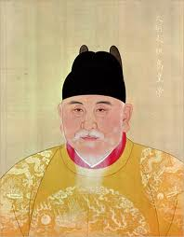
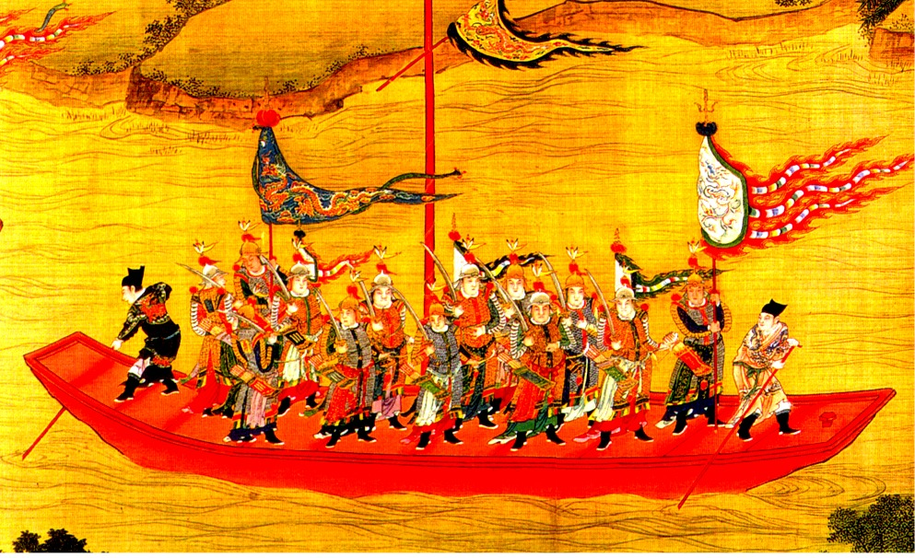
The Ming Dynasty
What were the years?
Who was the ruler?
What were accomplishments?

Slide 9
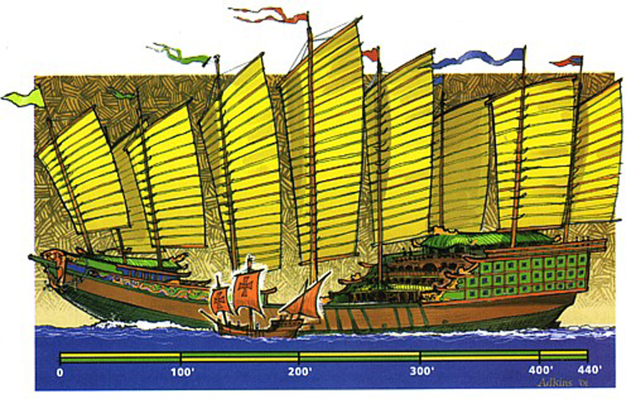
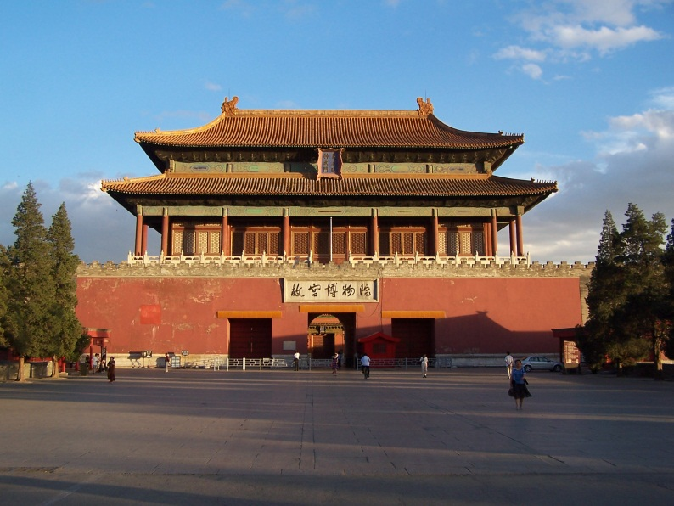
Great Sea Voyages
Great Building Projects
Describe the “Forbidden City”
Describe the Great Wall
Who was the greatest sailor of the time?
Where did he sail?
What were his contributions?

Slide 10
China under the Ming
What did the Ming work to do?
Relations with other Countries
Government
List what the Ming did:
List what the Ming did:

Slide 11
Reflection
Refer back to the Topic Question.
Based on discussion write a 7 sentence paragraph answering the question.

