Slide 1
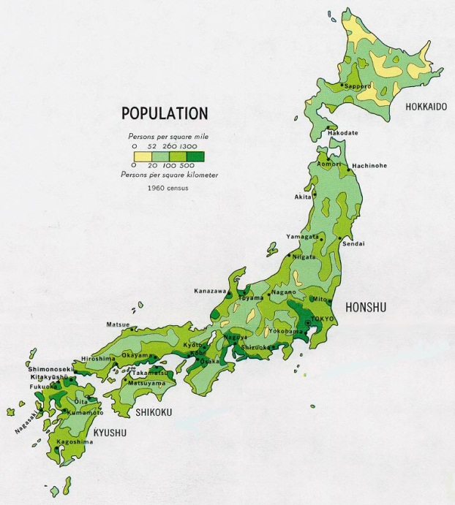
Geography and Early Japan
Chapter 8, section 1

Slide 2
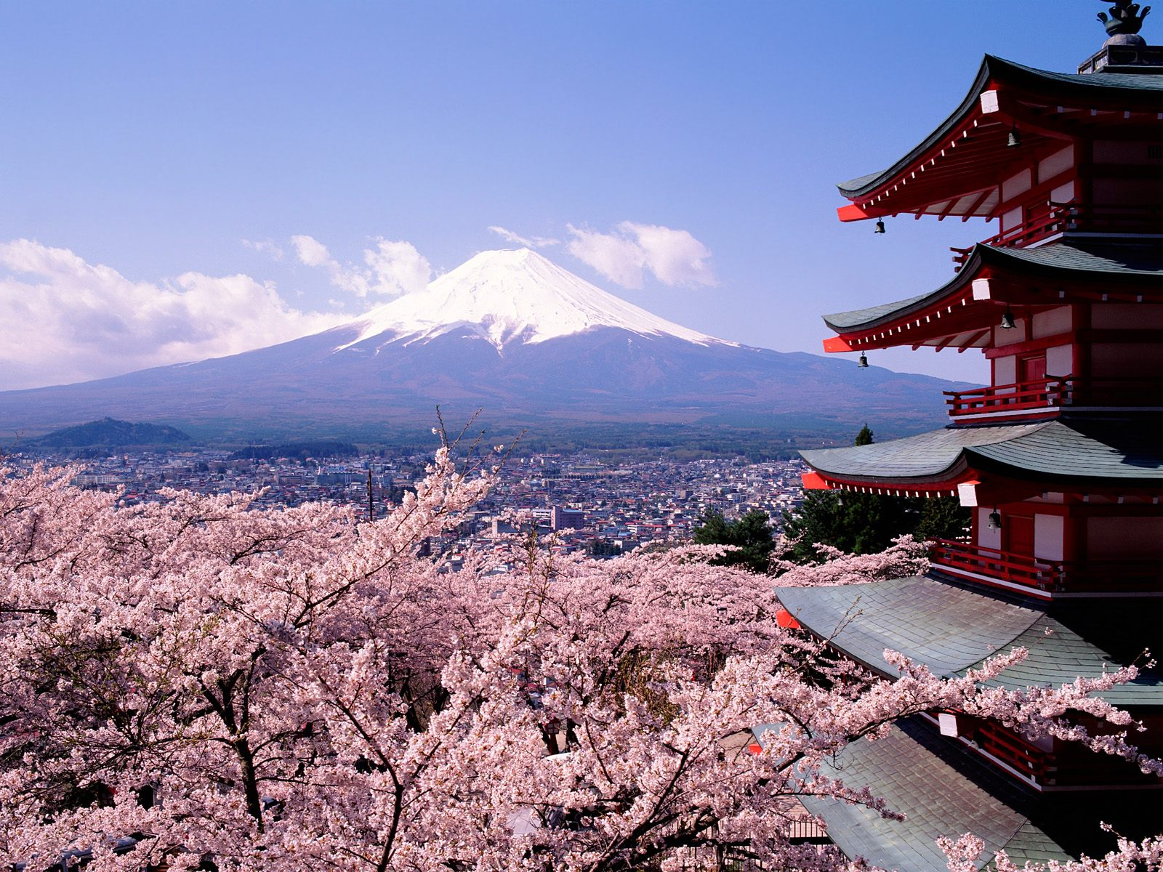
Topic Question
How did early Japanese life change after the influence of China and Korea?

Slide 3
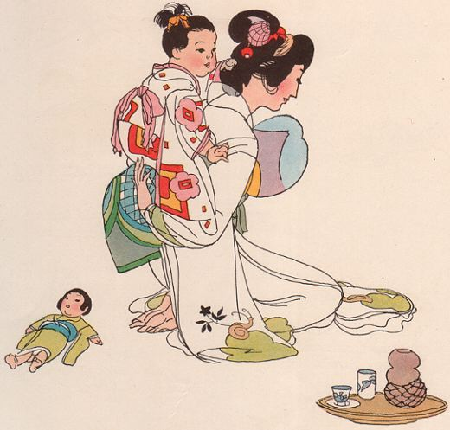
The Big Idea
Japan’s earliest societies were both isolated from and influenced by China and Korea.

Slide 4
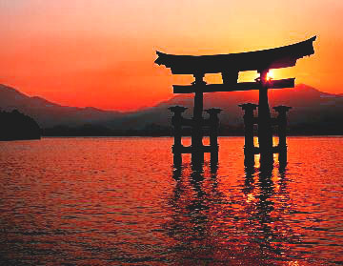
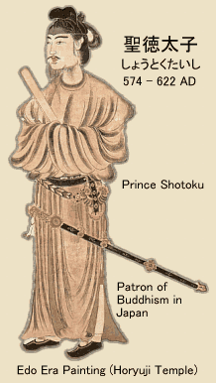
Vocabulary
Clan
Shinto
  Read green box p 200
Prince Shotoku
  Read Biography p. 202
Regent

Slide 5
Geography of modern Japan
Use your devices and go to this website:
How close is Korea? China?
What is the highest mountain?
What are the bodies of water around Japan?
How many sea ports are there?
What is the country’s capital?
http://www.mapsofworld.com/japan/

Slide 6
Geography shapes Life in Japan
What are the islands of Japan?
What percentage of the land is flat?
What is the most important geographic feature to the Japanese?
What makes up most of the Japanese diet?

Slide 7
Early Japanese Society
The earliest Japanese had:
a. lots of contact with the mainland
b. little contact with the mainland
c. no contact with the mainland

Slide 8
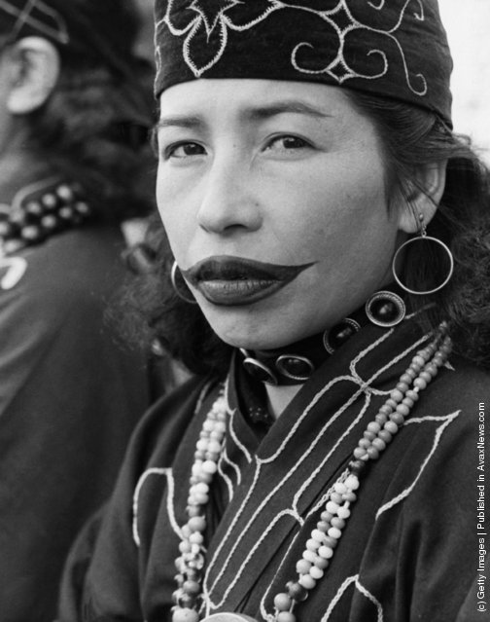
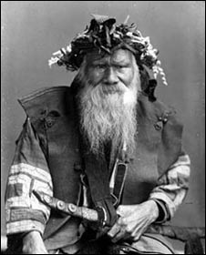
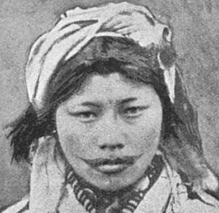
The Ainu
Pronounced EYE-noo
Where were they from?
How were they different?
Where do they live?
Any similarities to America?

Slide 9
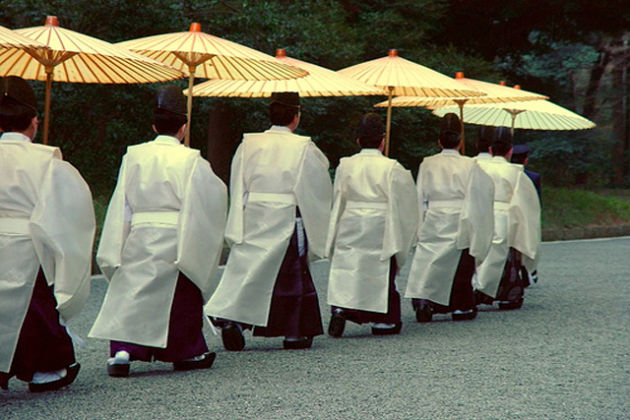
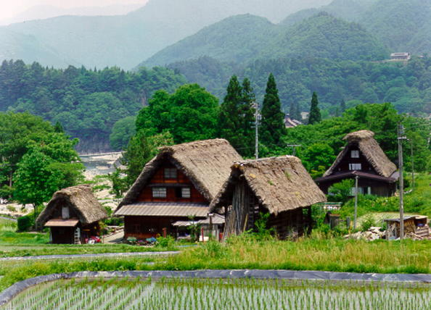
The First Japanese
Small farming villages
Who ruled the villages?
What was the ruler called?
What were the duties of the ruler?
Japanese honored their ancestors
From what were they descended?
What are the beliefs?

Slide 10
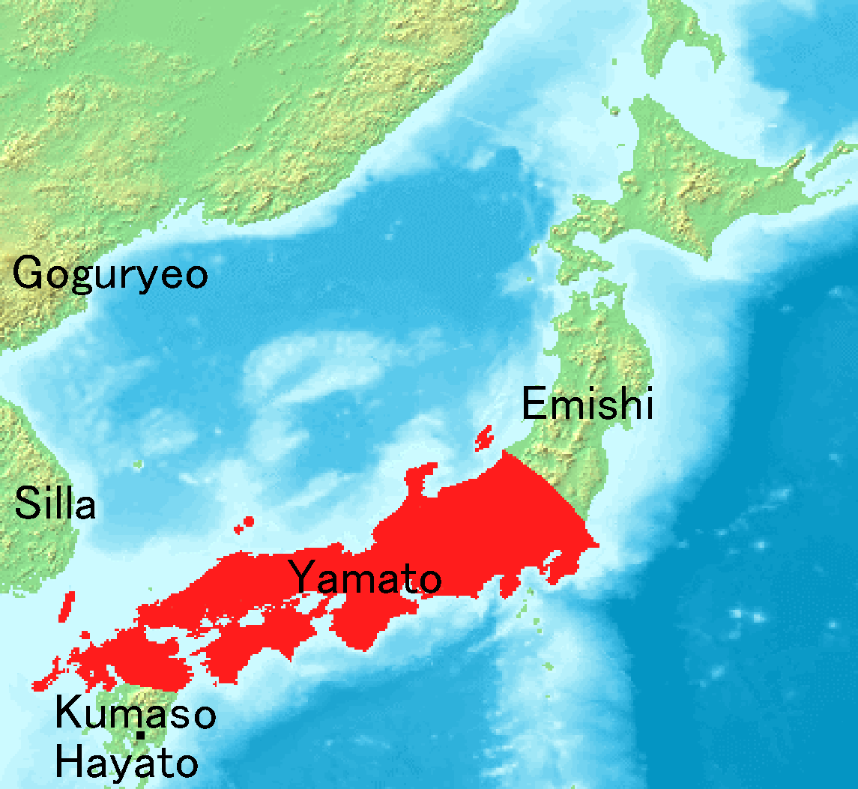

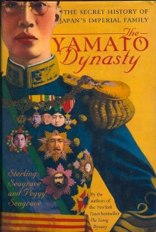
The First Emperors
Yamato rulers
What were their claims to power?
Where were they located?

Slide 11
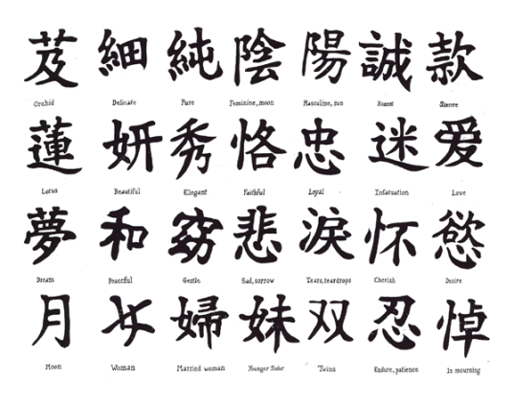

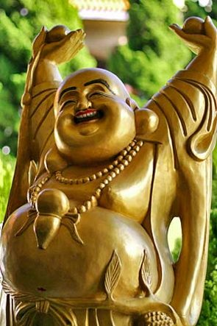
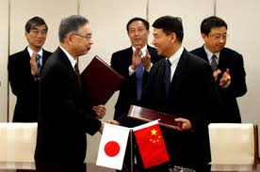
Japan Learns from Korea and China
Language
Religion
Philosophy
Government
Discuss how China and Korea affected each of these aspects of Japanese culture

Slide 12
Reflection
Refer back to the Topic Question.
Based on discussion write a 7 sentence paragraph answering the question.

