Slide 1
Growth of a Military Society
Chapter 8, section 3

Slide 2
Topic Question
What were the specific ruling details of Shoguns versus Samurai?

Slide 3
Big Idea
Japan developed a military society led by generals called Shoguns.

Slide 4
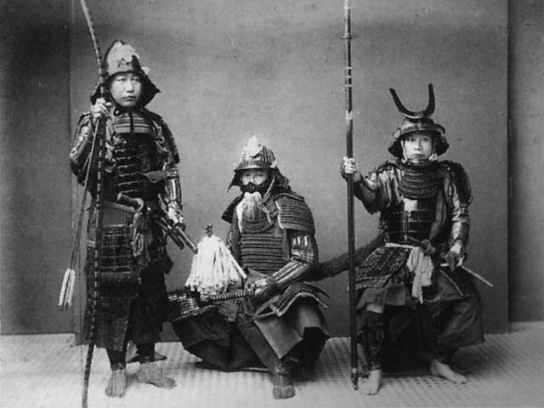
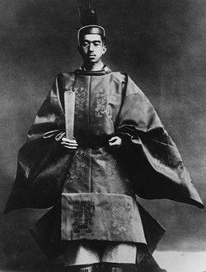
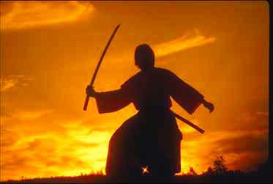
Vocabulary
Daimyo
Samurai
Quick Facts p. 213
Samurai box p. 214, 215
Figurehead
Shogun
Bushido

Slide 5
Samurai and Shoguns take over Japan
What events led to problems in Japan?

Slide 6
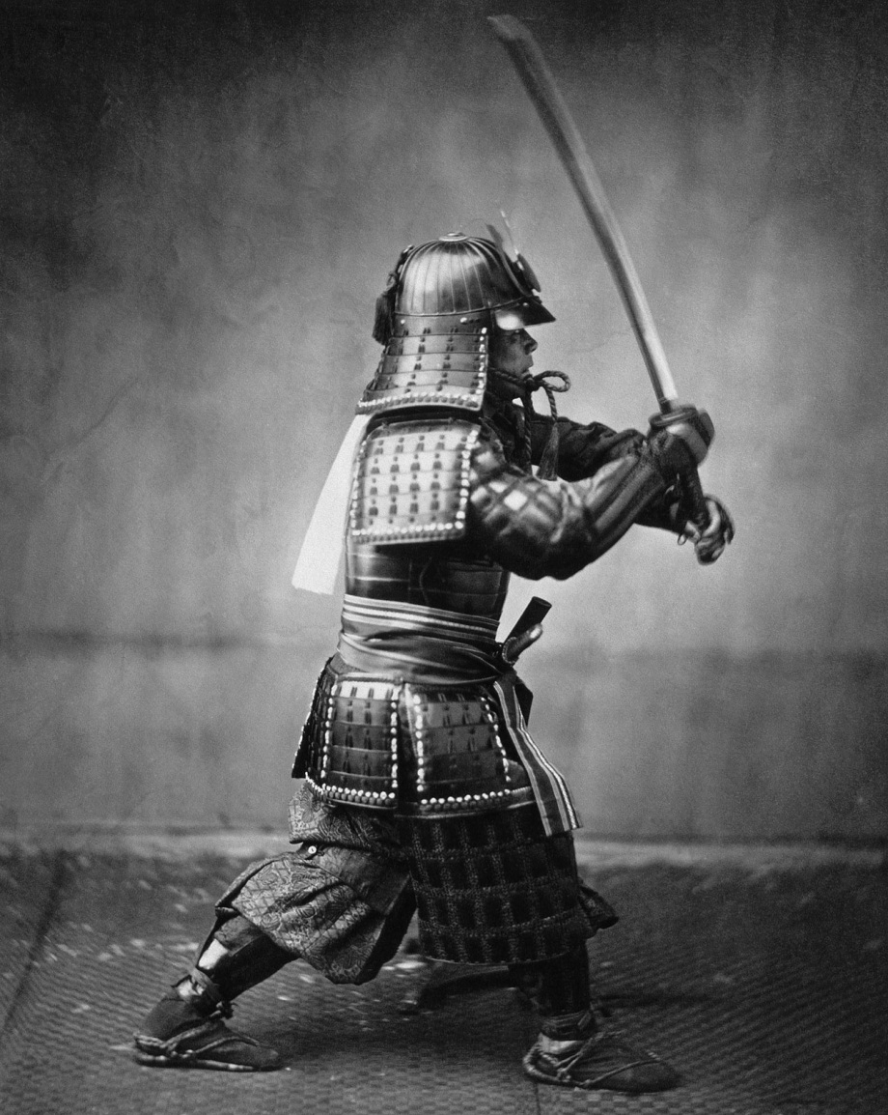
Rise of the Samurai
With the Emperor distracted at court, landowners took matters into their own hands…
What did they do?
Who did they hire?
How did they pay them?

Slide 7
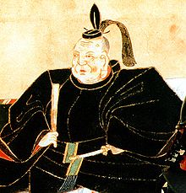
Shoguns rule Japan
Many landowners and nobles were dissatisfied with how the Emperor was ruling Japan. They saw him as an absent monarch.
What clans went to war?
How long did the clans fight?
Who won?
What did they do with the Emperor?
What title did the new leader take?

Slide 8
Samurai live Honorably
As the Shogun ruled, Samurai warriors became very popular and important to Japanese society. But they also had to follow a certain set of rules for behavior. This code was called…

Slide 9
Bushido
Requirements of the Bushido:
1.
2.
3.
4.
5.
How is the Bushido important to modern Japan?

Slide 10
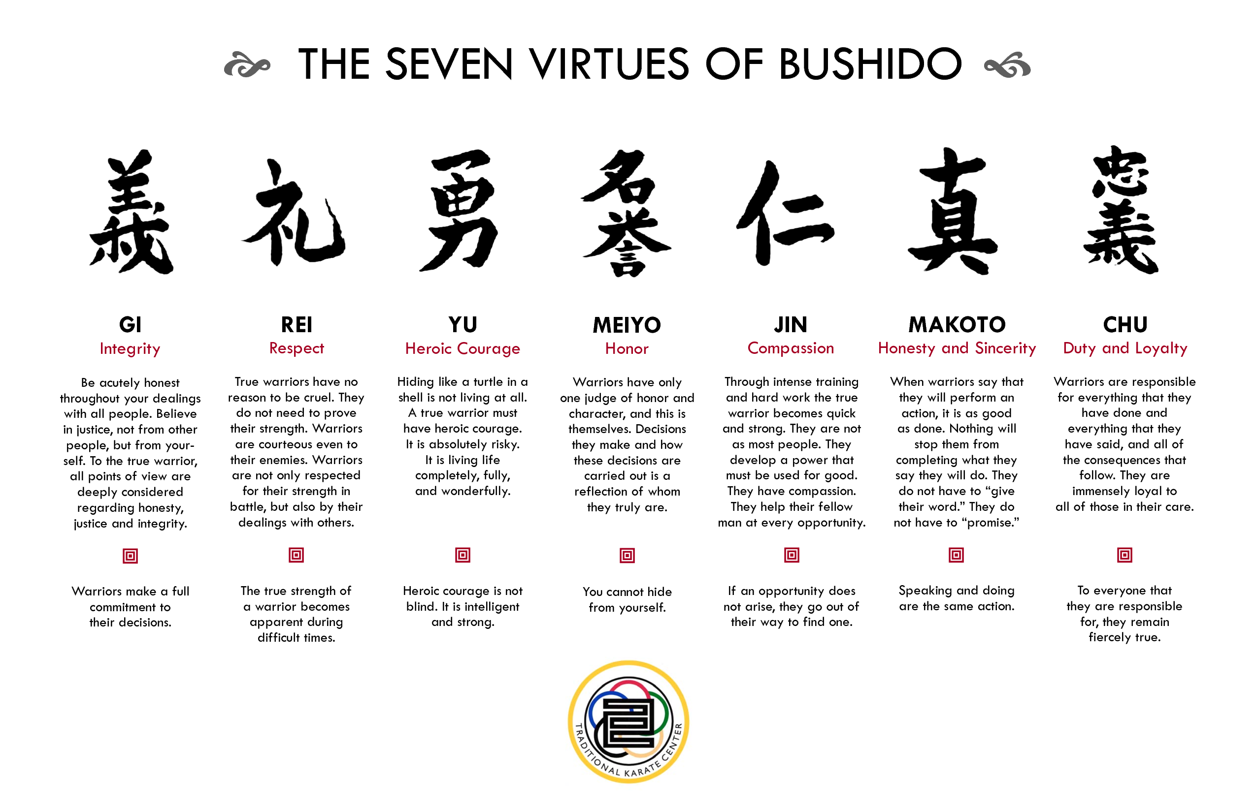

Slide 11
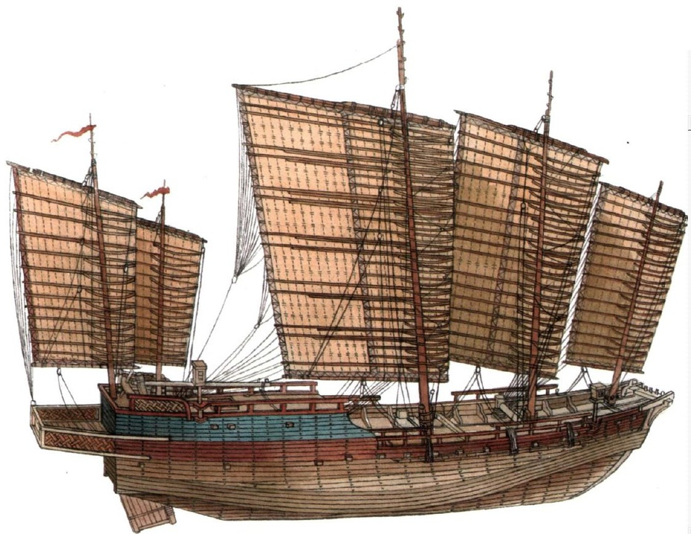
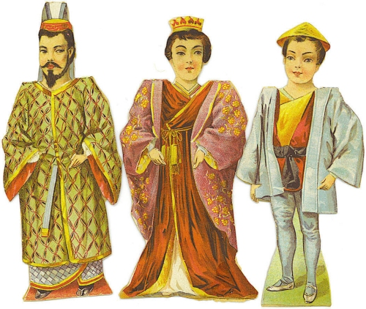
Order Breaks Down
Foreign Invasion
Who invaded Japan? Dates?
Who was China’s Emperor?
What helped the Japanese? Name?
Internal rebellion
Who battled the Shogun?
Who ended up ruling Japan?

Slide 12
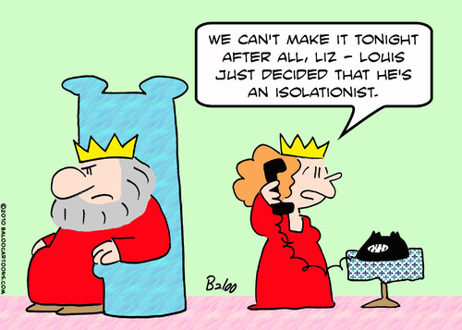
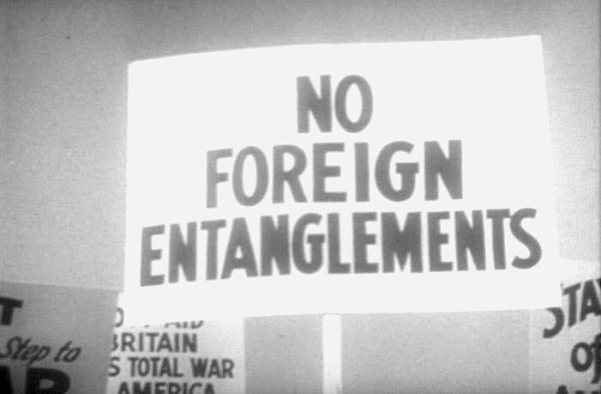
Strong Leaders Take Over
Unification
Oda Nobunaga
Tokugawa Ieyasu
Who helped them?
What did they give them?
Isolation
What did the Shogun do in 1630?
Why did he do it?

Slide 13
Reflection
Refer back to the Topic Question.
Based on discussion write a 7 sentence paragraph answering the question.

