Slide 1
Feudalism and Manor Life
Chapter 9, section 3

Slide 2
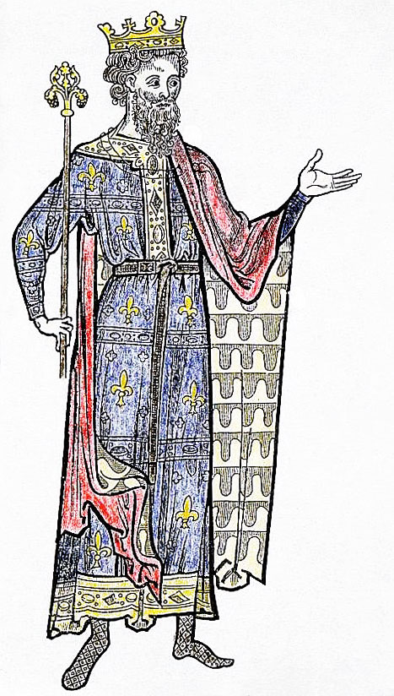

Topic Question
Discuss the basic structure of feudalism and how it worked.

Slide 3
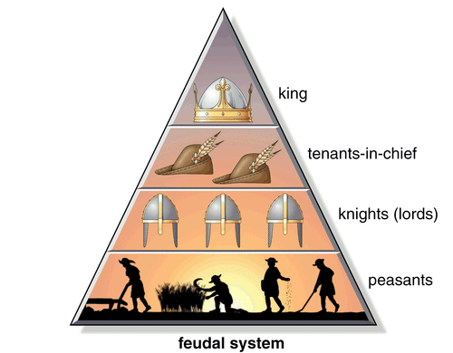
The Big Idea
A complex web of duties and obligations governed relationships between people in the Middle Ages.

Slide 4
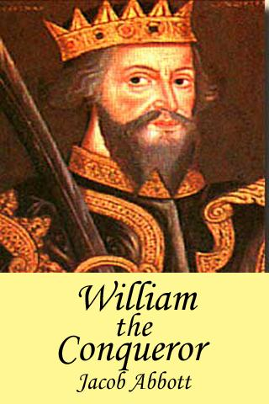
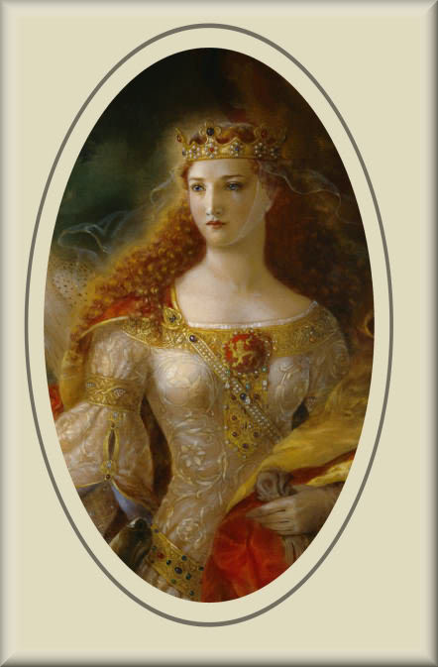
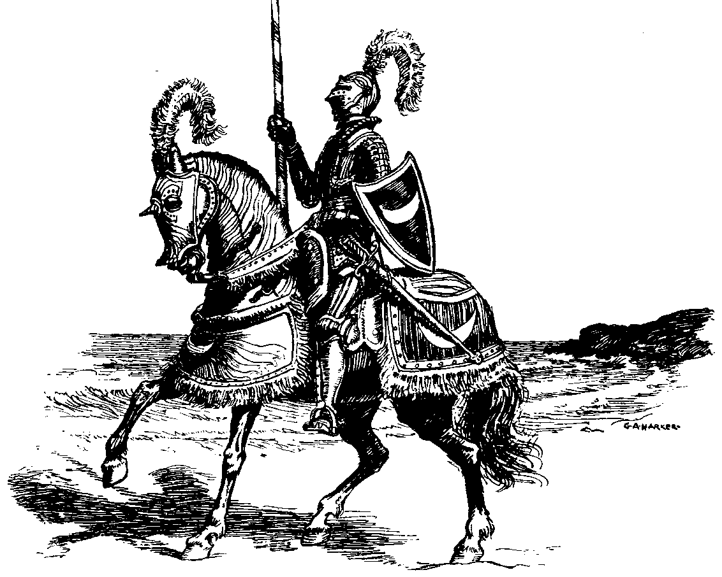
Vocabulary
Knights
Vassal
Feudalism
  P. 243 Feudal Society
William the Conqueror
Manor
  P. 244-245
Serfs
Eleanor of Aquitaine
  P. 246 bio

Slide 5
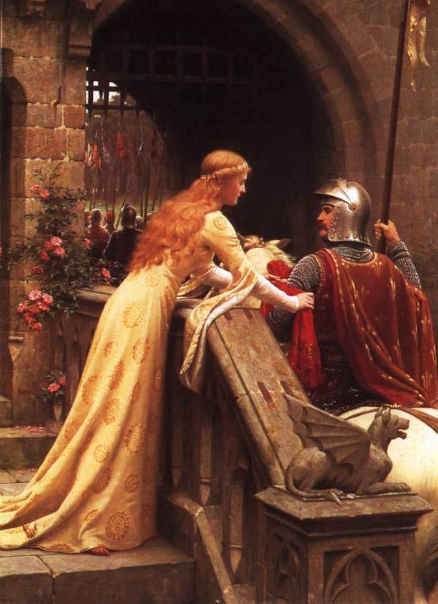
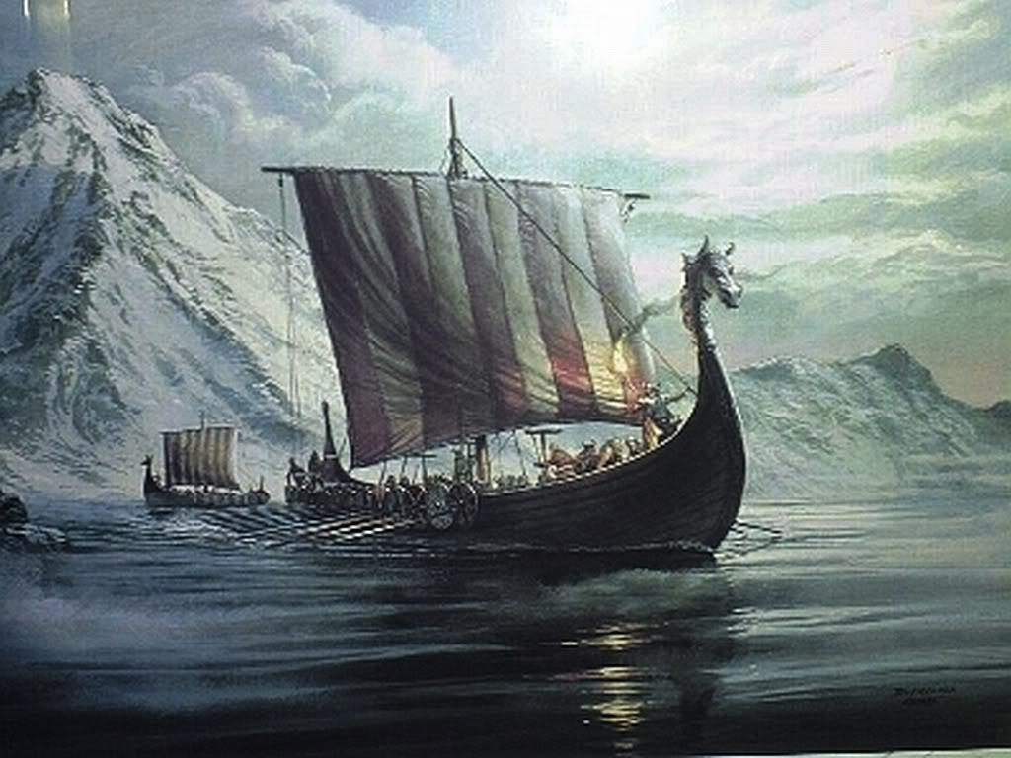
Feudalism Governs Knights and Nobles
Invaders became a large problem for Europeans.
Name the invading tribes
How did the king help?
How did nobles respond?

Slide 6
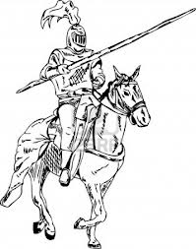
Knights and Land
For Nobles to defend their land they needed…
List the needed supplies:
What did the nobles give to their soldiers?
What did the solider owe the noble?
A noble became a ________
A knight became a _______
This system is called ______

Slide 7
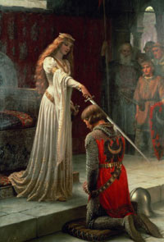
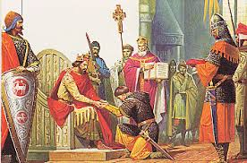
A Lord’s Duties
A Lord had many responsibilities to his people and his vassals.
Lord to Vassal
Lord to Land/People

Slide 8
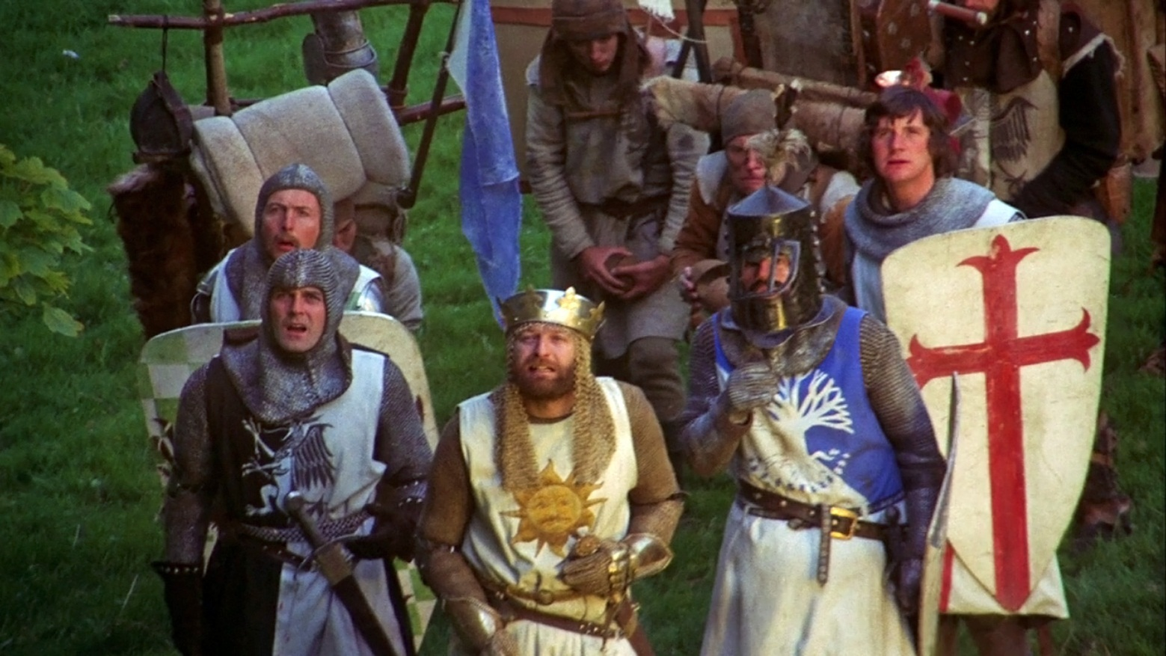
A Vassal’s Duties
A vassal had many responsibilities to his lord.
List what a vassal was required to do:
How could a vassal become a lord?

Slide 9
Feudalism Spreads
Who created Feudalism?
Who brought Feudalism to England?
In what year did the Normans invade?
What was the leader’s name?
How did he reward his knights?

Slide 10
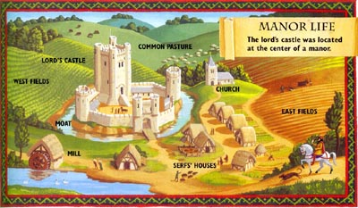
The Manor System
When a knight received a fief from his lord he needed someone to work it.
Describe the system that was created.

Slide 11
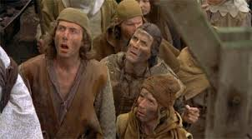
Peasants, Serfs and other Workers
How much land was a serf allowed?
What did the serfs receive for their work?
Discuss the different gender jobs.
Men
Women
Children

Slide 12
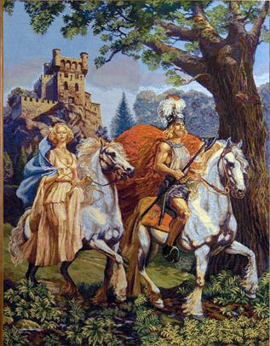
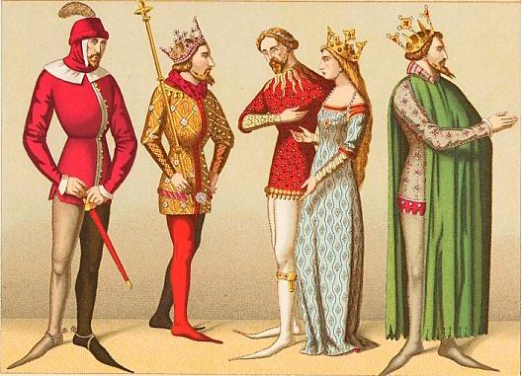
Manor Lords
Discuss the responsibilities of a Manor Lord

Slide 13
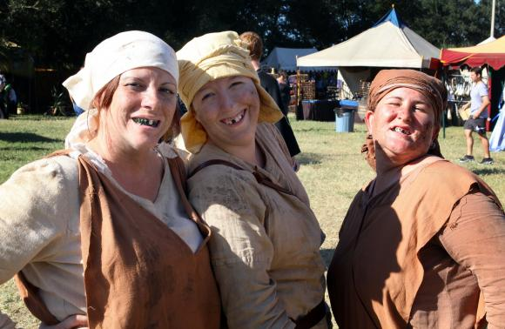
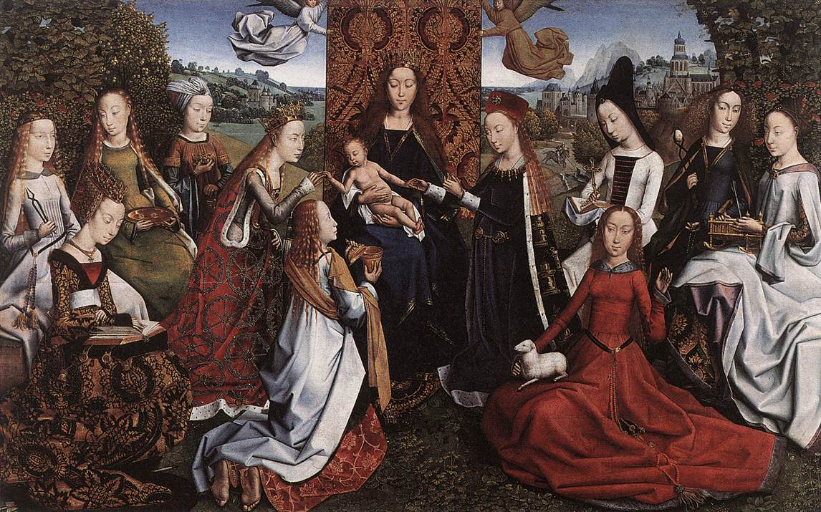
Women in the Middle Ages
What were women required to do?
What were the roles of a:
  Peasant woman
  Noble woman

Slide 14
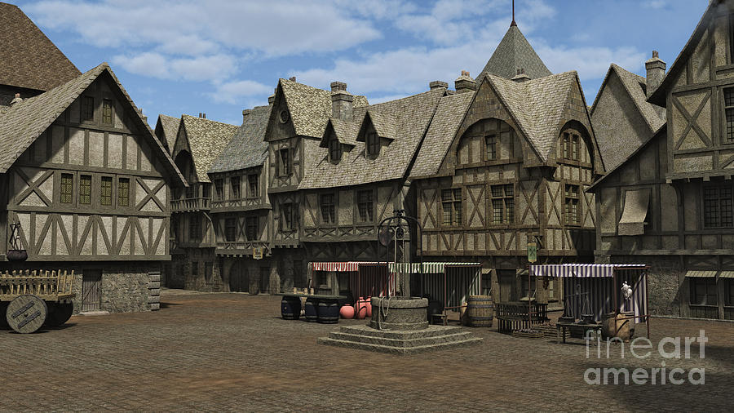
Towns and Trade Grow
What led to the growth of Medieval TOWNS?

Slide 15
Reflection
Refer back to the Topic Question.
Based on discussion write a 7 sentence paragraph answering the question.

