Slide 1

District Interim Assessment
2015 Quarter 01

Slide 2
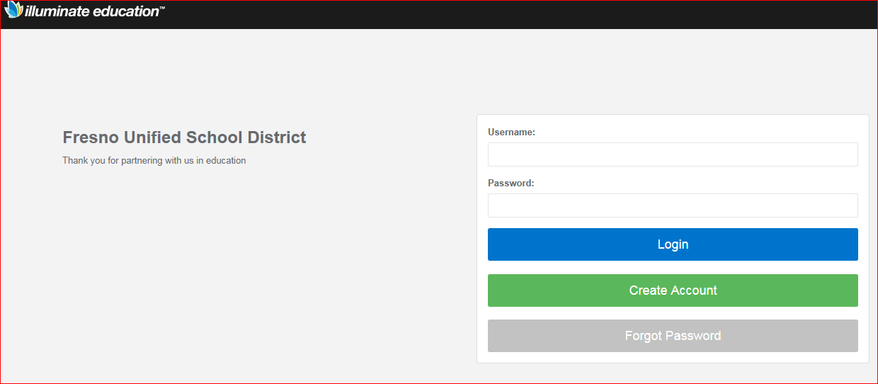
Steps to Start the Assessment
Turn on devices and log into device.
Go to one of the following:
  go.fresnounified.org/iAssess
  fresnounified.illuminatehc.com/login
It should look like this
Log in with you 4-character login
Do not include the @fresnou
Do not include the @edisoncomputech

Slide 3
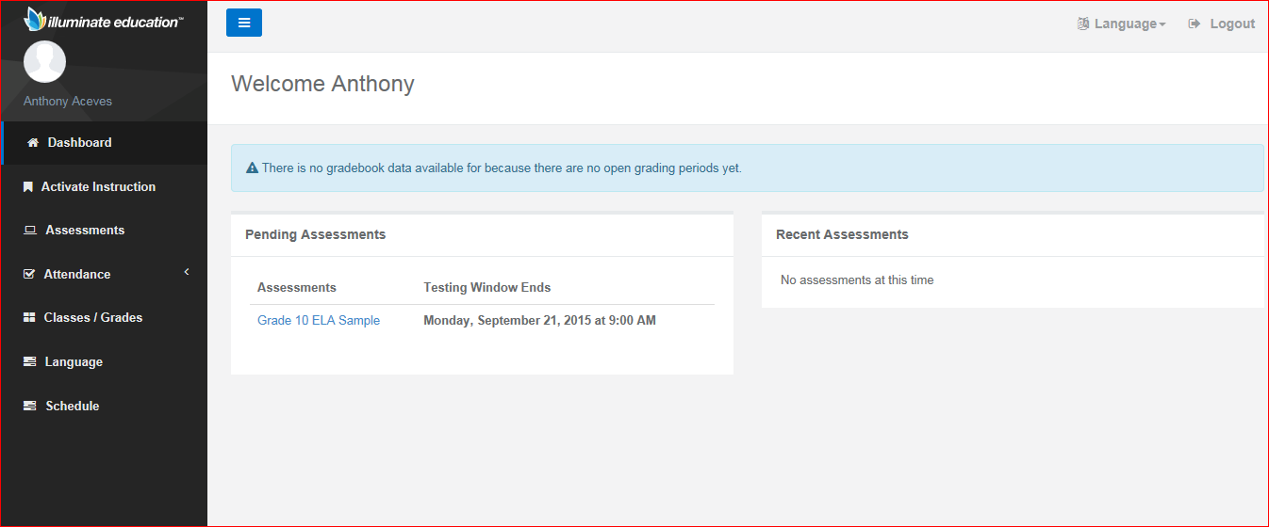
Steps to Start the Assessment
It should show both of the district interim assessments.
Click on the assessment for the class in which you are currently.
  If you are in ELA/CORE click on the ELA Assessment.
  If you are in MATH class, click on the MATH assessment.
It should look like this
Once the test begins, students only have 3 pauses (including at the end of each day), so limit restroom breaks.

Slide 4
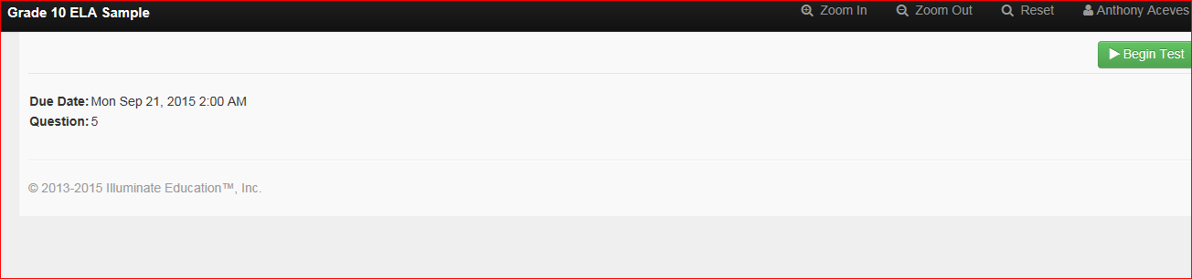
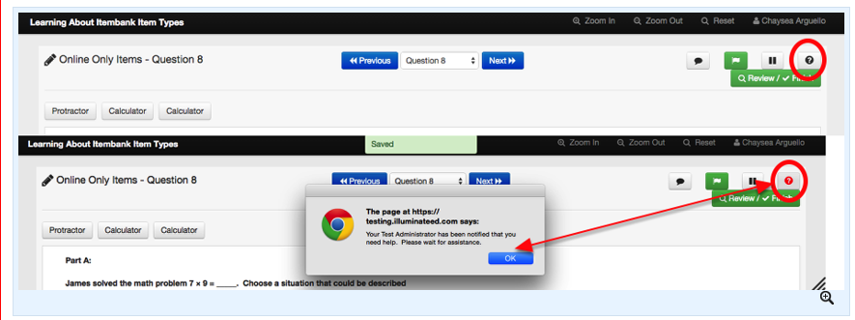
Begin Test when teacher prompts…
1
2
3
Index of Buttons
1: Zoom in
2: Zoom out
3: Reset
4: Notes
5: Flag item
6: Pause
7: Help (sends notification to proctor)
8: Review/Finish
5
6
7
4
8

Slide 5


At the end of Day 01
Click on the Pause Button
Log out of the website
Close your browser

Slide 6
When you are completely finished.
Click on the Review/Finish button

