Slide 1
District Interim Assessment
Turn on devices.
Log in to device.

Slide 2
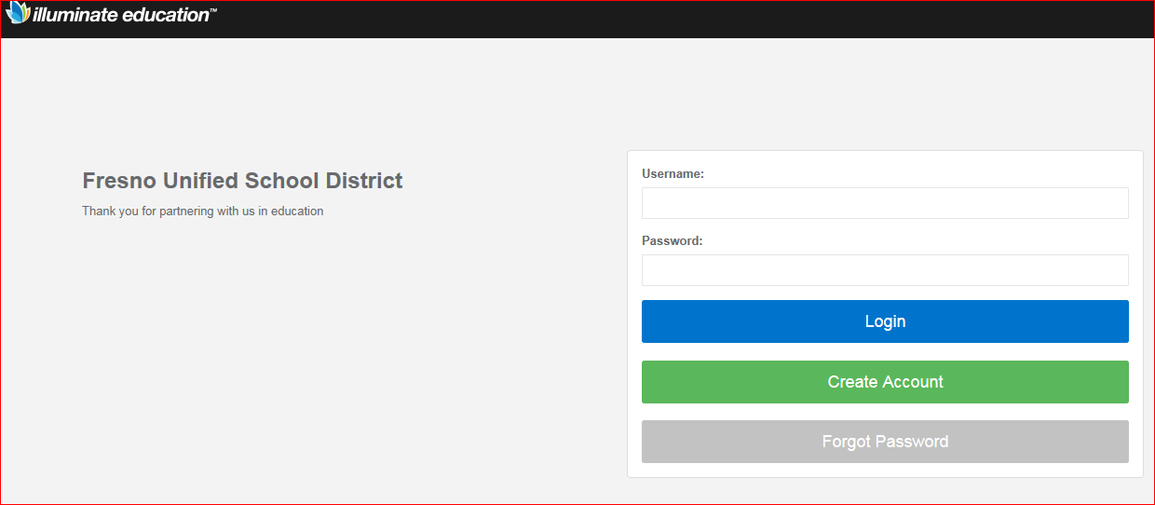
District Interim Assessment 01
Go to: Go/iAssess
If that does not work, go to:
fresnounified.illuminatehc.com/login
Student Logins
Username: Shortname (4-characters)
Password: District password
Teachers can access list of student logins by going to: Go/studentlogins

Slide 3
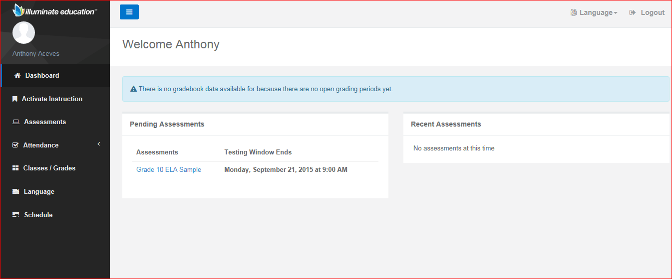
District Interim Assessment 01
Upon entering the student site, students will see links for assessments that have been assigned to them. They will click on these links to get started with the test.

Slide 4
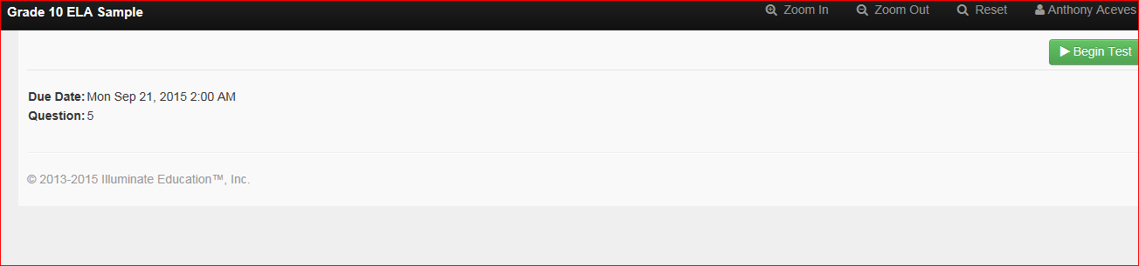
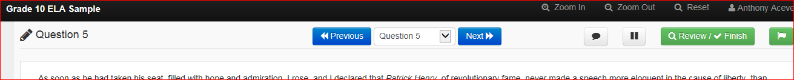
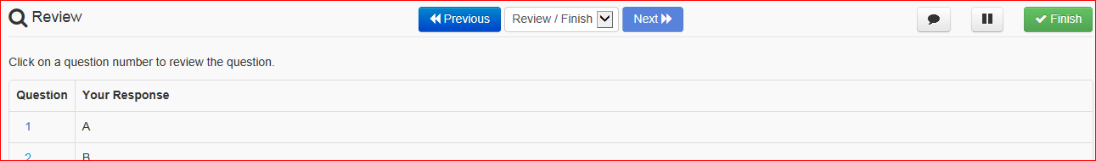
Student Views

Slide 5
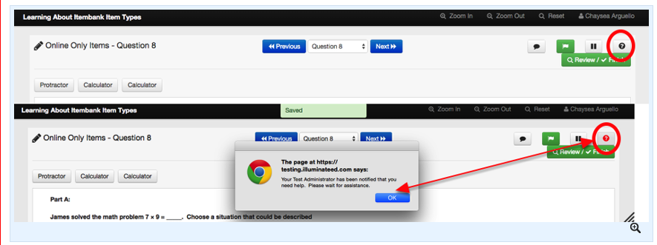
Summary of student Test Tools
1
2
3
5
6
7
4
8
1: Zoom in
2: Zoom out
3: Reset
4: Notes
5: Flag item
6: Pause
7: Help (sends notification to proctor)
8: Review/Finish

Slide 6
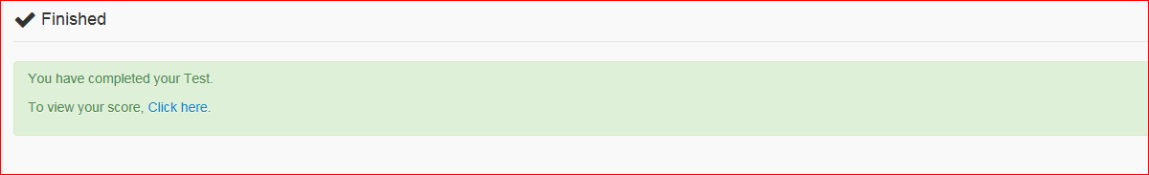
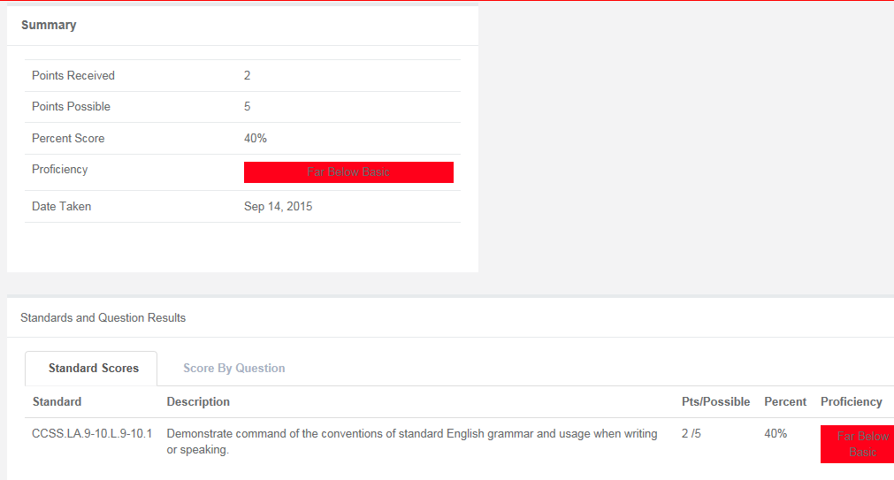
Student View

Slide 7
Click pause. Log out.
End of the day.

