Slide 1
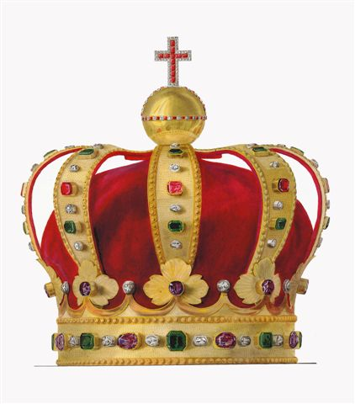
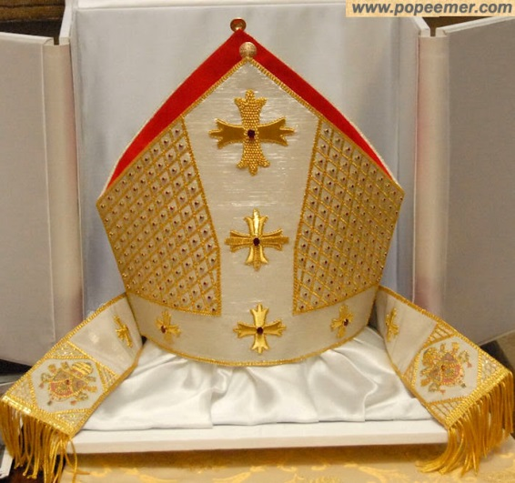
Popes and Kings
Chapter 10, section 1

Slide 2
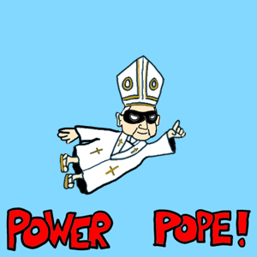
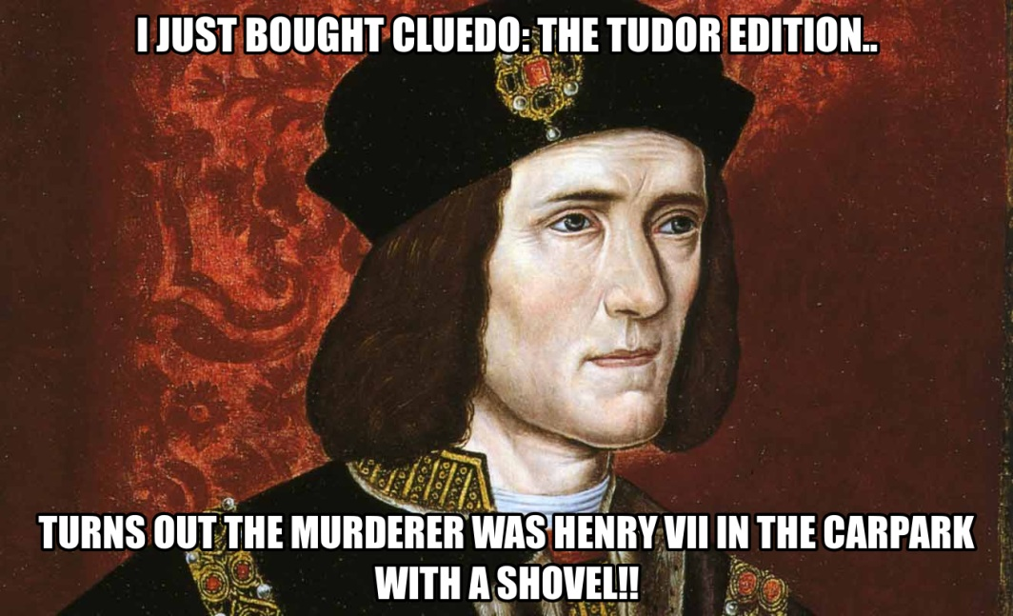
Topic Question
What were the powers of popes and kings, and how did these powers lead to conflict?

Slide 3
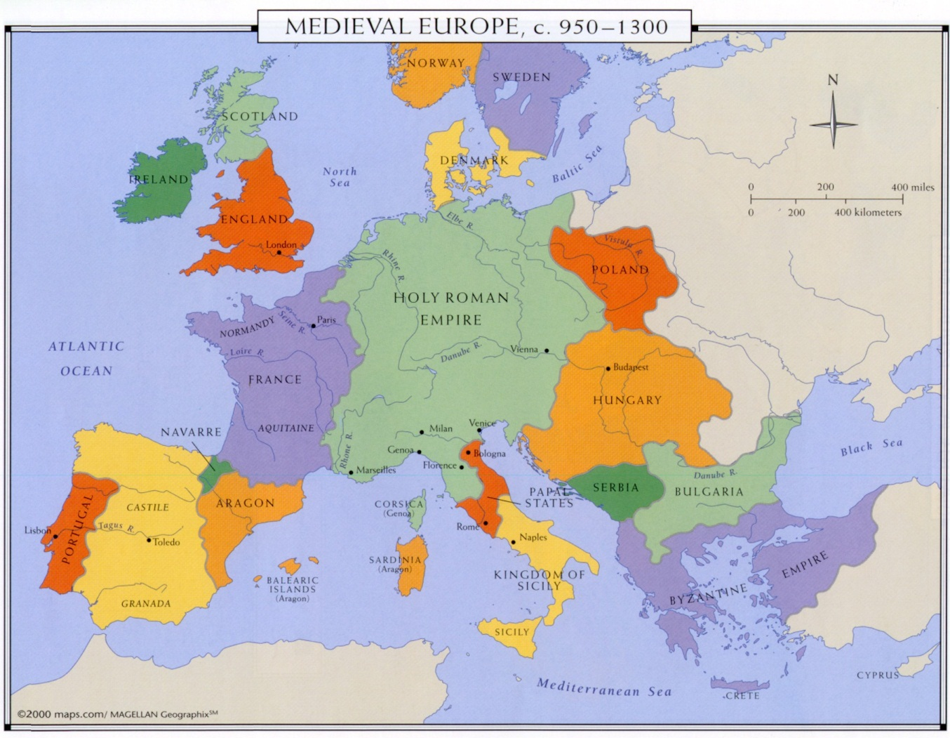
The Big Idea
Popes and Kings dominated European society in the Middle Ages.

Slide 4
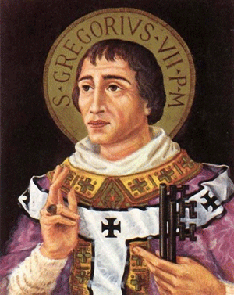
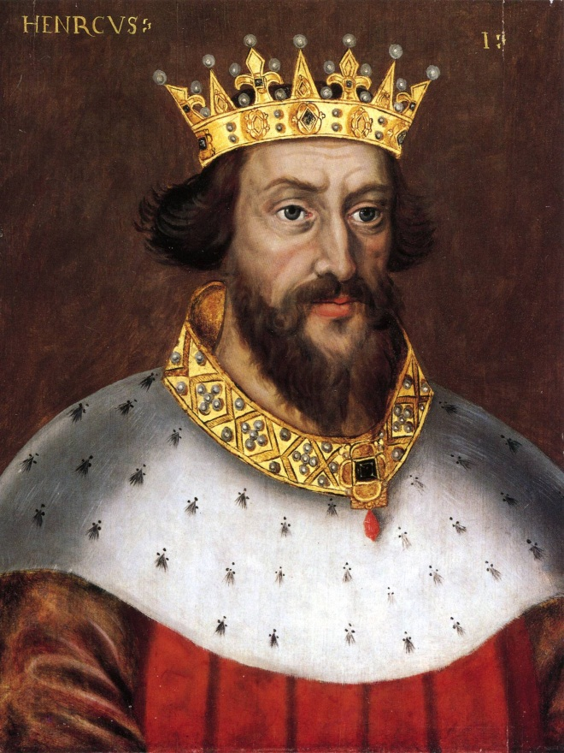
Vocabulary
Excommunicate
Pope Gregory VII
Map p. 261
King Henry IV
POV p. 262

Slide 5
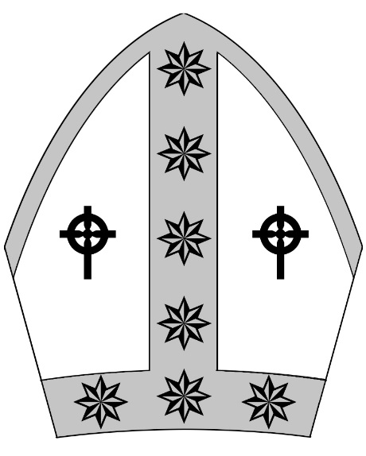
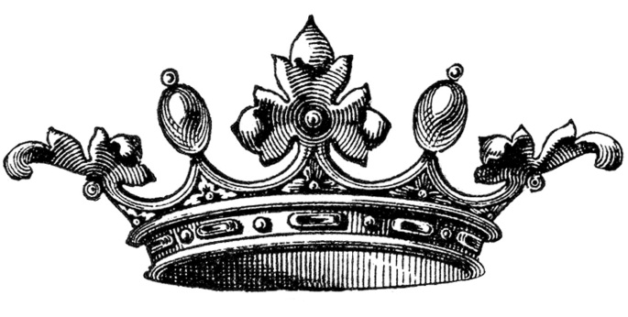
Popes and Kings Rule Europe
In the early Middle Ages…
Who had the most power?
Power shifted to be held by two types of leaders…
What kind of power did each wield?

Slide 6
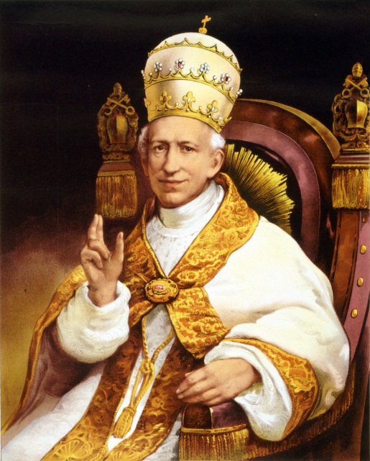
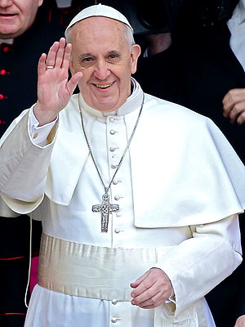
The Power of Popes
Describe the Pope:
How is he seen?
Who does he lead?
What were his duties?
Why was excommunication
such a big deal?
What powers does he have?

Slide 7
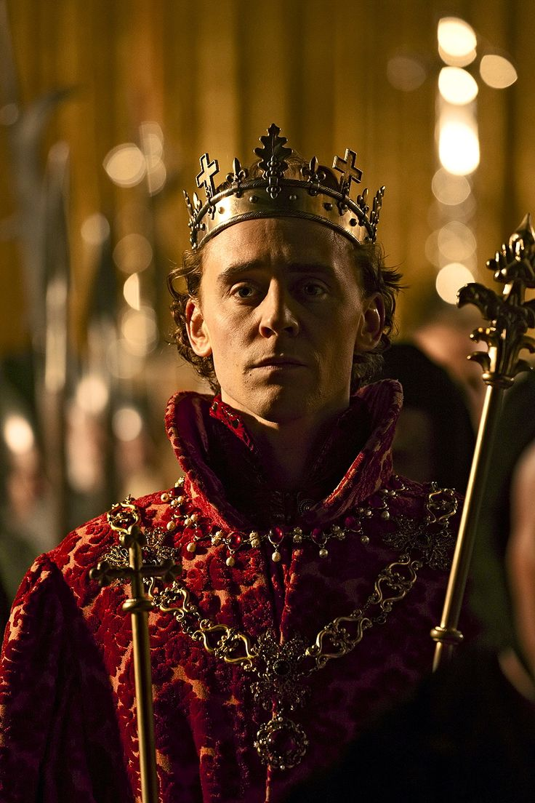
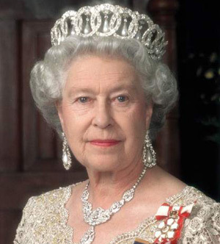
The Power of Kings
Describe Kings:
Who are the most powerful in Europe?
Who do they lead?
What were their duties?
How did kings obtain their titles?
What powers do they have?

Slide 8
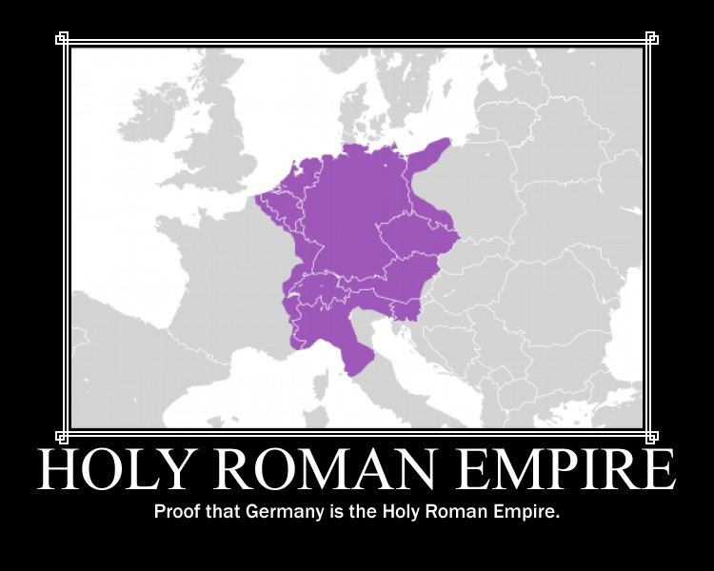

The Holy Roman Empire
Why was the Holy Roman Empire different?
How does the Pope exert power over the Empire?
How are emperors chosen?

Slide 9
Popes fight for Power
Western Europe saw the Pope as the head of the Church but Eastern Europe disagreed…
Who was the Pope?
What were the bishops doing?
What did the Popes do about Eastern Europe?
What was the result of this decision?
List the two churches and their leaders

Slide 10
Kings and Popes Clash
In 1073 a new Pope came to power with his own ideas on power…
Who was Pope?
What was he upset about?
Who was King?
What was he upset about?
These two fought and the Pope chose to punish the king. What happened?

Slide 11
Reflection
Refer back to the Topic Question.
Based on discussion write a 7 sentence paragraph answering the question.

