Slide 1


Share it Forward
Donorschoose.org
Rachel Hibler
Computech Middle School

Slide 2

What is donorschoose.org?
Charitable website designed for classroom teachers to get supplies
78% of public school teachers use it
Stephen Colbert is on the Board of Directors
Started by a History Teacher
  2000
  Charles Best
$650,478,040
dollars raised
1,106,545
projects funded
27,080,324
students helped
76,799
schools participating
412,538
teachers funded
3,069,639
supporters

Slide 3

Donorschoose.org Mission Statement:
“We make it easy for anyone to help a classroom in need, moving us closer to a nation where students in every community have the tools and experiences they need for a great education.”

Slide 4
How does it work as a teacher?
Step 1: Teachers set up profile
Log on to the website and complete the profile set up.
Find your school in their database.
Most schools are listed and the information on low-income, socio-economic status served is already loaded
Choose what levels and subjects you teach
Write a short paragraph about your program and goals
Choose a picture

Slide 5
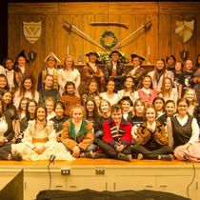
Step 1: Teachers set up profile
Classroom Description
Hi! My name is Mrs. Hibler and I teach Theatre and Forensics at Computech Middle School in Fresno, CA. This is the second year of all day drama at Computech and the program is growing quickly! We are so excited to be building a comprehensive theatre program which currently includes introduction to acting and a director's training program. We hope to add a Stage Craft class for students interested in backstage production work. Our Forensics team is a member of the National Speech and Debate Association and we compete at the middle school, high school and national levels.

Slide 6
How does it work as a teacher?
Step 2: Teachers write a project
Determine your needs
Write about how you plan to use the items in classroom
Go shopping with a variety of suppliers
  Best Buy
  Amazon Business
Projects can be for:
  Supplies
  Professional development
  Student Experiences

Slide 7
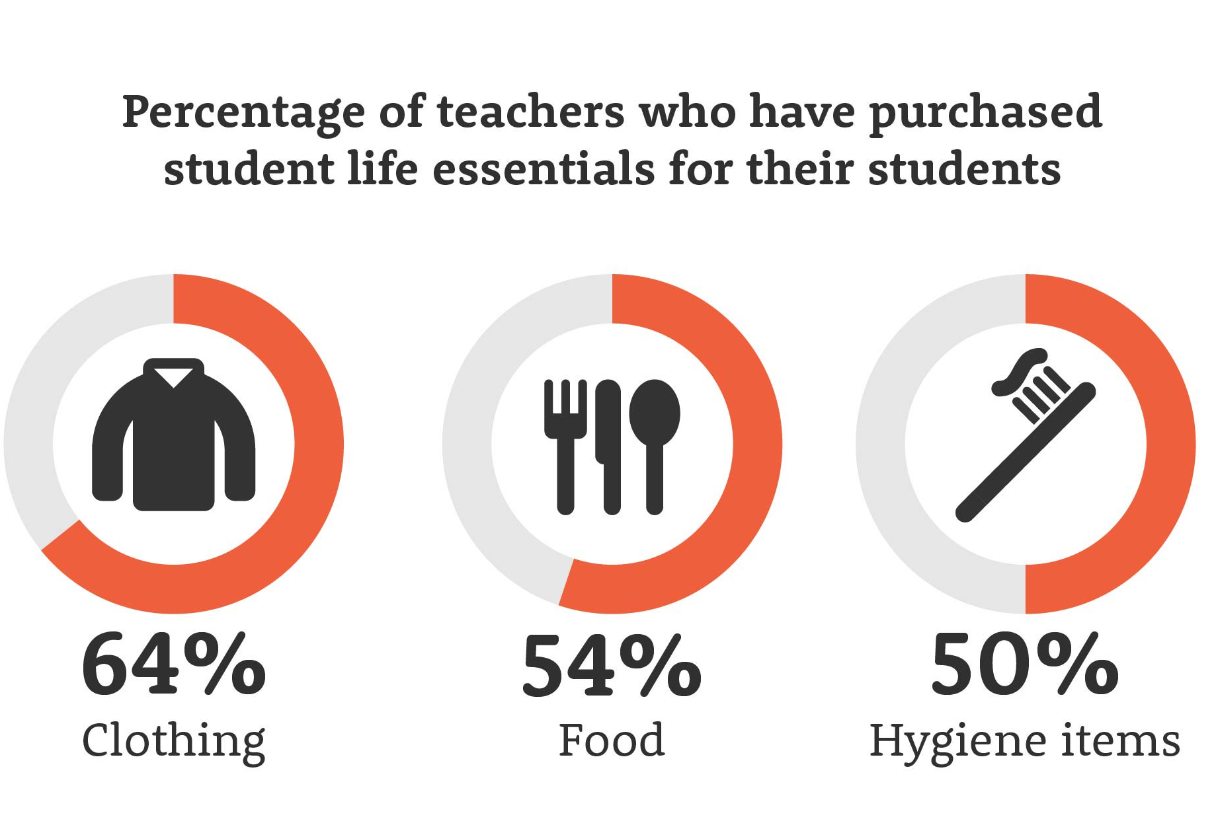
Step 2: Teachers write a project
Supplies don’t have to be for school projects, some teachers use the website for life essentials for their needy students
Clothing
Food
Hygiene
Backpacks
Pencils, paper

Slide 8
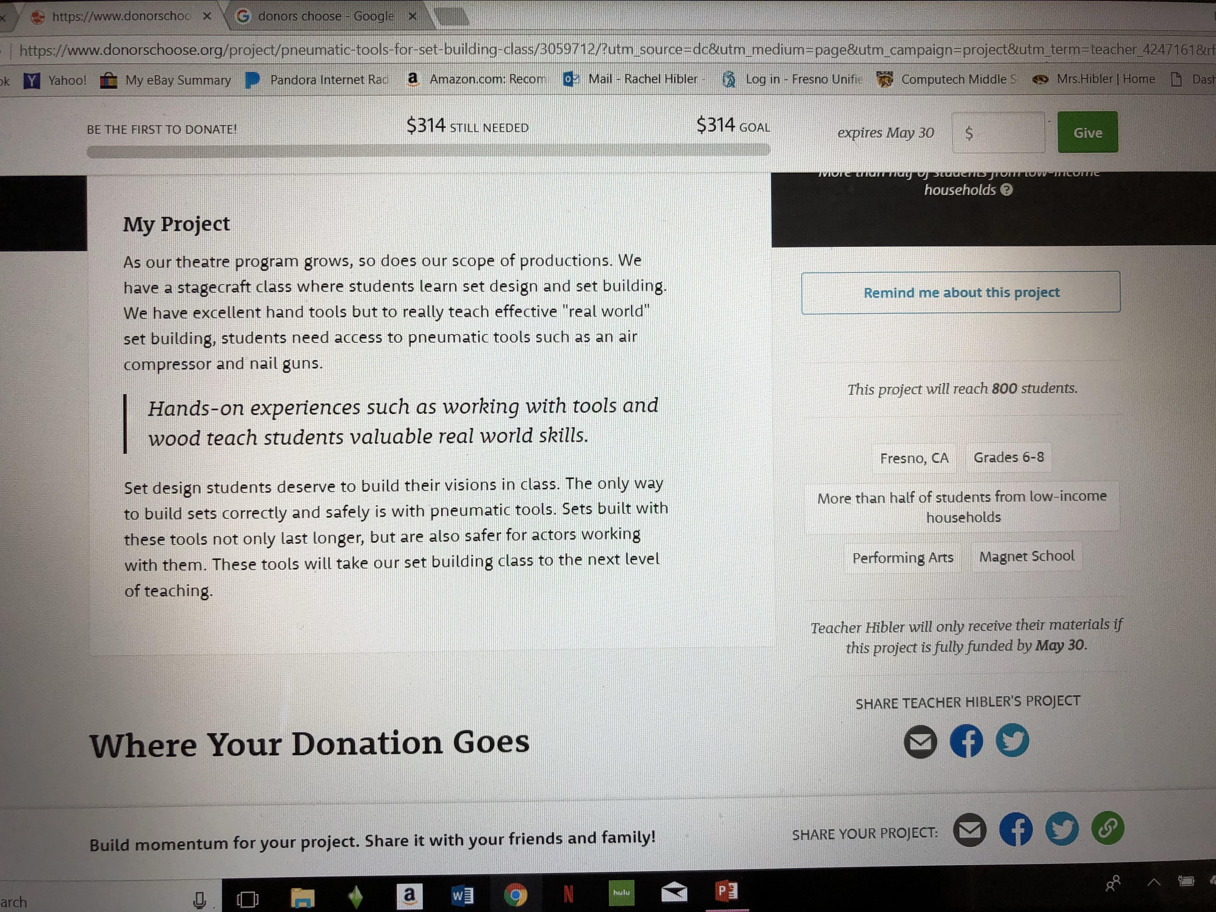
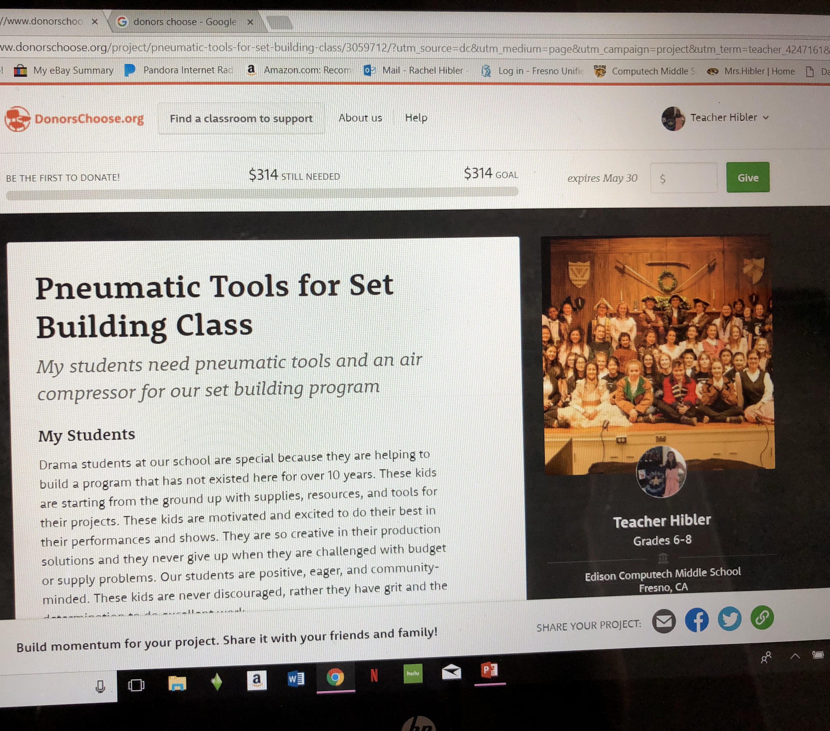
Step 3: Post the project

Slide 9
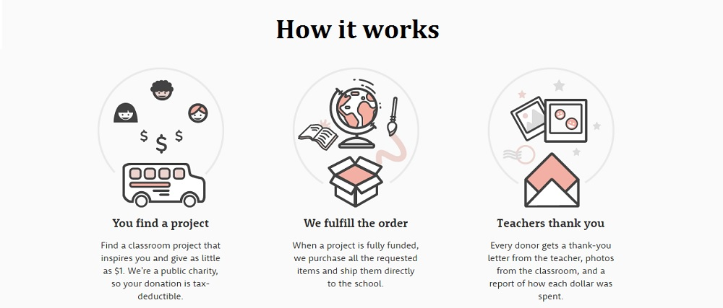
How does it work as a donor?

Slide 10
My Donorschoose.org projects funded
13 projects fully funded through donorschoose.org
  Costume construction sewing supplies $1172
  2 Props tables $200
  30 painting aprons $347
  Drama and Forensics Instruction books $298
  16 Walkies and headsets $575
  2 storage cabinets $869
  Set construction supplies $1282
  3 Wireless microphone systems $3625
  Pneumatic tool set $314
  Stage lights $390
  Costume closet organization supplies $939

Slide 11


Remarkable donations
Chevron
  fully funded 4 of my tech based projects
    3 wireless microphone systems
    Set building tool sets
  Actively seeks tech based projects
  Goes on the website regularly
Ripple
  Fully funded 3 of my posted projects
  Fully funded every posted project March 2018
  $29 million total given to 35,000 projects
  https://www.youtube.com/watch?v=wfw4FWJJVOQ

Slide 12
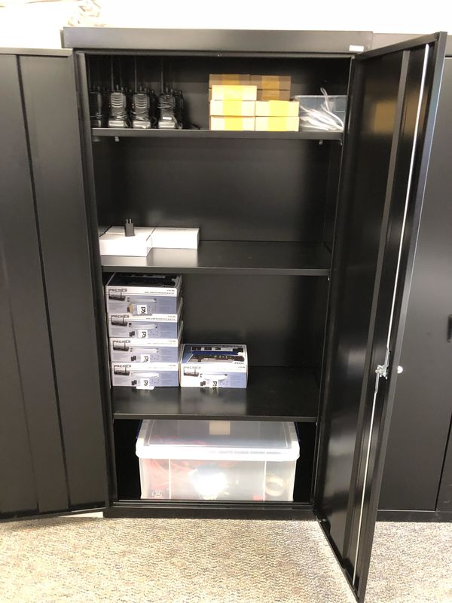
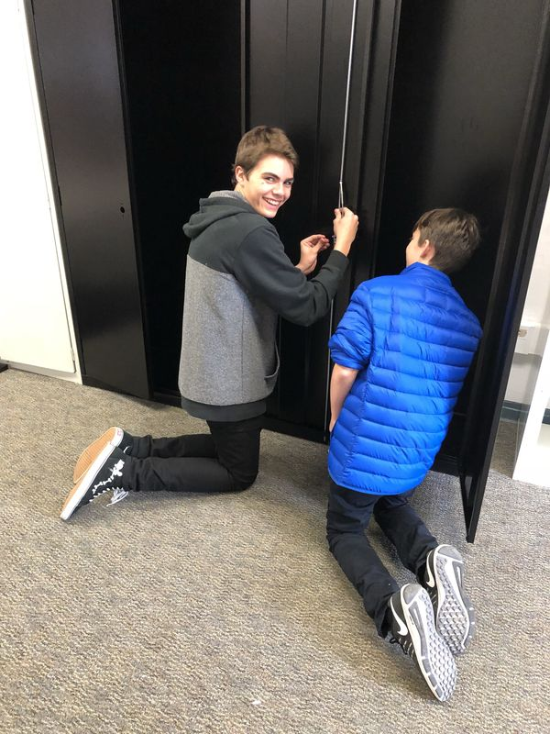
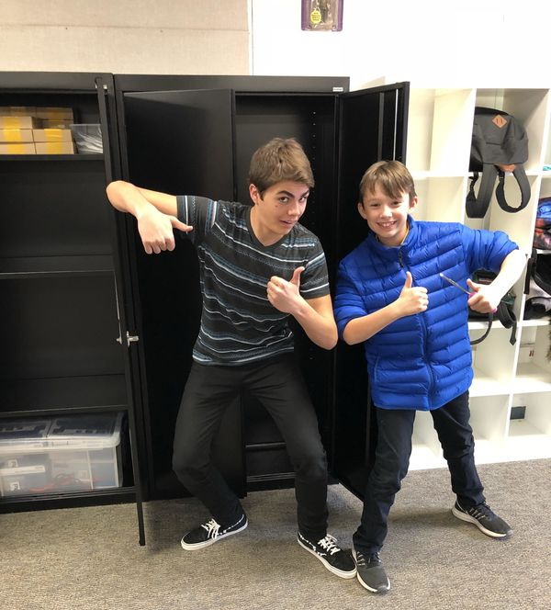
Josh and Nick put the cabinets together

Slide 13
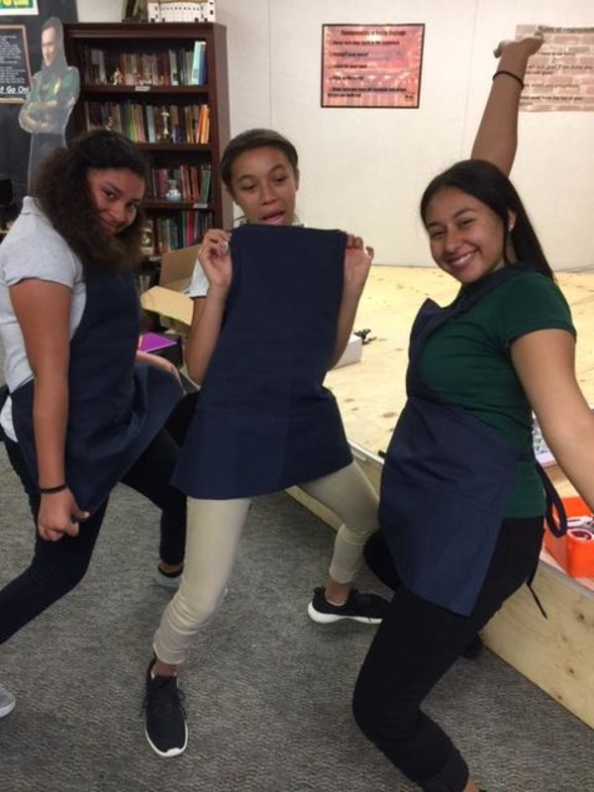
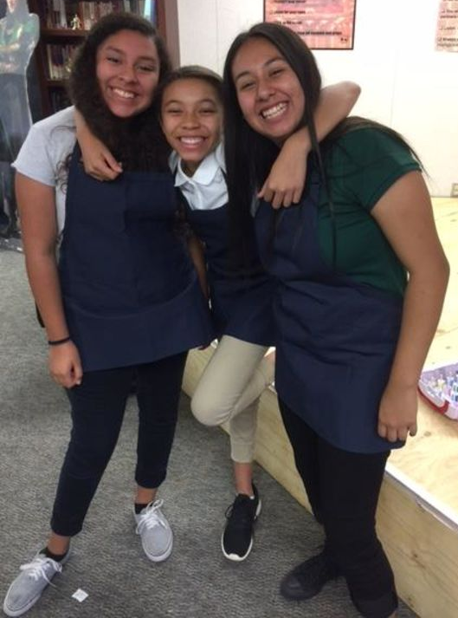
Jazmin, Rayven and Alissa loved modeling the aprons

Slide 14
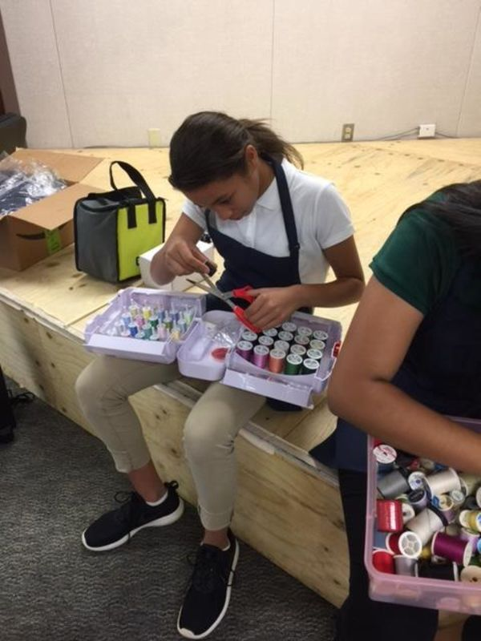
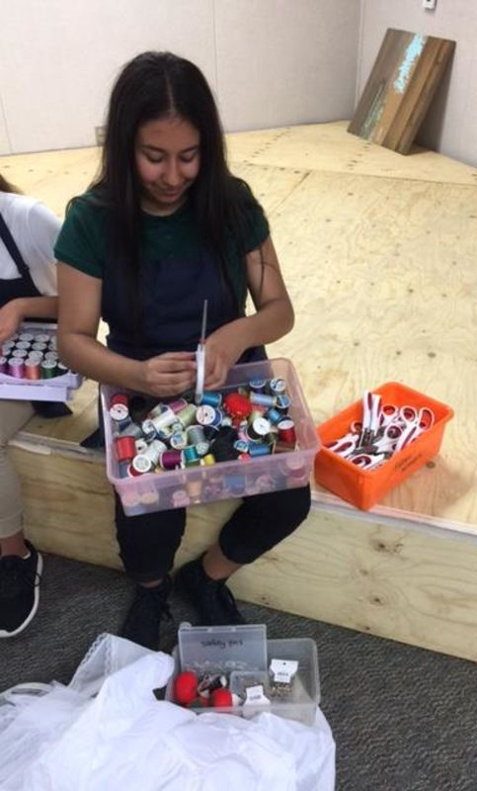
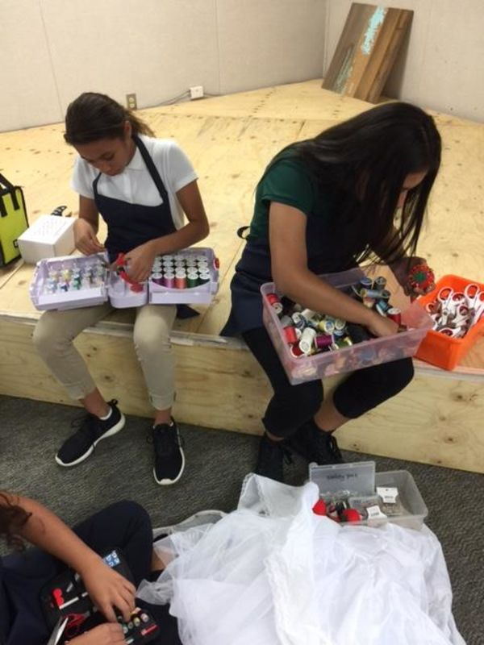
Then they got to work sewing

Slide 15
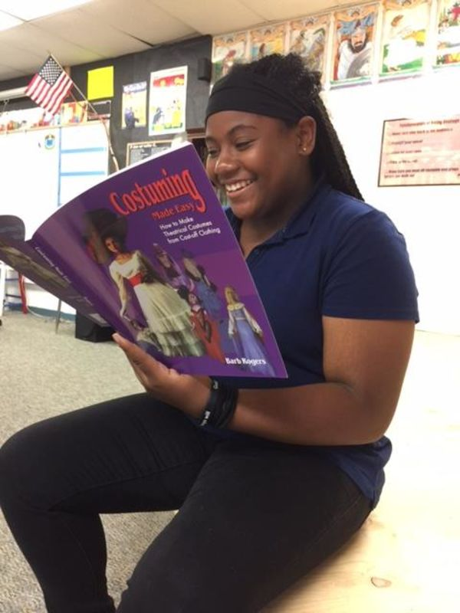
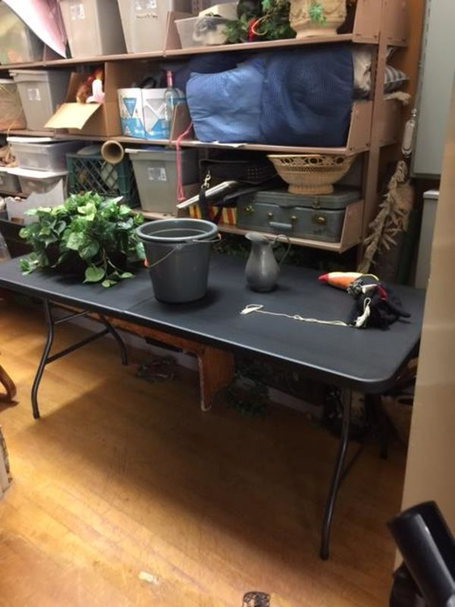
Kennedy reading about costuming and one of our props tables in use

Slide 16
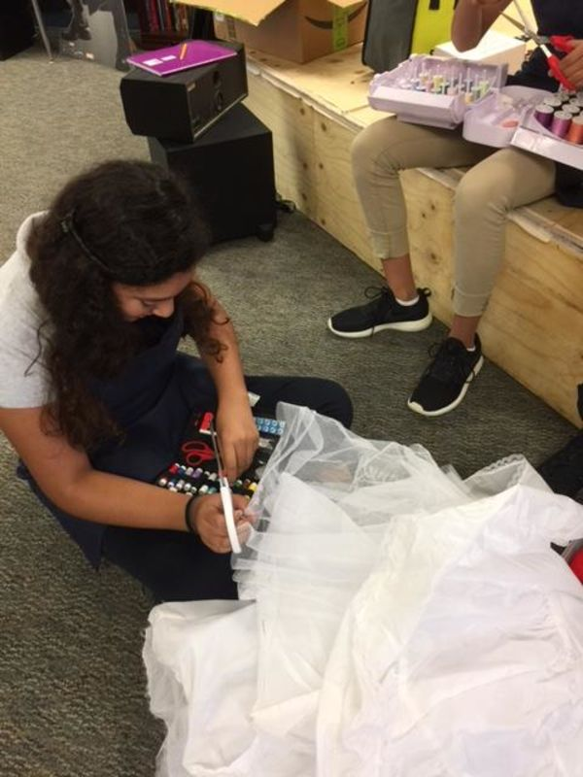
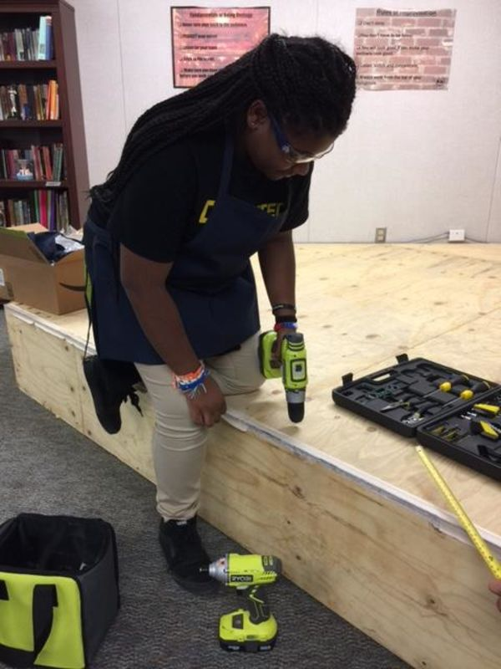
Jazmin and Kennedy working on projects with the supplies from donorschoose

Slide 17
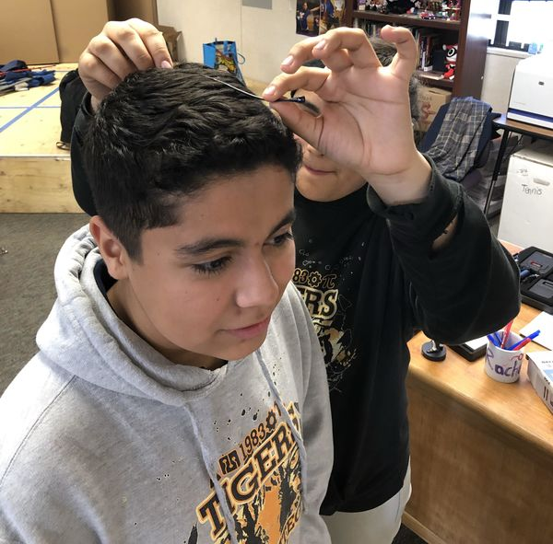
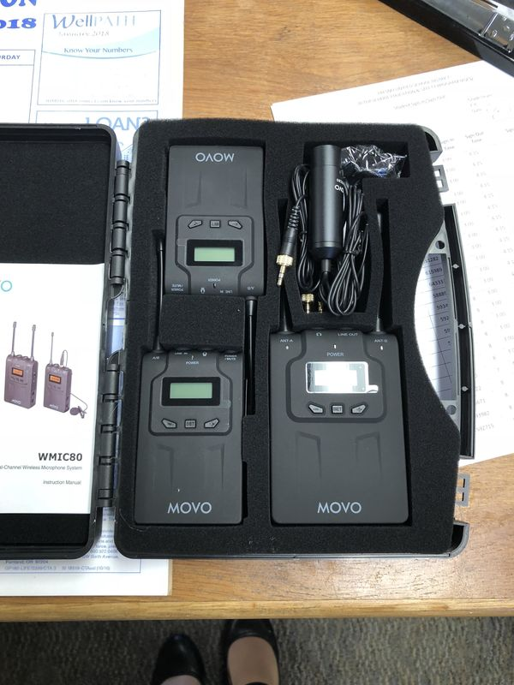
The microphones were the biggest hit!

Slide 18
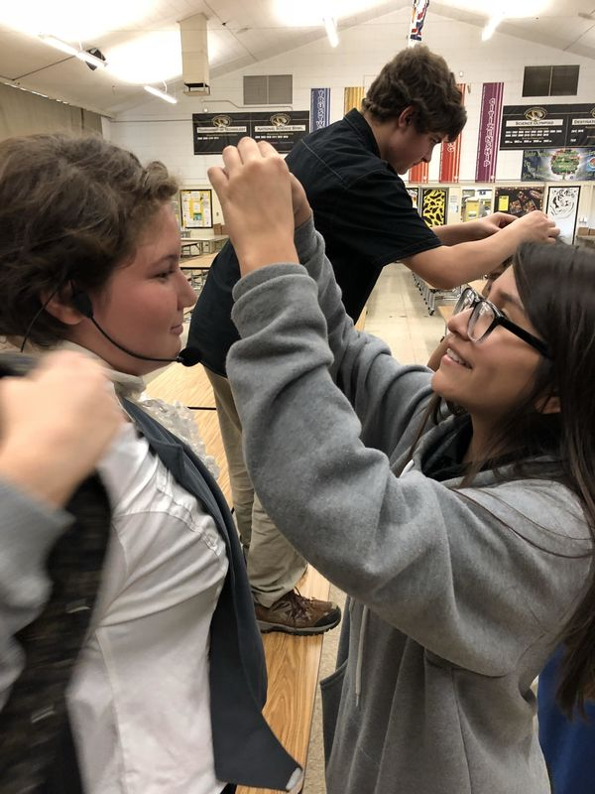
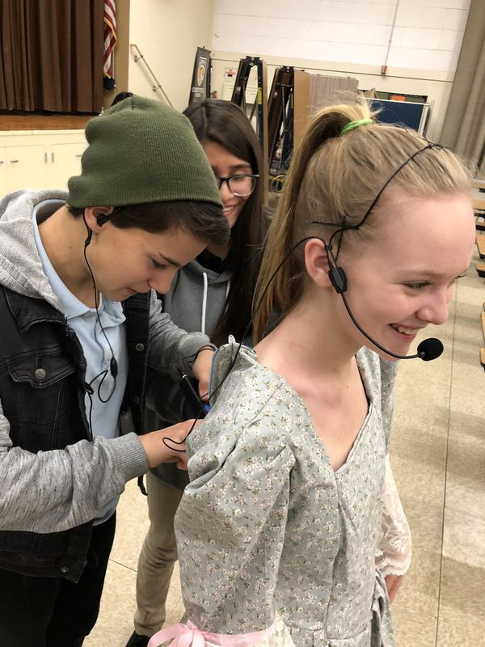
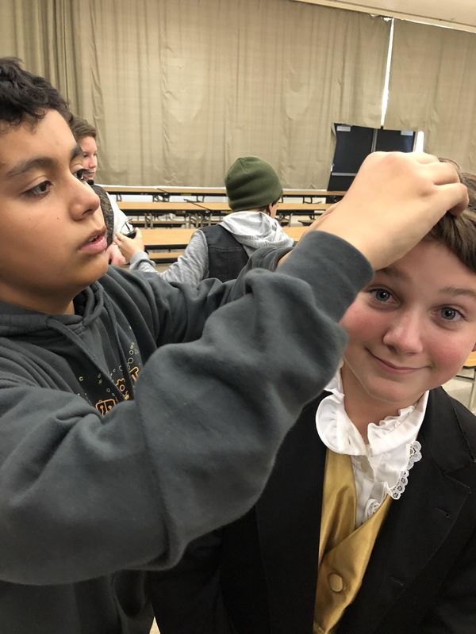
Rigging up the cast of Sleepy Hollow for sound

Slide 19
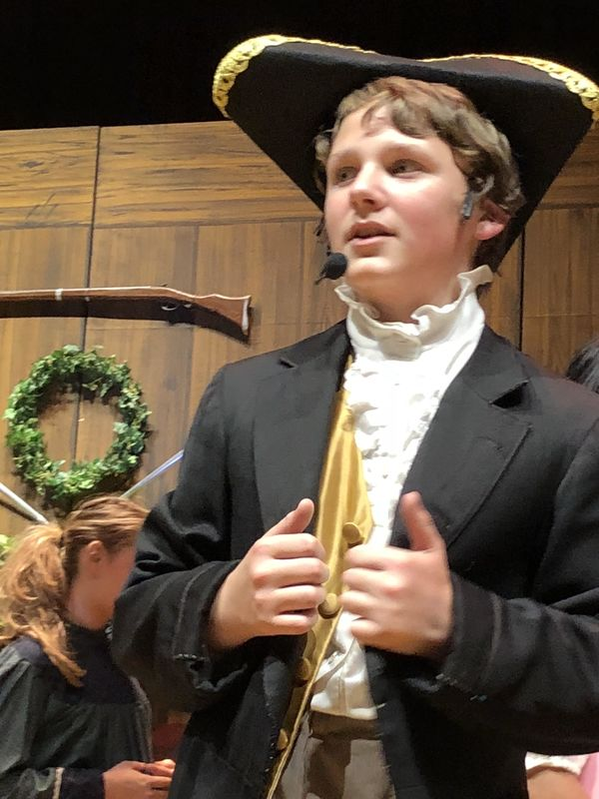
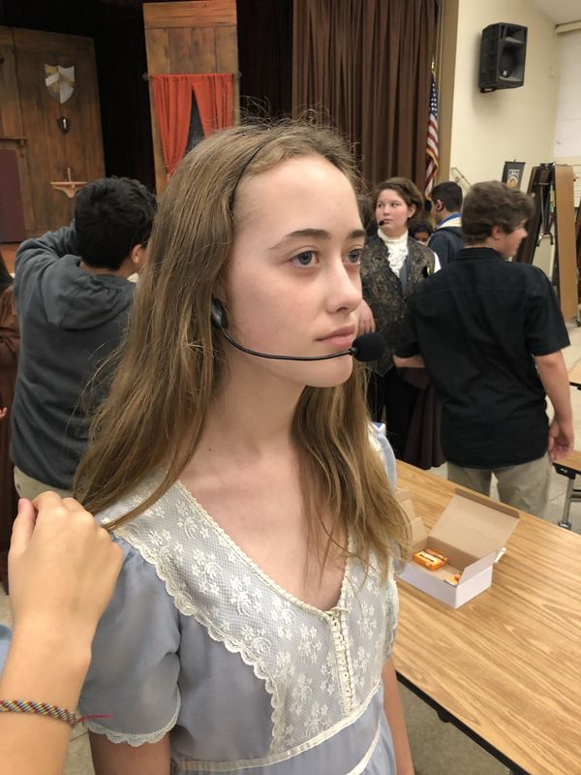
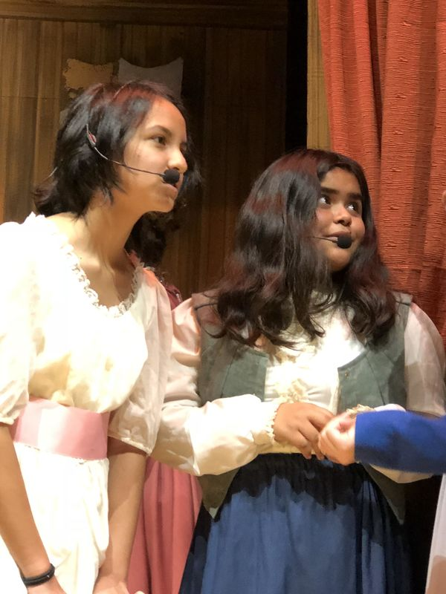
Sleepy Hollow microphones in use

Slide 20
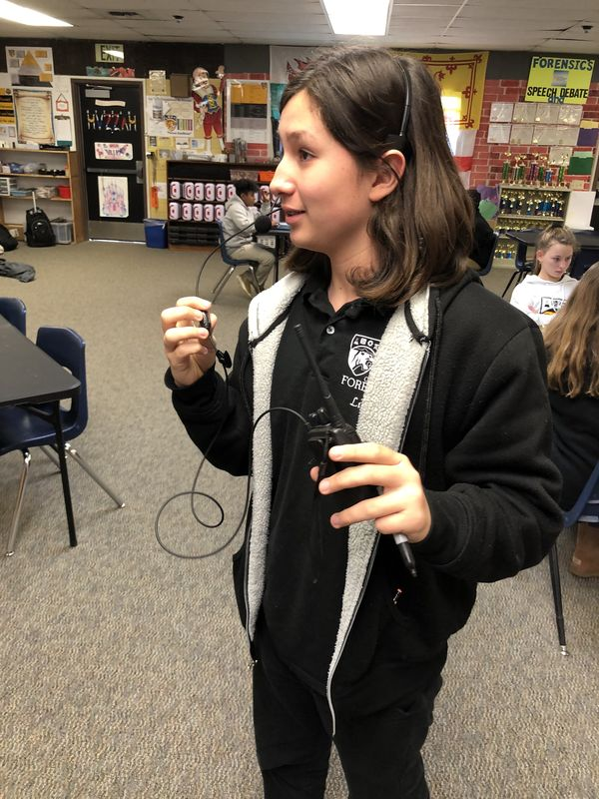
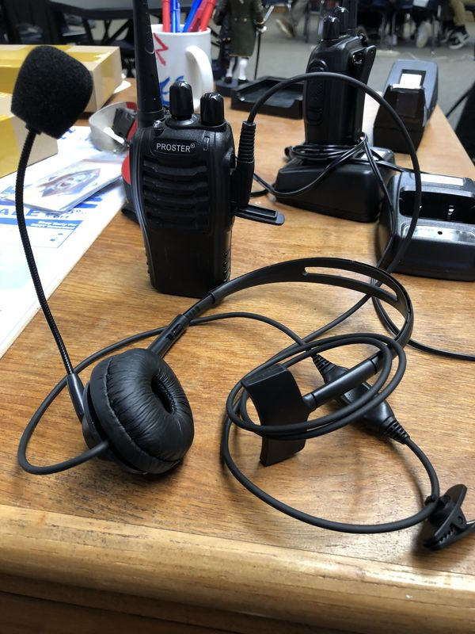
And not to forget crew…

Slide 21
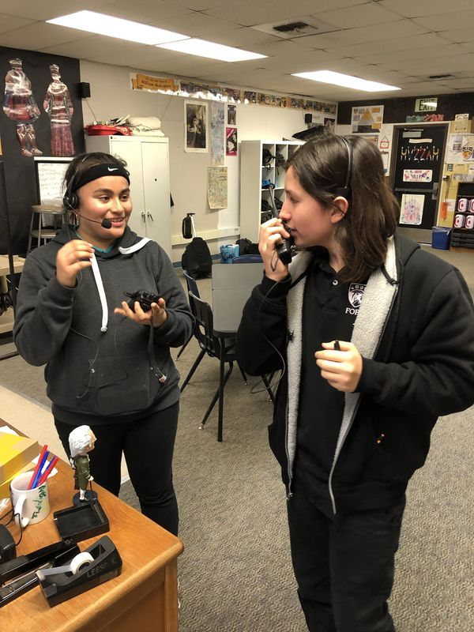
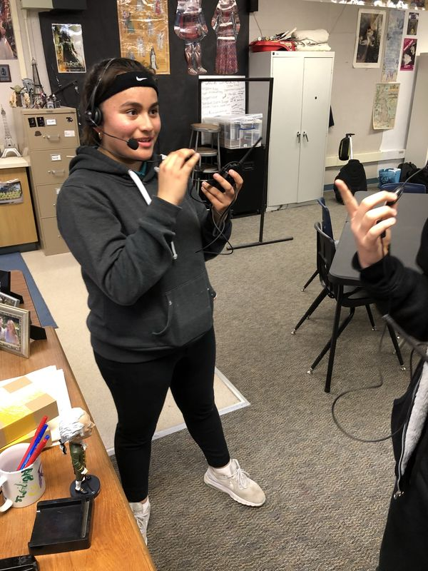
Our backstage crew is stoked to have good headsets and walkies. Andrea and Liam try them out

Slide 22



Promoting your Projects
Even if you don’t promote it, you NEVER know who goes on every day looking to donate!
Promote your projects via social media
Post on school alumni pages
Post on your website
Friends and family can donate to your project

